Slide 1
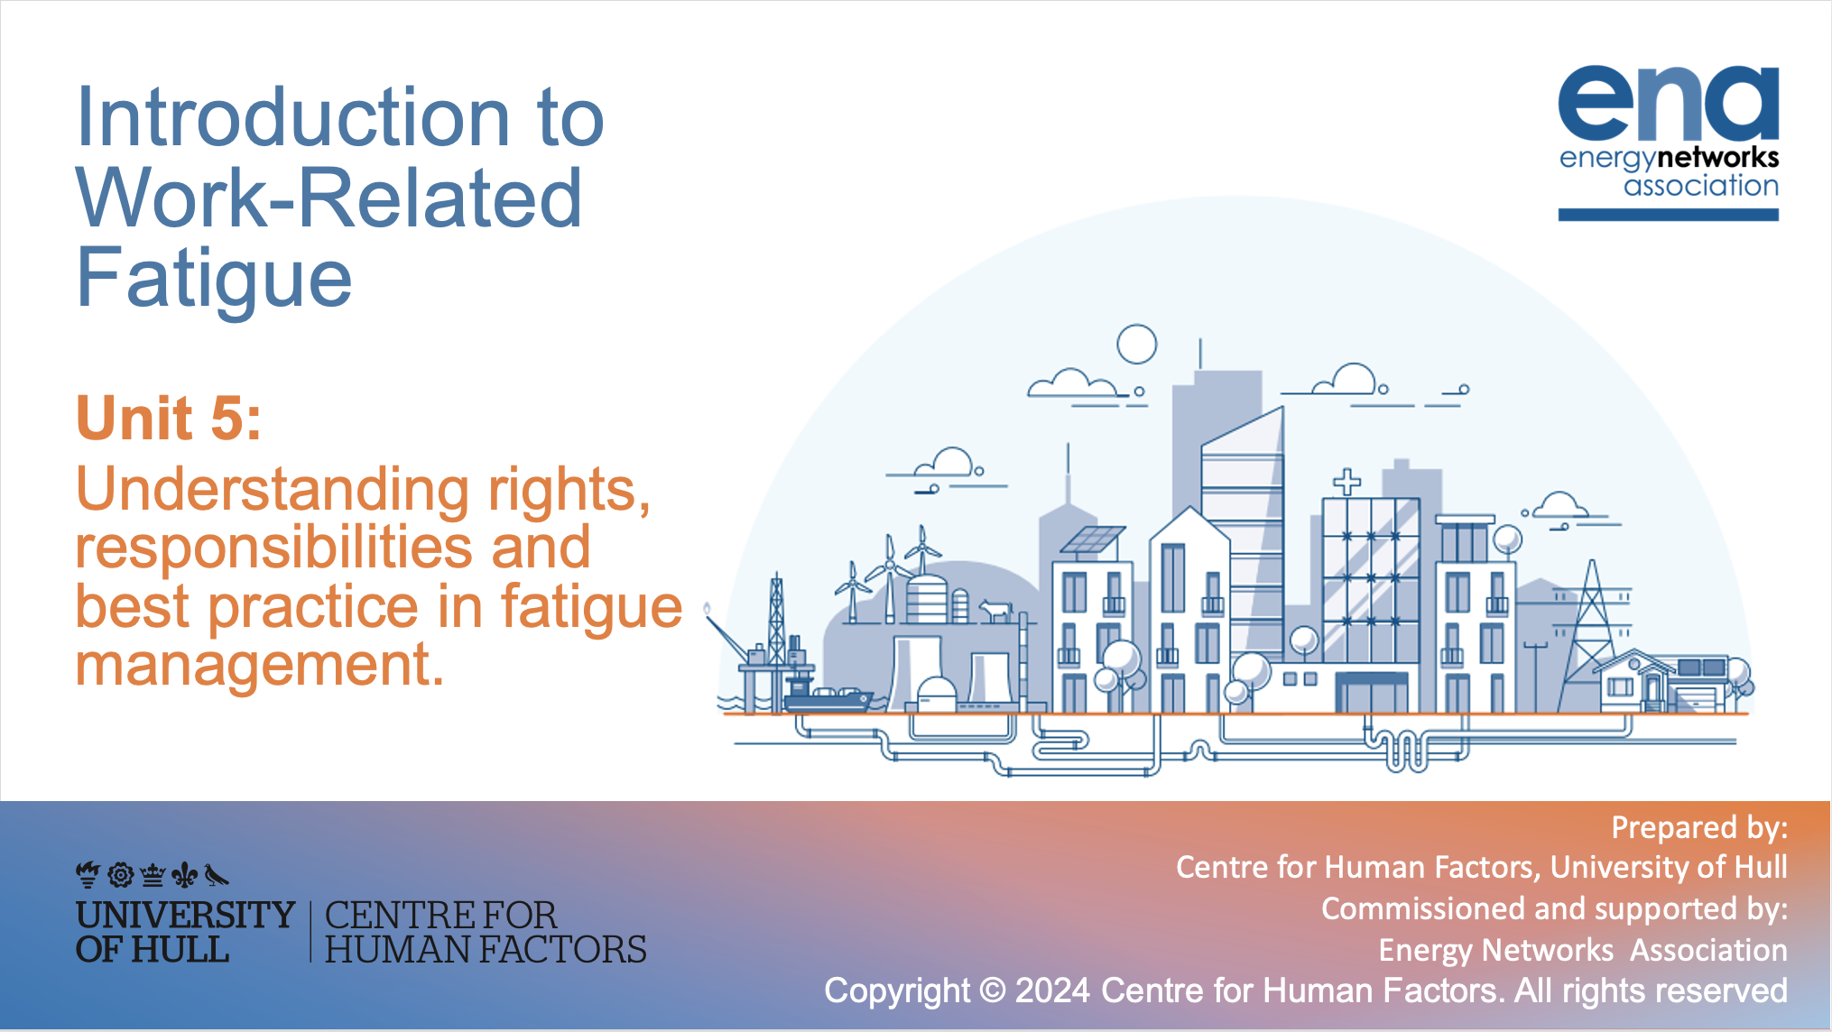


Introduction to Work-Related Fatigue
Unit 5:
Understanding rights, responsibilities and best practice in fatigue management.
Prepared by:
Centre for Human Factors, University of Hull
Commissioned and supported by:
Energy Networks Association

Slide 2

Key learning points from Unit 4:
A lot of factors can influence our decisions related to the assessment of fatigue
We are all prone to errors in decision making, but these can be overcome if we understand the sorts of errors we might make
It is important to re-evaluate your situation during a job and consider changing your decision
The more you consider the different factors and how they feature in your decision making, the better position you will be in on future occasions to evaluate your decisions
As each situation is different, it should be considered separately from past decisions, and given a unique and well-justified answer

Slide 3
What unit 5 will cover
As we have covered throughout Units 1-4, understanding and managing fatigue is paramount to ensuring the health and safety (and productivity) of people at work. Of course, managing fatigue is also a legal responsibility. Regulations and responsibilities will be the focus for this unit.
The aims of Unit 5 are:
To make you aware of the regulations governing fatigue management and understand what this means for you.
To the organisational policies and procedures that should be in place to manage fatigue.
To introduce you to the importance of an open fatigue culture
To help you to think through what you can do for yourself and your team

Slide 4

Overarching legal framework- Key Act and Regulations
The Health and Safety at Work Act, 1974 places the duty on the employer to ensure health, safety and welfare at work
(It is also important to note that this Act places duties on employees to take reasonable care of their own safety and that of others.)
2. Management of Health and Safety at Work Regulations, 1999 places a duty on employers to assess and manage risks arising from work activities.
3. The European Working Time Directive (WTD) sets a maximum weekly working time limit.
Employees must not work more than 48 hours per week (normally averaged over 17 weeks).
Individuals can opt out of this if they choose to do so.
4. Safety Representatives and Safety Committees Regulations 1996
Requires employers to meaningfully consult with employees on health and safety matters.
Notes:
This is fairly complex and a little dry, but focus on the orange text in each box as this is the main contribution of each aspect of this legislation/regulation

Slide 5

What does that mean for me?
This all sounds quite complicated to Deeta, she really just wants to know….
What does all this mean for me and my fatigue management?
Duty of Every Employer:
Your employer is legally responsible for ensuring your health, safety, and welfare. This includes fatigue management and limits on working hours.
Your employer must put in place effective arrangements for fatigue risk assessment (including addressing any identified risks).
Your employer must also offer information, instruction, training, and supervision to ensure your fatigue is well managed.
Your employer should meaningfully consult you when they are in the process of making changes to your work.

Slide 6

Key elements of a Fatigue Management System (FMS)
Your organisation can best meet these requirements by establishing a comprehensive Fatigue Management System – This would ideally include:
Governance and Leadership
Policy and Procedure:
Fatigue Reporting Procedure
Risk Assessment and Control

Slide 7


Governance and Leadership
Ah, so I should be able to identify who is responsible, and what their role is in managing fatigue ….
I guess this is just like the duty holder responsibility for managing any risk!
Ok, Sally can help us to understand the key elements of this….
Your organisation should be clear about the structure for the elements of their FMS – You should be able to find out the various parts of your process and how they relate to one another.
Establish clear roles and responsibilities – do you know who is involved with each element and their role in
(1) implementing and (2) overseeing the system?
Hmm, I think the key person responsible here is Keith. It’s good to know that we have some of these elements in place and I know who to speak to

Slide 8
Policy and Procedure
I’ve heard a lot lately about fatigue reporting, and although I know who to go to, I’m still not sure what I should be reporting…
What do we need to think about here, Sally?
Your organisation should have a fatigue management policy that outlines their commitment to managing fatigue.
This should be supported by clear and written procedures for assessing, reporting, and mitigating fatigue risks.
So, Deeta isn’t sure what to report and when.
What can Deeta’s organisation put in place to make sure she can report fatigue effectively?

Slide 9
Fatigue Reporting Procedure
Designated Reporting Channels:
1
Documentation Procedures:
2
Training:
3
Operational and strategic monitoring of reports
4
Non-Retaliation Policy:
5
Clear channels for all workers to follow
Provide necessary support and resources to ensure process is understood and followed
Establish a monitoring and review system to address issues proactively
Commitment to ensuring that there are no adverse consequences for reporting fatigue or a fatigue related incident
Clear instructions
for what information to collect/submit
Confidential process

Slide 10
Working hours considerations
All companies and regions have their own challenges around resourcing during non-optimal hours. However, there are a few design considerations that should be taken account of (HSE guidance on managing fatigue):
Night shifts
Restrict number of night shifts [no more than three consecutive if possible]
Allow at least two days off following night shift
Early starts
Move early shift starts before 6:00am forward
Limit the number of successive early starts before 7:00am
Shift length
If 12-hour shift, then no overtime worked in addition
Avoid back to backs with 12-hour shifts
Rotation
Rest periods
Allow minimum of 11 hours between shifts and avoid quick return of eight hours if possible
Avoid keeping workers on permanent nights
Shifts involving early start should be shorter to counter fatigue later in shift
Avoid long working hours (more than 50 hours per week)
Plan opportunities for weekend off, advisably every three weeks
Rotate shifts quickly
Use forward rotations
Notes:
A further key area for developing a clear policy is the rules and restrictions on working hours. Working at night is never ideal but is necessary in your industry.
Nonetheless, it is vital that companies put restrictions on working hours to protect your health and safety.
Although all companies and regions have their own challenges around resourcing during non-optimal hours, there are a few design considerations that should be taken account of (HSE guidance on managing fatigue):

Slide 11
Pause for reflection
Clearly, the working patterns seen in your industry do not completely align with these ideal recommendations.
Pause for a moment to consider which aspects of the recommendations you do not (or are not able to) adhere to and think about the impact of these variations on your fatigue.
Are you most affected by working nights, early starts, long shifts or inadequate recovery?
When you are facing these conditions, you should be particularly mindful that you are vulnerable to fatigue.

Slide 12
Is it enough to have good procedures?
Sally explains that having clear policies and processes isn’t enough to ensure effective fatigue management:
People are sometimes worried at work about raising concerns about fatigue – Like we discussed earlier, some people don’t feel comfortable raising their concerns
I think it’s important that we have an environment where I feel supported and empowered to report any fatigue-related concerns I have. I need to know what is likely to happen
So, let’s have a think about culture…
Notes:
Summarise sally then deeta

Slide 13
Pause for reflection on culture:
There are a number of ways you can tell if your organisation has an open and positive fatigue culture – think about the elements below and then consider what might be required for your organisation to move more towards a positive and open fatigue culture.
Is it clear why fatigue and related incidents should be reported?
Are staff consulting about any potential actions being introduced to manage fatigue?
Are the consequences of reporting shared and carried out in practice?
Is feedback shared about the implementation of any controls of mitigating actions that follow fatigue reporting?
Is reporting quick and easy?
Notes:
Pause video here to ….. shorted information

Slide 14
Benefits of an open culture
Why aim for an open fatigue culture?
Improves risk management:
It allows access to important information about risks that might not otherwise reach the right people in the organisation
Promotes awareness:
Provides learning opportunities for all staff about the causes and consequences
Peer support:
It creates an environment of good peer support if team members can openly explain their fatigue concerns and how they are doing

Slide 15
Risk Assessment and Control
Ah, yes, I remember, my organisation is responsible for identifying and managing fatigue risks….
Ok, so we are hearing about some really helpful elements to effective fatigue management, but are there more mandatory requirements?
Remember from the beginning of this unit, we introduced key regulations, including the Management of Health and Safety at Work Regulation, which places a duty on employers to assess and manage risks arising from work activities.
In line with this regulation, risk assessment is a key component of fatigue management.
This is a legal requirement.
But what does a good fatigue risk assessment look like?

Slide 16
Fatigue Risk Assessment
Identification of fatigue related hazards:
1
Implement controls of the risks (causes) as far as reasonably practicable:
2
Explore the range of possible consequences of being fatigued:
3
Implement mitigations where possible
4
What in our workplace causes fatigue?
Consider the full range of consequences of being fatigued
Try to mitigate the effects of fatigue where possible
clear attempts to provide reasonable controls that effectively minimize exposure to the risks
Notes:
WEB-Guidance-on-managing-fatigue-16.04.14.pdf (hpog.org)

Slide 17
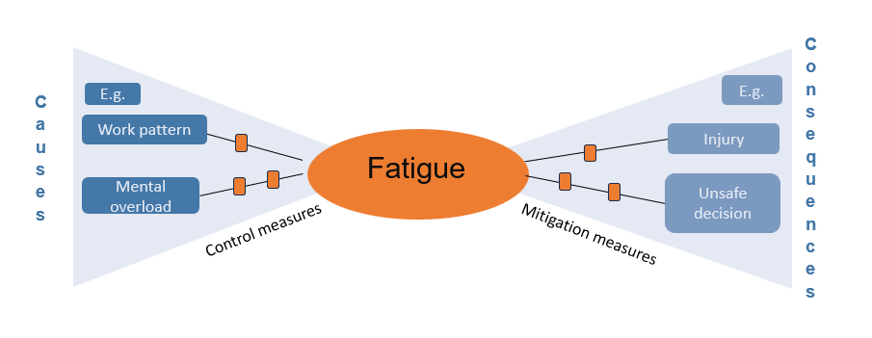
How does that relate to our bowtie?
Sally explains how risk assessment fits really well with all the earlier units that used the Bowtie Framework to plan fatigue risk assessment and management:
The Bowtie Framework supports a thorough exploration of causes, consequences and thinks through controls and mitigations
Remember, we need to think more broadly than sleep, but putting controls around working hours is the most important element.

Slide 18
Optional training exercise:
As you may remember from Unit 2, there are many different causes of fatigue
Take a moment to reflect on those you think are notable for you and then think about which of these you
would feel comfortable reporting...
know how to report...

Slide 19
Trainer notes:
Remember the four categories of causes we focused on unit 2 were sleep, physical, emotional and mental fatigue.
Considering these categories, try to order which category is the most to least comfortable.
Discuss why some aspects of fatigue reporting are more acceptable than others.
Explore reporting mechanisms in your company and prepare to include your policy around reporting.

Slide 20
What about me?
Fatigue should be carefully managed by my employer like any other hazard!
So, Deeta is starting to make sense of what all this means for fatigue management by her employer…
But what is my role in this? If it is like any other hazard, I must have some responsibilities too…
That’s right, Deeta. You also have important responsibilities.
Duty of Every Employee:
To take reasonable care for their health and safety, as well as the well-being of others who may be affected by their actions or inactions while at work.
In terms of fatigue management, this would include
1. arriving to work in a fit and well rested state to undertake your work
2. meaningful engagement in both fatigue training and dynamic fatigue risk assessment
3. reporting concerns about your own fitness for work

Slide 21
What about me?
1. Following the rules – remember it is my duty to comply with our fatigue policies and procedures
2. Optimising my sleep, rest and recovery needs
This includes adequate sleep pre shift and seeking medical advice if I have a concern about a health condition that affects my sleep
3. Assessing my own fitness for work
  before commencing work
  during work – ongoing monitoring
4. Raising concerns through the appropriate channels if I foresee or experience being impaired by fatigue
5. In consultation with my supervisor, I will take steps to manage fatigue on task, for example taking breaks or rotating my tasks.
6. Take suitable commuting and accommodation
options if I am concerned that my journey home is not safe.
Deeta is now starting to understand her role in
effective fatigue management
There is clearly lots of ways I can contribute to this, to keep myself and others safe
This seems to be a good list of things I should be doing:

Slide 22
What about my team?
We have already talked a little about a positive fatigue culture. What can Deeta do to support her team-mates?
I’m concerned about Alan. He seems to be a little different tonight….
Deeta has spotted some of the classic signs in the way Alan seems tonight:
What do you think she should do to support him?
Notes:
Relecting on previous exercise, discuss options for reporting in your company.

Slide 23
What about my team?
That’s Right!
There are a few ways Deeta can help Alan
We have already talked a little about a positive fatigue culture. What can Deeta do to support her team-mates?
Raise Concern
Encourage a dynamic risk assessment
Then, if required – raise through formal reporting route
Promote positive culture
Contribute to a positive culture by asking how Alan is, giving him the opportunity to talk
Share your own reflections and things you find difficult
Then, if required – raise with supervisors
I’m concerned about Alan. He seems to be a little different tonight….
Deeta has spotted some of the classic signs in the way Alan is tonight….
What do you think she do to support him?

Slide 24
Pause for reflection: What about my supervisor?
Supervisors also play a crucial role in recognising and addressing fatigue within their teams. What do you think their role is?

Slide 25

Pause for reflection: What about my supervisor?
Supervisors also play a crucial role in recognising and addressing fatigue within their teams. What do you think their role is? Deeta and Alan have some thoughts to help!
Supervisors also have a role in encouraging suitable breaks and time off for recovery. This demonstrates their commitment to proactive and effective fatigue management.
They should be trained to recognise signs of fatigue in team members and take appropriate action.
They should consider adjusting work assignments, when necessary, to help prevent excessive fatigue and raise fatigue as a topic of regular consideration.

Slide 26
Best practices
Organisational level: Employees:
Risk assessment: carrying out proactive risk assessment to understand fatigue causes ​and consequences
Effective design of controls and mitigations of the risks identified
Creating a supportive environment: Encouraging an open line of communication between organisation and employees​
Having regular check ins, listening and understanding causes and effects of fatigue
Positive approach: Providing resources that can be used by employees and managers to help understand fatigue
Know and follow policies and practices
Talk openly about fatigue with peers to create a positive culture
Report concerns for self and others
Ensure you come to work fit for your shift

Slide 27
Summary unit 5:
There are legal responsibilities on your organisation to effectively risk assess fatigue
There are many ways you can support your own interaction with your work to keep you and your teammates safe from the risks of fatigue
There are clear policies and practices that should be in place to effectively manage fatigue within your organisation

Slide 28
Useful Resources:
HSE policies on fatigue and its importance
https://www.hse.gov.uk/humanfactors/topics/fatigue.htm
Study discussing the effectiveness of FMRS
https://www.ncbi.nlm.nih.gov/pmc/articles/PMC8806333/

Slide 29
For further learning:
Take a look at the link below for further reflection on fatigue in a similar industry to your own.
On page 10-12 there is content which overlaps with what we have already learned from Units 2 and 3.
Chapter 2 goes into detail about individual differences as discussed in Unit 4 such as circadian rhythms.
If you are interested in learning more about managing fatigue, look into Chapter 3 as where there is a focus on fatigue management risk planning.
WEB-Guidance-on-managing-fatigue-16.04.14.pdf (hpog.org)

Slide 30
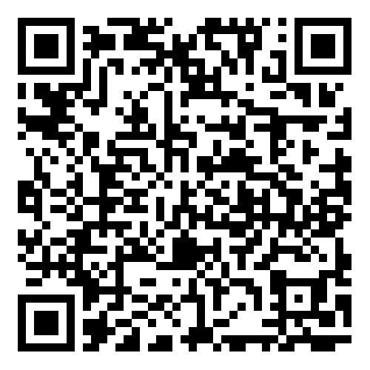
Training evaluation:
Thank you for participating in this training!
Please take 2 minutes to complete our evaluation form and let us know what you think. Your feedback will help the Centre improve the training course.

Slide 31

Prepared by:
Centre for Human Factors, University of Hull
Please contact humanfactors@hull.ac.uk if you have any questions about our work in fatigue

