Slide 1

Trainer notes - unit 4 (v1 - field staff)
This module offers an opportunity for participants to explore and reflect on the factors influencing their decision-making about fatigue and whether they consider themselves fit for work. In particular, it helps to unravel some of the cognitive processes influencing their decisions, as well as the social constraints perhaps preventing them from making ‘good' decisions in relation to fatigue.
The aim of this unit is to empower people by giving them insight into the factors involved in their own decision-making process.
This module has been designed separately for two different groups
  Frontline workers and engineers
  Managers, supervisors and dispatch
This version is #1, so the focus is on understanding decisions relating to one’s own fatigue.

Slide 2
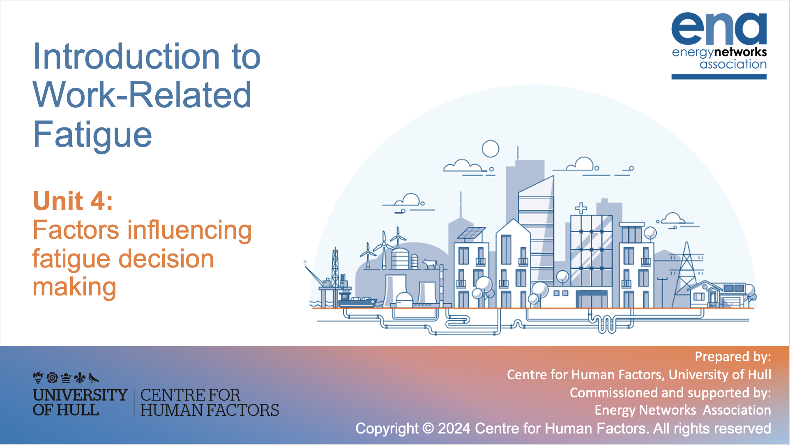

Introduction to Work-Related Fatigue
Unit 4: Factors influencing fatigue decision making
Prepared by:
Centre for Human Factors, University of Hull
Commissioned and supported by:
Energy Networks Association
Copyright © 2024 Centre for Human Factors. All rights reserved

Slide 3

Key learning points from unit 3:
Fatigue is a process that develops in response to work and/or disruption to sleep. It is dynamic and needs ongoing review and assessment to effectively manage it.
The key characteristics of a fatigued state are the feelings of tiredness and shifts towards lower effort processing. This impacts on the decisions you make at work and influences the ways you engage with your tasks.
What happens to your task engagement is influenced by how you feel about your work – if you are highly motivated to maintain your effort, task effects (e.g. errors) are likely to occur later.
Fatigue is a healthy response which protects us from working beyond what is healthy for us.

Slide 4
What unit 4 will cover
The focus on this unit is on a very specific aspect of your decision making: The decision you make when it comes to reporting (or considering) yourself as ‘fit’ or ‘not fit’ for work.
The aims of this unit are….
To help you understand and identify the factors influencing your decisions and their importance in your decision
To propose discussion activities to offer an opportunity for reflection about these factors
To invite you to challenge your automatic thoughts or decisions to cultivate good mental habits

Slide 5

The decision-making process
Like all our decision making, we like to think our judgements about our level of fatigue is guided by rational thought:
When we feel tired, we stop working
When we don’t feel tired, we feel okay to continue working
However, it is never easy to make such decisions because:
1. We often feel pushed by the urgency of situation to make quick decisions about whether we are fit for work
2. A fatigued state drives us to make impaired decisions (Unit 3) as we have a higher tendency towards low effort and cutting corners
3. Other situational factors push us to continue working can divert us from our own fatigue state

Slide 6

1. Context of urgency
Sally the psychologist discusses how we make decisions in an urgent context
When decisions are made in an urgent context the possibility of being rational is limited due to a short time to collect information, fully evaluate and draw rational conclusions – you are more likely to rely on
‘gut feel’
Therefore, it’s likely that you would compromise with “good enough” decisions
One way to compromise with time is relying on your expertise and knowledge of a situation to make decisions
However, when doing this, there is a higher chance of relying on mental shortcuts and biases. These can lead to less optimal decisions and potential errors.

Slide 7
Pause for reflection
Think about the context in which you usually assess your own level of fatigue during a shift
How much time do you usually dedicate to this assessment?
Not urgent at all (several minutes to think fully through your state and your exposure to risks)
Very urgent (within seconds with a ‘gut feel’ evaluation)
Given the importance of this decision for your safety and the safety of your colleagues, we think you owe it to yourself and your team to give yourself time for a considered evaluation of your state!

Slide 8
2. Fatigue increases likelihood of cutting corners
As discussed in unit 3, fatigue tends to affect decision-making because we are driven to avoid effort during the activity, potentially leading to corner cutting in our work.
This is a shift towards riskier strategies of working – for example emphasising speed over accuracy.
The same processes which make us vulnerable to errors/accidents/near misses in our work, impact on our ability to make good decisions about continuing to work.
What ‘corner cutting’ can look like in our engagement with our work:
VS
What ‘corner cutting’ can look like in our decisions about our own state of fatigue:
Neglect of safety protocols
Neglect of self-reflection – brief or no review of your decision ‘drivers’
Skipping double checks
Brief or no review of your cumulative
exposure to risks
Rushing through tasks without ensuring safety conditions for you and your team
Brief or no review of remaining task requirements or journey to home

Slide 9
The role of cognitive heuristics (1)
We now know that fatigue can impair our decision making, as this increases our drive towards low effort processing - this in practice leads us to rely even more heavily on mental short cuts. Interestingly, we know quite a lot about the sort of short cuts we are likely to make, as well as the errors that this leaves us prone to.
There is an entire literature about just this topic, known as cognitive heuristics.
Cognitive heuristics:
These are mental shortcuts that allow us to make pragmatic decisions based on what we think is likely to be true
They develop as mostly effective strategies to reduce the time and mental effort needed to process complex information
They allows us to follow general rules, but are associated with known errors that are helpful for us to understand
We are more likely to rely on these short cuts when we are fatigued as they allow us to use simpler strategies
Notes:
Trainer notes – this is complex, but has value in terms of explaining the sorts of mistakes we are likely to make
If you need more support, watch these short videos for a little more information: How heuristics impact our judgement
What are heuristics? Representativeness Heuristic Availability Heuristic Recognition Heuristic
If you are now fascinated… read this for a detailed exploration: Thinking fast and slow
There are lots of Youtube videos that might further enhance your understanding.
If you have more bespoke examples from your organisation, these might bring this interesting topic to life a little more.

Slide 10
The role of cognitive heuristics (2)
There are many known cognitive heuristics, but we will focus on just a few to help us think about the ways we might make mistakes in our safety-related decisions:
Representativeness Bias
We are influenced by how much something or someone is representative of its category or stereotype
Anchoring Bias
We over rely on an initial piece of information (known as the anchor)
Availability Bias
We judge the likelihood of an event based on how easily examples come to mind (the availability of examples)
Our subsequent estimates tend to be closer to our original estimates
This can be influenced by personality: open-minded people are less likely to stick to rigid initial estimates
We assume that the person or situation is more like our known mental model or stereotype and focus on the similarities
We are less likely to focus on differences and unique factors

Slide 11


Cognitive heuristics (3): Training task
Work together to review and discuss the examples below of things Deeta and Alan have said while deciding if they and others are fit for work:
Can you identify which of these are examples of Availability, Anchoring and Representativeness biases?
“I know this
sort of fault. I will be able to complete this before I get too tired”
“I initially said it would take 2 hours, I’m now thinking I was a little short… maybe 2 hours and 10 minutes will do it”
“John fell asleep on his drive home last week. I really must stop before midnight”
“Tom will be able to keep going. He is ‘old school’ and the type that won’t quit”

Slide 12
Cognitive heuristics (3): Training task
How did you do? Can you and your group think of your own examples?
Representative Bias
Anchoring Bias
Representativeness Bias
Availability Bias
“I know this
sort of fault. I will be able to complete this before I get too tired”
“I initially said it would take 2 hours, I’m now thinking I was a little short… maybe 2 hours and 10 minutes will do it”
“John fell asleep on his drive home last week. I really must stop before midnight”
“Tom will be able to keep going. He is ‘old school’ and the type that won’t quit”
That is right! Deeta has assumed she can judge this fault without a full review of the unique features of the situation - remind yourself that knowing a situation doesn't prevent you from being fatigued!
Yes, Deeta is reluctant to deviate too much from her first estimate and is perhaps again underestimating the time she needs to complete the task
Right again! Alan assumes he shouldn’t worry about Tom because Tom will just carry on under any conditions - he fits a stereotype of ‘old school’. But remember, everyone gets fatigued.
Yes, Alan now has this important event in the front of his mind and focusses on this rather than evaluating the unique case of this situation and task. (Although in this example the shortcut is helpful as it reminds him of the risks!)

Slide 13
Cognitive heuristics (4): How to avoid bias
Many of the safety processes and practices you already have in place will help you to avoid these biases, they are often designed to do exactly that! Think about the following safety examples of safety management and how they are designed to support our effective decision making.
Fatigue risk assessment
This practice can minimize the risk that we base our judgement on single (available) experiences, or mental models (stereotypes) and include wider information that allows us to consider the unique conditions and their impact on our state
Group review of job requirements
Reviewing and justifying your estimates of the length of time required to complete the job with others (fatigue manager or wider team) encourages you to undertake a thorough and reasoned review of the context, less influenced by initial ‘gut feel’ or first estimate

Slide 14


3. Situational factors influencing decision-making
In addition to known mental bias influencing our decisions, there are also dynamic situational factors in our working context that influence the outcomes of our decision making.
Alan and Deeta would like their decisions around their levels of fatigue to contribute to a healthy and safe working culture and, as the very least, lead to no harm to anyone…
However, they often feel that it is difficult for them to make the right decision.
Some factors come into play that influence their decisions.
Let’s explore Deeta and Alan’s situation to identify some of these.

Slide 15
Deeta’s situation:
Deeta is a committed team member, who takes on extra shifts to support her understaffed team. She is motivated by a fear of letting her colleagues down. She feels pressure from management to meet targets and she empathises with customers and their urgency for prompt service. However, she also struggles to prioritise her own well-being, fearing judgement from her peers if she admits to fatigue. Maintaining a tough image at work is crucial to Deeta, as she navigates the fine line between dedication and healthy boundaries.
Based on Deeta’s situation, reflect on:
What compromise is Deeta making?
Which factors can you identify in her situation that may influence her decisions?
Reflect on these factors as a group. Are there any factors in this situation that resonate with you and play a role in your own decisions around fatigue?
As a group discuss which factors feel possible to ‘push back’?
Notes:
Trainer notes
What compromise Deeta is making: overlooking her own health for her team​
Which factors can you identify in her situation that can influence her decisions? ​
Team situation with staff shortage ​
- Social pressure – not letting others down, fatigue is a sign a weakness ​
- Customer concerns​
- Pressure from management/organisation​
Reflect on these factors as a group. Are there any present in this situation that play also a role in your decisions around fatigue? Prompt the discussion if no one kicks off by asking whether participants think that in their team fatigue is perceived as a sign of weakness ​
As a group discuss which ones feel possible to push back? It is important to distinguish between external factors that the individual cannot control vs more internal factors that the individual can control and change (e.g., culture within the team, perception of weakness)​

Slide 16
Alan’s Situation:
Alan, a father of two, often opts for extra shifts or longer hours to boost his income, a necessity for him in the face of the rising cost of living. However, balancing work with childcare and domestic duties strains his ability to recuperate, especially during night shifts when his children disrupt his sleep. This juggling act often leads to conflict with his partner, as childcare responsibilities clash with his work schedule. Alan's fatigue-induced irritability further complicates matters, highlighting the challenges of maintaining work-life balance in the face of financial pressures.
Based on Alan’s situation, reflect on:
What compromise Alan is making?
Which factors can you identify in his situation that may influence his decisions?
Reflect on these factors as a group. Are there any factors in this situation that play a role in your own decisions around fatigue?
As a group, discuss other factors that play an important role in your decision to say you are fit for work that are not displayed in these examples?
Notes:
Trainer notes
What compromise Alan is making? Balancing his personal health against his family’s financial needs. There is no judgment – this is a personal decision​
Which factors can you identify in his situation that can influence his decisions? ​
Financial incentives (extra income)​
Impact on his recovery pattern is a consequence of him doing additional shifts; as well as personal conflicts and irritability ​

Slide 17

3. Training task: Situational factors
Our exploration into your working context found some factors influencing your decision-making. This list is not exhaustive.
Take a moment to look at them and reflect what they mean to you…
Which factors often play a significant role in your own decision making? Which factors are you most likely to prioritise at the risk of detriment of your health?
Pressure to meet targets
Personal finance
Under- staffed
Willingness to finish tasks
Economic incentive
Sustainability of the company
Concerns for customer
Fear of stigma
Professionalism
Staff absence

Slide 18
3. Training task: Trainer notes
What may help you to balance these factors to prioritize your health?
Consider:
A conscious focus on your health and your recovery from work
Personal orientation towards your safety
Accountability of your role in mistakes
Pressure to meet targets
Personal finance
Under- staffed
Willingness to finish tasks
Economic incentive
Sustainability of the company
Concerns for customer
Fear of stigma
Professionalism
Staff absence

Slide 19
What does “good enough” mean when talking about fatigue?
Unfortunately, there is no perfect answer. It’s likely that there will always be compromises, but it is essential for individuals to engage in thoughtful consideration of factors in each situation. Every situation at work is different and should be given a unique and tailored answer.
Saying “Yes, I’ll continue working” shouldn’t become a habit in any situation and instead you should:
1. Consider what pushes you to continue working and what pushes you to stop in each specific situation
2. Be aware that some factors are given more importance than others depending on:
What matters to you at the time of the decision
The constraints of the situation
3. Reflect on the importance of each factor and ask yourself which factors do not feel right

Slide 20
How to improve the decision-making process?
Practical hints and tips to minimise your own bias:
Produce a reasoning:
Explain and justify (to yourself or your team)
how you have reached this decision (fit for work/not fit for work)
which factors have played a role in your decision
When people are asked why they have made this decision, they tend to put in greater effort to make a more well-informed decision.
2. Post-decision check:
Decisions shouldn’t be fixed once for all as your state is dynamic and will change; Don’t make the mistake of being too ‘committed’ to your initial estimate.
Continuously monitor your fatigue when performing a task and communicate any change in your state.

Slide 21
Summary unit 4:
A lot of factors can influence our decisions related to the assessment of fatigue
We are all prone to errors in decision making, but these can be overcome if we understand the sorts of errors we might make
It is important to re-evaluate your situation during a job and consider changing your decision
The more you consider the different factors and how they feature in your decision making, the better position you will on future occasions to evaluate your decisions
Each situation is different, should be considered separately from past decisions, and given a unique and well-justified answer

Slide 22
Useful Resources:
TED talk into combating decision making fatigue: https://www.youtube.com/watch?v=N__V-oh7dys
Video focusing on the cognitive heuristics process: https://www.youtube.com/watch?v=9x53PtjVwqA
Video providing understanding more into situational decision making: https://www.youtube.com/watch?v=D2T7wHXSt0s

Slide 23
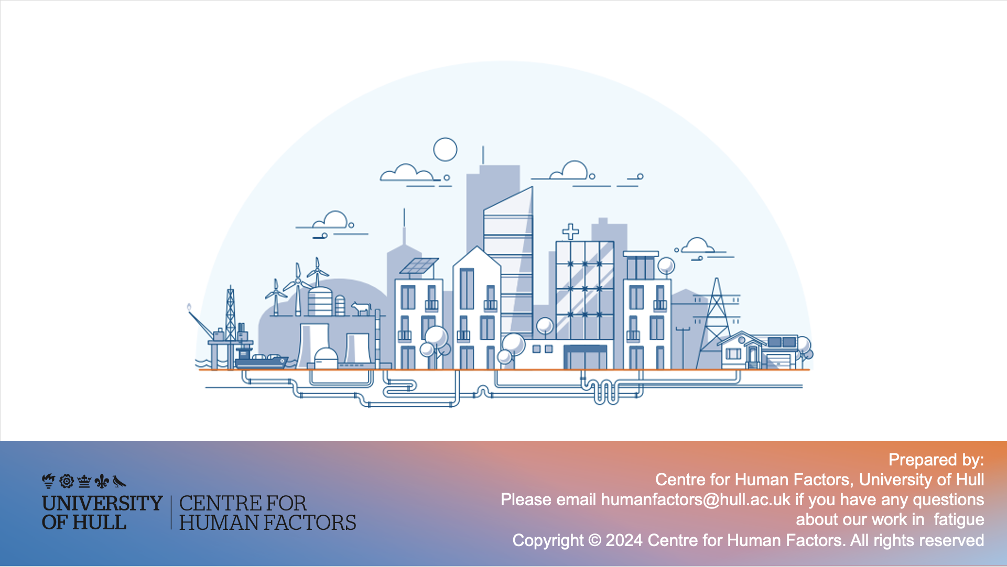
Prepared by:
Centre for Human Factors, University of Hull
Please contact humanfactors@hull.ac.uk if you have any questions about our work in fatigue
Copyright © 2024 Centre for Human Factors. All rights reserved

