Slide 1

Trainer notes - unit 4 (v2)
This module offers an opportunity for participants to explore and reflect on the factors influencing fatigue decision-making, with a focus on whether a person is fit for work. In particular, it helps to unravel some of the cognitive processes influencing decisions, as well as the social constraints perhaps preventing people from making ‘good' decisions in relation to fatigue.
The aim of this unit is to empower people by giving them insight into the factors involved in their own decision-making process.
This module has been designed separately for two different groups
  Frontline workers and Engineers
  Managers, Supervisors and Dispatch
This version is #2, so the focus is on enhancing decisions relating to fatigue in others for whom we have some work-related responsibility.

Slide 2
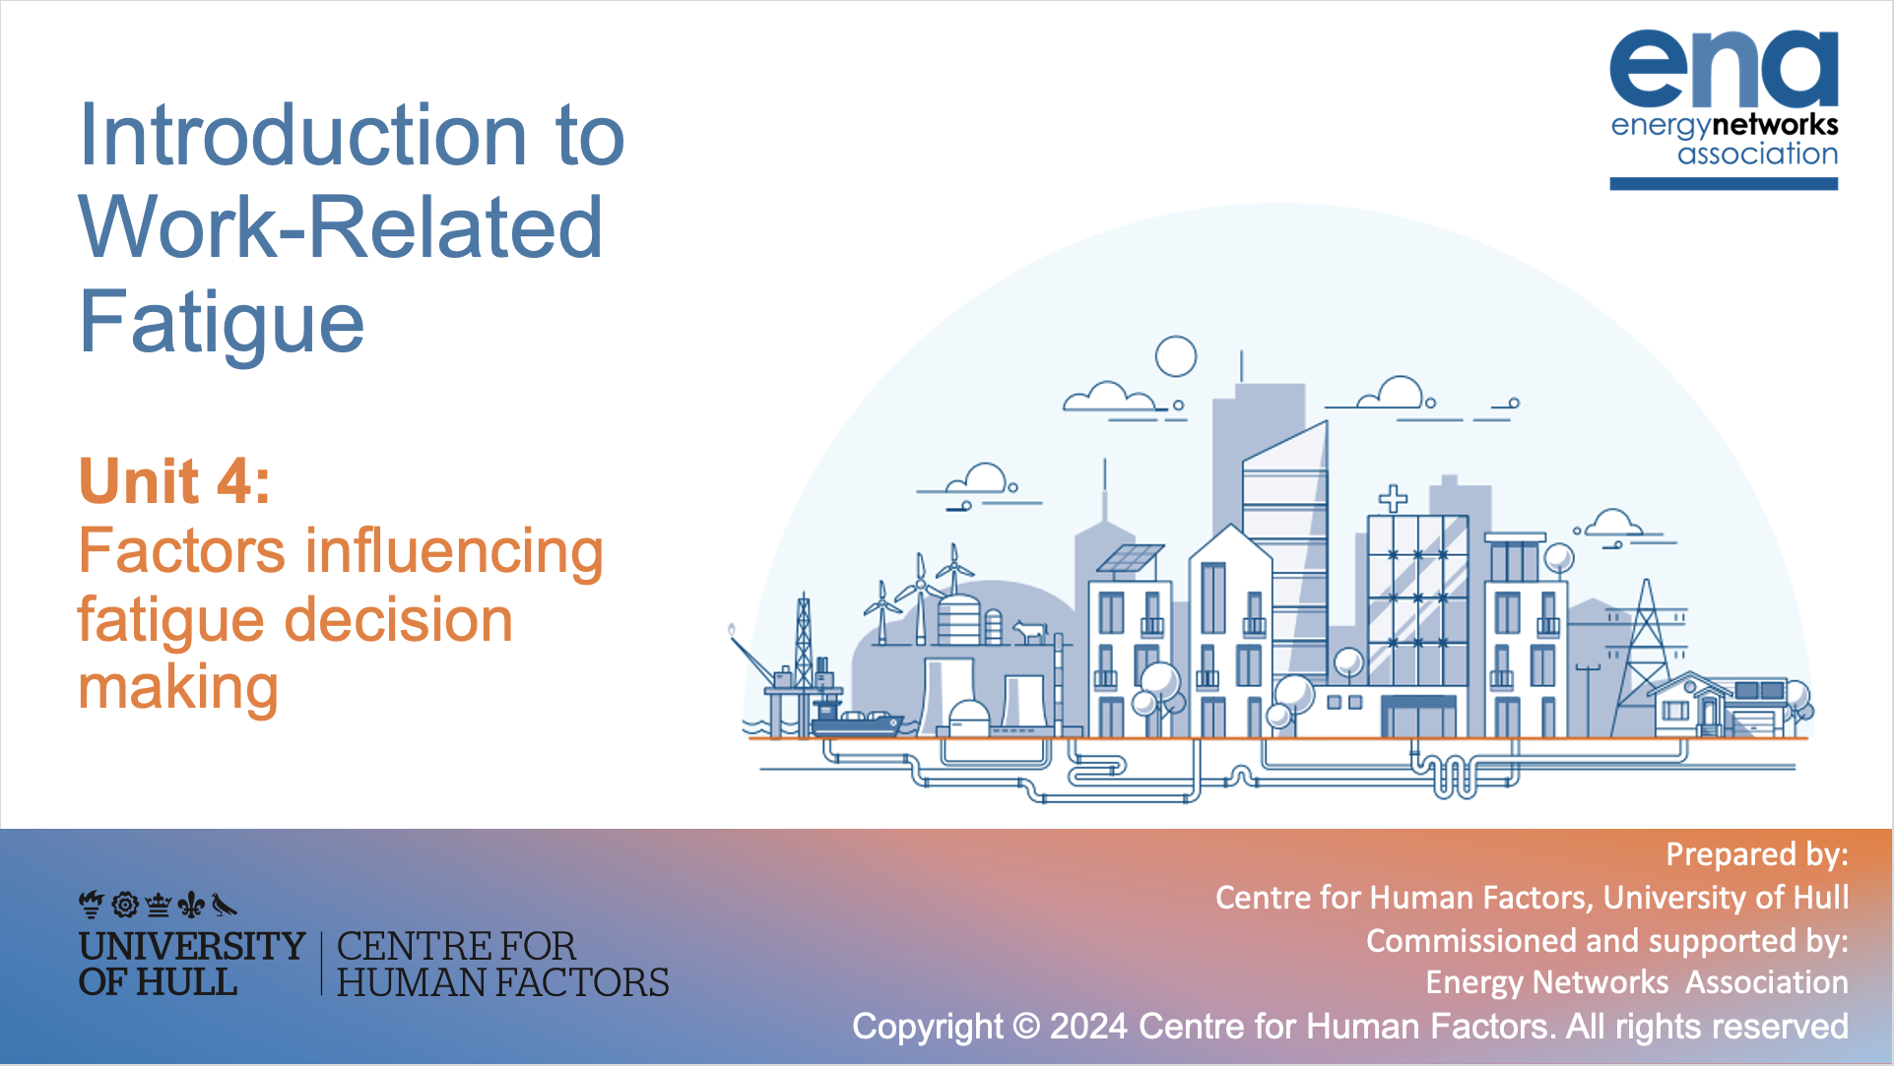

Introduction to Work-Related Fatigue
Unit 4: Factors influencing fatigue decision making
Prepared by:
Centre for Human Factors, University of Hull
Commissioned and supported by:
Energy Networks Association

Slide 3

Key learning points from unit 3:
Fatigue is a process that develops in response to work and/or disruption to sleep. It is dynamic and needs ongoing review and assessment to effectively manage it.
The key characteristics of a fatigued state are the feelings of tiredness and shifts towards lower effort processing. This impacts on the decisions you make at work and influences the ways you engage with your tasks.
What happens to your task engagement is influenced by how you feel about your work – if you are highly motivated to maintain your effort, task effects (e.g. errors) are likely to occur later.
Fatigue is a healthy response which protects us from working beyond what is healthy for us.

Slide 4
Unit 4 aims:
The aim is this unit is not to judge your decisions when assessing workers’ level of fatigue
Instead, the aim is:
To help you understand the factors influencing the decisions of frontline/technical workers about their own levels of fatigue, as well as understanding the drivers in your own decisions.
To propose discussion activities to offer an opportunity for reflective thought about these factors
To invite you to challenge your automatic thoughts or decisions to cultivate good mental habits

Slide 5
Introduction- Decision making process:
When making decisions, we like to think that our decisions are guided by rational thought processes.
To be rational when making decisions implies:
We collect all information available
Evaluate all of this information carefully before coming to a decision
Analyse costs and benefits for all options
However, often, when workers make decisions about their state, there are many factors preventing them from being rational. For example:
1. We often feel pushed by the urgency of situation to make quick decisions about whether we are fit for work
2. A fatigued state drives us to make impaired decisions (Unit 3) as we have a higher tendency towards low effort and cutting corners
3. Other situational factors push us to continue working can divert us from our own fatigue state

Slide 6
Introduction- Decision making process:
Some of these factors influence the decisions made by frontline and technical colleagues as to their current level of fatigue, and also influence your own decision when assessing others’ level of fatigue
So, while we might assume that others
stop working when they are tired, or
decide to carry on working when not tired…..
You probably already know that it is never that simple in reality!
Let’s start by thinking about the role of urgency in decision making

Slide 7


1. Context of urgency
Sally the psychologist discusses how we make decisions in an urgent context
One way to compromise with time is relying on our expertise and knowledge of a situation to make decisions
When decisions are made in an urgent context the possibility of being rational is limited due to a short time to collect information, fully evaluate and draw rational conclusions – we are more likely to rely on
‘gut feel’
Therefore, it’s likely that we all compromise with “good enough” decisions
However, when doing this, there is a higher chance of relying on mental shortcuts and biases. These can lead to less optimal decisions and potential errors.

Slide 8
Pause for reflection
Think about the context in which you usually assess a worker’s level of fatigue. How much time do you usually dedicate to this assessment?
Not urgent at all (several minutes to think fully through their state and exposure to risks)
Very urgent (within seconds with a ‘gut feel’ evaluation)
Now reflect on what you know about the field workers you are responsible for:
To what extent do you think they are likely to take their time to reflect fully on their own state?
Given the importance of this decision for the safety of your colleagues, we think it is vital that you give yourself time for a considered evaluation of their state. You may think you already do this, but it never hurts to reflect!

Slide 9
2. Fatigue increases likelihood of cutting corners
As discussed in unit 3, fatigue tends to affect decision-making because we are driven to avoid effort during the activity, potentially leading to corner cutting in our work.
This is a shift towards riskier strategies of working – for example emphasising speed over accuracy.
The same processes which frontline workers vulnerable to errors/accidents/near misses in their work, impact on their ability to make good decisions about continuing to work. It is really helpful to reflect on what this means in terms of their decision to say they are fine.
What ‘corner cutting’ can look like in engagement with their work:
VS
What ‘corner cutting’ can look like in their decisions about their state of fatigue:
Neglect of safety protocols
Neglect of self-reflection – brief or no review of their decision ‘drivers’
Skipping double checks
Brief or no review of their cumulative
exposure to risks
Rushing through tasks without ensuring safety conditions for themselves and their team
Brief or no review of their remaining task requirements or journey to home

Slide 10
The role of cognitive heuristics (1)
We now know that fatigue impairs decision making, as this increases one’s drive towards low effort processing - this in practice leads people to rely even more heavily on mental short cuts. Interestingly, we know quite a lot about the sort of short cuts people are likely to make, as well as the errors that this leaves them prone to.
There is an entire literature about just this topic, known as cognitive heuristics. It is helpful for you to understand the sorts of decision errors your team members are likely to make, as well as reflecting again on your own decision process.
Cognitive heuristics:
These are mental shortcuts that allow us to make pragmatic decisions based on what we think is likely to be true
They develop as mostly effective strategies to reduce the time and mental effort needed to process complex information
They allows us to follow general rules, but are associated with known errors that are helpful for us to understand
We are more likely to rely on these short cuts when we are fatigued as they allow us to use simpler strategies
Notes:
Trainer notes – this is complex, but has value in terms of explaining the sorts of mistakes we and others are likely to make
If you need more support, watch these short videos for a little more information: How heuristics impact our judgement
What are heuristics? Representativeness Heuristic Availability Heuristic Recognition Heuristic
If you are now fascinated… read this for a detailed exploration: Thinking fast and slow
There are lots of Youtube videos that might further enhance your understanding.
If you have more bespoke examples from your organisation, these might bring this interesting topic to life a little more.

Slide 11
The role of cognitive heuristics (2)
There are many known cognitive heuristics, but we will focus on just a few to help us think about the ways we might make mistakes in our safety-related decisions:
Representativeness Bias
We are influenced by how much something or someone is representative of its category or stereotype
Anchoring Bias
We over rely on an initial piece of information (known as the anchor)
Availability Bias
We judge the likelihood of an event based on how easily examples come to mind (the availability of examples)
Our subsequent estimates tend to be closer to our original estimates
This can be influenced by personality: open-minded people are less likely to stick to rigid initial estimates
We assume that the person or situation is more like our known mental model or stereotype and focus on the similarities
We are less likely to focus on differences and unique factors

Slide 12


Cognitive heuristics (3): Training task
To help you understand the thought processes of your team, work together to review and discuss the examples below of things Deeta and Alan have said while deciding if they and others are fit for work:
Can you identify which of these are examples of Availability, Anchoring and Representativeness biases?
“I know this
sort of fault. I will be able to complete this before I get too tired”
“I initially said it would take 2 hours, I’m now thinking I was a little short… maybe 2 hours and 10 minutes will do it”
“John fell asleep on his drive home last week. I really must stop before midnight”
“Tom will be able to keep going. He is ‘old school’ and the type that won’t quit”

Slide 13
Cognitive heuristics (3): Training task
How did you do? Can you and your group think of your own examples of the sorts of comments you hear from the frontline?
Representative Bias
Anchoring Bias
Representativeness Bias
Availability Bias
“I know this
sort of fault. I will be able to complete this before I get too tired”
“I initially said it would take 2 hours, I’m now thinking I was a little short… maybe 2 hours and 10 minutes will do it”
“John fell asleep on his drive home last week. I really must stop before midnight”
“Tom will be able to keep going. He is ‘old school’ and the type that won’t quit”
That is right! Deeta has assumed she can judge this fault without a full review of the unique features of the situation – it is important that she reminds herself that knowing a situation doesn't prevent her from being fatigued!
Yes, Deeta is reluctant to deviate too much from her first estimate and is perhaps again underestimating the time she needs to complete the task
Right again! Alan assumes he shouldn’t worry about Tom because Tom will just carry on under any conditions - he fits a stereotype of ‘old school’. But remember, everyone gets fatigued.
Yes, Alan now has this important event in the front of his mind and focusses on this rather than evaluating the unique case of this situation and task. (Although in this example the shortcut is helpful as it reminds him of the risks!)

Slide 14
Cognitive heuristics (4): How to avoid bias
Many of the safety processes and practices you already have in place will help your and your team to avoid these biases, in fact they are often designed to do exactly that! Think about the following examples of safety management and how they are designed to support our effective decision making.
Fatigue risk assessment
This practice can minimize the risk that we base our judgement on single (available) experiences, or mental models (stereotypes) and include wider information that allows us to consider the unique conditions and their impact on the state of the frontline worker
Group review of job requirements
The opportunity for your team to review and justify estimates of the length of time required to complete a job with you or others (fatigue manager or their wider team) encourages them to undertake a thorough and reasoned review of the context, less influenced by their initial ‘gut feel’ or first estimate

Slide 15
Cognitive heuristics (5): Your role
As a manager, dispatcher or supervisor:
It is very important you understand the cognitive biases influencing fatigue-related decision making in the field. Awareness of these processes will improve your ability to assess the decisions of your teams.
When making safety decision on behalf of your team (e.g. allocating further work) it is help to remember that you too are prone to these biases and reflect on how they might be influencing you.
Meaningfully employ structured processes for fatigue-related decisions – remember that fatigue risk assessments were specifically designed to overcome errors in decision making.
Actively seek opportunities to justify your decisions about work allocation (or standing down) to others – this will increase the changes that your decision is justified
Notes:
Trainer notes
Ask trainees how they could actively adopted these approaches in their working context.

Slide 16


3. Situational factors influencing decision-making
In addition to known mental bias influencing fatigue-related decision making, there are also dynamic situational factors in the working context that influence the outcomes of our decision making and the decisions made by those in the field.
As frontline workers, Alan and Deeta would like their decisions around their levels of fatigue to contribute to a healthy and safe working culture and, as the very least, lead to no harm to anyone…
However, they often feel that it is difficult for them to make the right decision.
Some factors come into play that influence their decisions.
Let’s explore Deeta and Alan’s situation to identify some of these.

Slide 17
Deeta’s situation:
Deeta is a committed team member, who takes on extra shifts to support her understaffed team. She is motivated by a fear of letting her colleagues down. She feels pressure from the wider organisation to meet targets and she empathises with customers and their urgency for prompt service. However, she also struggles to prioritise her own well-being, fearing judgement from her peers if she admits to fatigue. Maintaining a tough image at work is crucial to Deeta, as she navigates the fine line between dedication and healthy boundaries.
Based on Deeta’s situation, reflect on:
What compromise is Deeta making?
Which factors can you identify in her situation that may influence her decisions?
Reflect on these factors as a group. Are there any factors in this situation that resonate with what you know about your team and play a role in their decisions around fatigue?
As a group discuss which factors you think your teammates would feel possible to ‘push back’?
Notes:
Trainer notes
What compromise Deeta is making: overlooking her own health for her team​
Which factors can you identify in her situation that can influence her decisions? ​
Team situation with staff shortage ​
- Social pressure – not letting others down, fatigue is a sign a weakness ​
- Customer concerns​
- Pressure from management/organisation​
Reflect on these factors as a group. Are there any present in this situation that play also a role in your decisions around fatigue? Prompt the discussion if no one kicks off by asking whether participants think that in their team fatigue is perceived as a sign of weakness ​
As a group discuss which ones feel possible to push back? It is important to distinguish between external factors that the individual cannot control vs more internal factors that the individual can control and change (e.g., culture within the team, perception of weakness)​

Slide 18
Alan’s Situation:
Alan, a father of two, often opts for extra shifts or longer hours to boost his income, a necessity for him in the face of the rising cost of living. However, balancing work with childcare and domestic duties strains his ability to recuperate, especially during night shifts when his children disrupt his sleep. This juggling act often leads to conflict with his partner, as childcare responsibilities clash with his work schedule. Alan's fatigue-induced irritability further complicates matters, highlighting the challenges of maintaining work-life balance in the face of financial pressures.
Based on Alan’s situation, reflect on:
What compromise Alan is making?
Which factors can you identify in his situation that may influence his decisions?
Reflect on these factors as a group. Are there any factors in this situation that you think play a role in the decision making in your team?
As a group, discuss other factors that play an important role in your team members decision to say they are fit for work that are not displayed in these examples?
Notes:
Trainer notes
What compromise Alan is making? Balancing his personal health against his family’s financial needs. There is no judgment – this is a personal decision​
Which factors can you identify in his situation that can influence his decisions? ​
Financial incentives (extra income)​
Impact on his recovery pattern is a consequence of him doing additional shifts; as well as personal conflicts and irritability ​

Slide 19
Situation factors driving field workers
Ideally, the best decision related to fatigue always leads to no incident or no harm for anybody – resulting from the following scenarios:
  either because the person was actually fit for work
  or because the person wasn’t and took the decision to stop.
These are the ideal scenarios but we know it is always more complex, because the decisions taken in the field are never made in a vacuum, but within a context in which certain elements influence the decision process.
As a dispatcher, manager or supervisor, you are likely to have a role where you
allocate work to field workers, and/or
  influence the decision whether a person is still fit to continue.
In roles like yours it is vital that you understand the situational factors driving the decision to continue working, so you can effectively understand and assess their decision.

Slide 20

Situational factors
Our exploration into the frontline working context found some factors that influencing decision-making. This list is not exhaustive.
Take a moment to look at them and reflect what they might mean to your team…
Which factors do you think would play a significant role in their decision making? Which factors are they most likely to prioritise at the risk of detriment of their health?
Pressure to meet targets
Personal finance
Under- staffed
Willingness to finish tasks
Economic incentive
Sustainability of the company
Concerns for customer
Fear of stigma
Professionalism
Staff absence

Slide 21
Training Activity:
Having thought about the situation drivers for workers in the field, we now focus on some situational factors that can influence your decision when assessing workers’ levels of fatigue.
Have a look at the list individually and identify those that play an important role in your decision. Are there any important factors missing?
If so, add them to your list
Then, discuss these factors/challenges as a group
Notes:
Trainer’s note: list any factors mentioned as missing and feed them back to ENA for continuous monitoring and improvement

Slide 22
Training Activity: Factors (non-exhaustive list)
Factors that push you to prioritise or listening to workers' fatigue:
  Willingness to prevent any incidents that will harm employees and put more pressure to the rest of the team
  High personal orientation towards worker safety & wellbeing
  Accountability of your role
  Possibility/availability to allocate someone else for the job/task
  Worker raising concern related to their own fatigue
Factors that push you to divert your attention from workers' fatigue:
  Amount of work to be done
  Being task-focused rather than individual-focused (e.g., I just want this to be done)
  Pressure from the organisation to comply with restoration time
  Lack of (human) resources & limited (or no options) to allocate someone else
  Your own targets
  Worker’s self-reporting of being fit for work
VS

Slide 23
What does “good enough” mean when talking about fatigue?
Unfortunately, there is no perfect answer. It’s likely that there will always be compromises relating to work in your industry, but it is essential for you and your team members to engage in thoughtful consideration of factors in each situation.
Every situation at work is different and should be given a unique and tailored answer.
Saying “Yes, to a frontline worker continuing working” shouldn’t become a habit in any situation and instead you should:
1. Consider what might be pushing the individual team member to continue working and what may be pushing them to stop in each specific situation
2. Be aware that some factors are given more importance than others depending on:
What matters to the person at the time of the decision
The constraints of the situation
3. Reflect on the importance of each factor and ask yourself which factors do not feel right

Slide 24
How to improve the decision-making process
Practical hints and tips to minimise your bias, the impact of your situational factors and urgent (gut feel) decisions:
Produce a reasoning:
Explain and justify (to yourself or others)
how you have reached this decision (to allocate further work or support the team member in continuing)
which factors have played a role in your decision
When people are asked why they have made this decision, they tend to put in greater effort to make a more well-informed decision.
2. Post-decision check:
Decisions shouldn’t be fixed once and for all as the fatigue state is highly dynamic and will change; Don’t make the mistake of being too ‘committed’ to your initial decision, if the circumstances change, review the decision and encourage those in the field to review from their perspective.
Field workers should continuously monitor their fatigue when performing a task and communicate any change in their state as well as changing circumstances.

Slide 25
Reflective activities on your own practices
Your own practices can have an impact on workers’ fatigue and health:
Reflect on your work allocation process → Do you tend to allocate people you know work faster and/or better rather than considering the fatigue level of these particular workers? Do you have a balanced allocation of the work? Do you consider or know the amount and quality of sleep this staff member had? You can track your allocation process over two or three weeks and reflect on it.
Reflect on the importance assigned to other factors that may divert your attention from workers’ health and safety:
Consider the list shown earlier and reflect on the factors that can have an important weight when assessing others’ level of fatigue.
Reflect on their importance and ask yourself which ones do not ‘feel right’
In which cases are you more likely to blindly follow what workers tell you instead of challenging them? Can you identify a pattern in these cases? How can you sometimes break this pattern to prioritise workers’ health and safety?

Slide 26
Summary
A lot of factors can influence the decision related to the assessment of fatigue
Each situation is different, should be considered carefully and separately from past decisions, and given a unique/specific answer
Your role is to ensure that workers have assessed accurately their own state, and that you have an understanding of their current situation to challenge them appropriately
As fatigue is not stable through time, it is okay for workers to change their mind afterwards
By understanding the role that the different factors play in your fatigue-related decisions, you will be in a better position to re-evaluate their importance in your future decisions.

Slide 27
Useful Resources:
TED talk into combating decision making fatigue: https://www.youtube.com/watch?v=N__V-oh7dys
Video focusing on the cognitive heuristics process: https://www.youtube.com/watch?v=9x53PtjVwqA
Video providing understanding more into situational decision making: https://www.youtube.com/watch?v=D2T7wHXSt0s

Slide 28
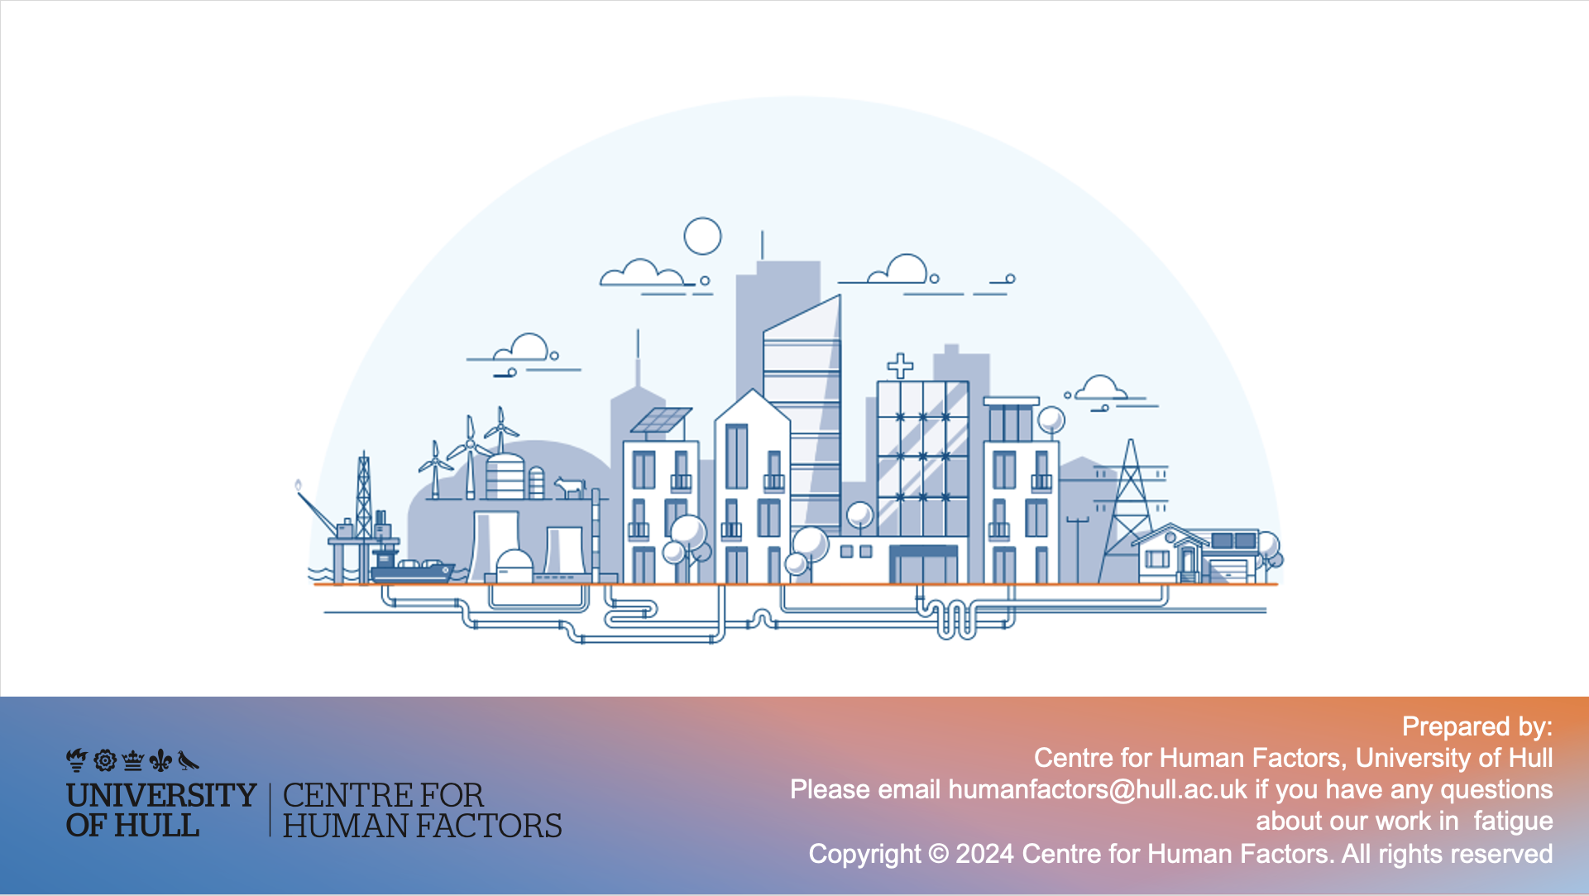
Prepared by:
Centre for Human Factors, University of Hull
Please contact humanfactors@hull.ac.uk if you have any questions about our work in fatigue

