Slide 1

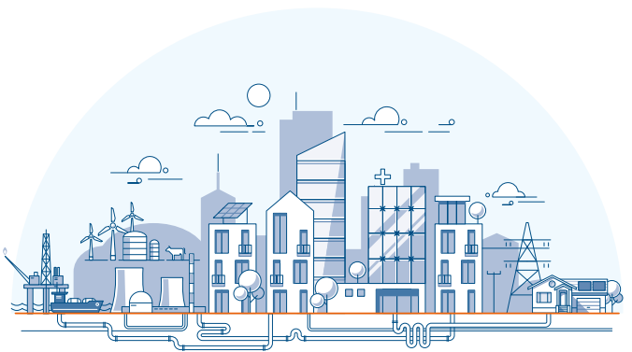
Introduction to Work-Related Fatigue
Unit 3:
The state of
fatigue and its consequences
Prepared by:
Centre for Human Factors, University of Hull
Commissioned and supported by:
Energy Networks Association
Copyright © 2024 Centre for Human Factors. All rights reserved

Slide 2


Key learning points from unit 2:
There are many causes of fatigue. Sleep is fundamental, but it is also important to think about other causes, such as physical, mental and emotional work.
The various causes of fatigue can interact and accumulate - e.g., long working long hours, weather conditions, conflicts, complex work can all combine to increase your risk.
There are things you and your organisation can do to control these risks.
Your greatest personal resources will be understanding your own fatigue, and active and well-informed reflection.

Slide 3
What unit 3 will cover
Fatigue is a complex state with significant potential consequences for individual health, safety, wellbeing and work performance. This unit explores the fatigue state and considers possible consequences for you and your work.
We will cover…
How to recognise the signs
The state of fatigue: what happens when we are tired?
The role of individual differences
The consequences of fatigue in your working context
What you can do to minimise your risks

Slide 4
Thinking about our model
The focus for this unit is on the middle and right side of our Bowtie Framework:
Consequences
Causes
E.g.
E.g.
Work pattern
Injury
Fatigue
Mental overload
Unsafe decision
Control measures
Mitigation measures
We will consider (1) state of fatigue, (2) the consequences of this state and (3) what you and your organisation can do to mitigate these consequences.

Slide 5




What is fatigue?
We have already talked about how complex fatigue is – this complexity explains the fact there are lots of different definitions and explanations of fatigue that have developed to be useful in different contexts.
There are also lots of misconceptions – unhelpful ideas that can confuse us or prevent us from managing fatigue safely. Alan has shared some things he’s overheard his colleagues say, but doesn’t quite know how to respond:
We will help Alan to think again
about these ideas shortly.
Hmmm???
“I don’t get fatigued – that is for other people!”
“It is only ‘real fatigue’ if it lasts a long time!”
“I know when to stop - I know my limits!”

Slide 6
What is fatigue?
So, what actually is fatigue? There are many definitions, but this ‘working definition’ is perhaps most helpful for us in terms of our real world understanding and practical fatigue management:
  Fatigue is a process that develops in response to effortful engagement in work and/or sleep disruption (including sleep loss and extended wakefulness). Put simply, we become fatigued when we work hard or experience inadequate sleep.
  A fatigued state is characterised by two core elements of:
  (It may be practical to think of these aspects of fatigue as an adaptive ‘stop emotion’, helpful in preventing us from working harder than is healthy! It is an in-built warning system that alerting us to the need to stop and rest.)​
  Research has shown that because fatigue impacts our information processing...
  fatigue impacts our ability to work safely.
(1) feelings of tiredness
(2) changes in information processing, including aversion to further work.
Notes:
If Im awake Im fine

Slide 7

Myth Busting 1
So, let’s help Alan think through some of the things he has been hearing from his colleagues:
Sally explains…
This simply isn’t true! Research has shown that fatigue can develop very quickly in a challenging context. This is especially the case for tasks that require vigilance and sustained attention.
If we are motivated, we can compensate for the early effects of fatigue by simply working harder to maintain our task performance – this means that early effects are often difficult to see.
However, if we do not rest, the effects of fatigue are likely to accumulate over time and increase in intensity. The longer we keep on going, the harder it is to compensate and the more likely it is that we will pay a price for our efforts, perhaps in later tasks.
“It is only really fatigue if it lasts a long time!”

Slide 8

Myth Busting 2
Sally explains…
“I don’t get fatigued – that is for other people!”
This is also not true: Fatigue is a healthy and normal state that occurs when we engage with challenging or prolonged work or if we experience disruption to our sleep – it is a drive to rest that is a basic human process.
However, it is true that we differ in the ways we are respond to work: Fatigue is a very individual experience.
Tolerance to challenging work and sleep disruption does vary between people and we will come back to individual differences later in this unit.

Slide 9
Sally explains…
Myth Busting 3
Not necessarily true!
One of the major challenges in dealing with fatigue is that, when we are fatigued, we become less and less able to judge our own state. In the same way we are less inclined able to make good decisions within our work, we are also less likely to make good decisions about our ability to keep on working safely.
This is very important to understand – we get less able to accurately judge our tiredness the more tired we get!
We will think about ways we can get better at this towards the end of this unit.
“I know when to stop - I know my limits!”

Slide 10
What does this all mean for me at work?
Decision-Making Impairment:
Fatigue has an impact on cognitive functioning:
Low Effort Tendencies:
Fatigued individuals are more likely to adopt low effort options:
When I’m fatigued, I’m more likely to cut corners in my work, doing what is quick and easy, rather than what is optimal or most safe.
When I’m fatigued, I will be more prone to making poorer decisions. I am likely to make judgements more quickly, and often with a less thorough review of the key information.
Lagged Effects: When we are motivated to compensate for our fatigue, there are likely to be delayed effects - So, its impact may be evident in later tasks:
It is likely that later tasks are more affected by fatigue, particularly when we feel we can relax a little after an intense period or task.

Slide 11

Thinking about his own fatigue, Alan is starting to understand…
That’s right - This is an important part of understanding fatigue – we (often subconsciously) shift to more low effort strategies when fatigued and that typically means cutting corners and being willing to rely on less information in making decisions!
Ah, so when I’m tired, I’m at greater risk of cutting corners
Yes, people can be extraordinarily heroic in challenging circumstances – Think about how you coped in the face of major storms / faults!
When something really matters to us, we can put in 'everything we have' to keep going, but this comes at a cost to us later.
Ah, so I can sometimes keep going, even when I am mentally extremely fatigued

Slide 12
What does this all mean for me at work?
  As we stated at the start of this unit…
  Fatigue impacts our ability to work safely.
  On task consequences – we are more likely to have accidents and near misses at work as a result of impaired cognitive functioning, low effort tendencies (leading to cutting corners) and poor decision making.
  Delayed effects - We are most vulnerable to the effects of fatigue after a period of intense work, when we have been compensating for our declining state by working harder to keep going. This means when we relax a little, we are most vulnerable.
      We are more likely to have an accident or near miss when driving home, as we relax a little at the end of the shift.
      We are more likely to make mistakes and have accidents on tasks that are routine and follow a period of intense working, e.g. after a long shift or storm.

Slide 13
Pause for reflection
Think about the times that you have felt that fatigue has impaired your safety at work. Do you these occasions reflect the sorts of risks we have been exploring?
  Everyone's experience is different, so...
  reflecting on the times you have personally felt most vulnerable in the past will enhance your own ability to improve your decision making in future similar conditions.
Cutting corners to avoid high effort strategies
Driving home after a long shift or period of intense working
Routine tasks following an intense task or period
Notes:
Activity – reflection practice
How many people have driven when very tired? What were your own signs?

Slide 14
Training Exercise (part 1)
In your role, think about….
the potential consequences of fatigue both during work and for your journey home.
​
Consequences
Causes
E.g.
E.g.
Work pattern
Accident/Injury
Fatigue
Mental overload
Task performance
Control measures
Mitigation measures
What specific consequences can you think of?

Slide 15
Trainer notes:
So, thinking about the consequences on the right side of our Bowtie Framework:
We can start to fill in what the range of consequences might be and then plan any mitigations.
It is helpful to think in terms of
Task performance
e.g. safety critical tasks that require sustained attention
Accidents and near misses – both on task and for the journey home.
Impact on team relationships e.g. poorer morale and reduced peer support.
Consequences
E.g.
On task performance
Fatigue
On task injury/near miss
Driving accident
Mitigation measures
Peer relationships

Slide 16
Possible mitigations you can consider:
Driving risks – think about your journey home when starting or completing a job. Ask for assistance if you need (willingness to go home no matter what). Test your reflex. Engage in mental activities when driving (e.g., call someone you can converse with – another mate driving home? ‘Conversation’ buddy? ).
Accident / Injury risk – engage in an ongoing assessment of your state throughout the task and communicate your concerns around you to others, e.g. peers and dispatchers
Task performance – produce a rationale for the decisions you make and test it around you. Does it seem robust?
Careful consideration of your decision make offset the tendency to cut corners or adopt low-effort solutions.
Peer relationships – when you’re fatigued, you might be less positive and more sharp/blunt.
Let others know when you’re not in your normal state. Apologising can sometimes help!

Slide 17
Possible company mitigations
Driving risks – providing mechanisms for you to go home safely (taxi) or to rest properly (a night in a hotel)
Accident / Injury risks – provision to assist you in assessing and reflecting on your current state
Peer relationships – providing training on effective communication (e.g. conflict resolution)
Task performance – providing a mechanism (dispatchers, managers or peers) to challenge your decisions and test your rationale to ensure that your decisions are based on an accurate and thorough understanding of the situation

Slide 18
Training Exercise (part 2)
In your role, think about….
the potential consequences of fatigue both during work and for your journey home.
​
Consequences
Causes
E.g.
E.g.
Work pattern
Accident/Injury
Fatigue
Mental overload
Task performance
Control measures
Mitigation measures
What specific consequences can you think of?
For each consequence, can you think of any mitigation measures?

Slide 19
Trainer notes part 2:
Use the last 2 slides on mitigation
Consider using the consequences formed from the first part of the exercise to form mitigations, use the information from prior slides to guide the discussion
It may be helpful initiallly to think in terms of
Driving Risks: e.g. having a driving mate
Accident and injury: e.g. having frequent assessment for your ongoing fatigue
Task Performance: e.g. trying to consider the reasoning behind your decisions
Peer Relationships: e.g. communicating with others when you are being affected by fatigued
But then think about what this might look like in your specific working context.
Consequences
E.g.
On task performance
Fatigue
On task injury/near miss
Driving accident
Mitigation measures
Peer relationships

Slide 20
Recognising signs of fatigue
Cognitive signs
Emotional signs
Physical signs
Difficulty concentrating and sustaining attention
Memory lapses, forgetfulness, confusion
Feelings of mental weariness
Yawning and feelings of weakness in your body/muscles
Reduced coordination – feeling clumsy and unsteady
Feelings of physical discomfort
Irritability with self and others
Frustration with the task in hand
Increased emotional sensitivity and reactivity

Slide 21

The role of Individual Differences
Why do my teammates develop fatigue differently?
Alan is worried why he feels fatigued, when others are not as tired doing the same job.
We are all very different.
How our fatigue is influenced by our work is affected by all sort of individual differences, e.g.
Circadian Type
Age
Resources
Notes:
While there are general categories of fatigue risks, and some commonly experienced consequence, everyone is different and it is helpful to think about the ways in which we are different and what this means in terms of fatigue.

Slide 22
Individual Difference 1
Why do I find night shifts more difficult than others ?
Alan is worried why he feels fatigued, when others are not as tired doing the same job.
Also known as 'owls and larks'
This is about when you typically feel tired within the day – are you a morning or evening person?
Circadian Type
Age
Resources

Slide 23
Individual Difference 2
Why do I feel more tired now than when I used to?
Alan is worried why he feels fatigued, when others are not as tired doing the same job.
Age has a complex relationship with fatigue.
Stage of life - Different life events lead to different personal circumstances, e.g. caring responsibilities / social life might affect your recovery capacity
Biological age - Sleep quality and recovery often deteriorates with age making it harder to manage fatigue
Circadian Type
Age
Resources

Slide 24
Individual Difference 3
Why do my peers develop fatigue differently?
Alan is worried why he feels fatigued, when others are not as tired doing the same job.
Different resources may help you to compensate:
Emotional and practical support at both work and home e.g.,
  good team or management support
  strong support network at home (family and friends)
Your level of experience that makes it easier to deal with challenging scenarios
Circadian Type
Age
Resources

Slide 25
Optional activity: Pause for reflection
What are your own physical, cognitive and emotional signs? Do you recognise your own changes in our list?
  Everyone is different …
  You will be able to manage your fatigue much more safely if you know your own signs and can actively reflect on your state when deciding whether you should continue or stop/take a break
Physical Signs
Cognitive Signs
Emotional Signs

Slide 26
Optional activity: Trainer notes
How many people have driven when very tired?
What were your own signs of fatigue in this context?
  How do the other factors such as age, circadian rhythm or resources affect your own fatigue compared to others?
  It’s important to understand this to know the signs we show when fatigue.
Physical Signs
Cognitive Signs
Emotional Signs
Notes:
Activity – reflection practice
How many people have driven when very tired? What were your own signs

Slide 27
Summary unit 3:
After engaging with this section, we hope you know more about what the state of fatigue is and how it manifests
Fatigue is a process which means 1) that your level of fatigue is dynamic and 2) you need ongoing review and assessment
The core subjective aspect of fatigue is the feeling of tiredness. This occurs to prevent you from working beyond healthy limits. This is a normal and healthy response to work.
Being in a state of fatigue changes the ways you engage with your work: Aversion to effort drives the increased tendency towards riskier ways of working.
Impairments to mental capacity and alertness are complex but likely to be influenced by the cause of your fatigue; the type of task you are doing; your motivation to maintain your task engagement.

Slide 28
Useful Resources:
A study delving into individual differences and the effects into driving: https://journals.sagepub.com/doi/abs/10.1177/154193120104502302?journalCode=proe
A video exploring fatigue mitigation at work:
https://www.youtube.com/watch?v=azFOQTK5crc
A complex academic study exploring individual differences and how self regulation can affect fatigue: https://www.ncbi.nlm.nih.gov/pmc/articles/PMC3882511/

Slide 29
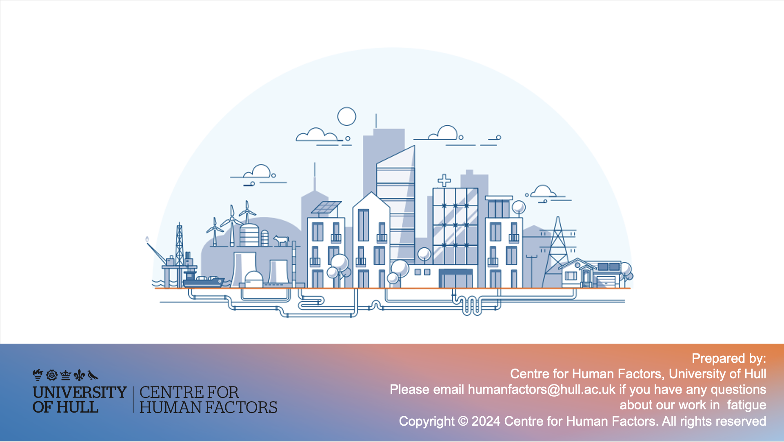
Prepared by:
Centre for Human Factors, University of Hull
Please contact humanfactors@hull.ac.uk if you have any questions about our work in fatigue
Copyright © 2024 Centre for Human Factors. All rights reserved

