Slide 1

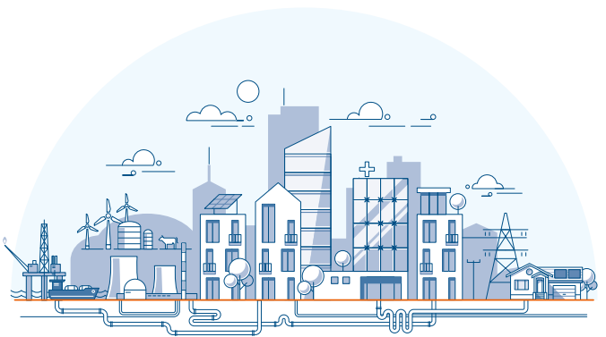
Introduction to Work-Related Fatigue
Unit 2:
Causes of Fatigue in your energy networks context
Prepared by:
Centre for Human Factors, University of Hull
Commissioned and supported by:
Energy Networks Association
Copyright © 2024 Centre for Human Factors. All rights reserved

Slide 2

Key points from unit 1:
Fatigue matters because it has an important role in safe and healthy working
If we don’t manage fatigue, we are much more likely to adopt unsafe and riskier ways of working
Being tired at work is normal and healthy, but there are more implications to being fatigued than feeling tired
It is helpful to explore fatigue using a Bowtie approach, which can help us explore risks, consequences and controls
Fatigue is difficult to manage because it’s really complex and difficult to predict

Slide 3

What unit 2 will cover:
Fatigue is a complex state which can have many different causes.
This unit explores the various possible causes and what you and your organisation can do to control any risks in your work.
We will cover…
The common causes of fatigue for frontline workers in your industry
Thinking about organisational control of these risks
The ways these causes can combine and accumulate
What you can do to manage these risks

Slide 4
Thinking about our model
The focus for this unit is on the left side of our Bowtie Framework:
What makes a person tired at work?
Consequences
Causes
E.g.
E.g.
Work pattern
Injury
Fatigue
Mental overload
Unsafe decision
Control measures
Mitigation measures
We will consider the broad causes of fatigue and think about what you and your organisation can do to control these causal risks.

Slide 5



Fatigue has multiple causes
When people think about fatigue at work, they are usually thinking about disruptions to sleep…
NEWSFLASH!!!
Fatigue is not only about sleep
Although sleep is a common and major cause, it is important to also think about a range of causes in our working context as a whole:
Physical Mental Emotional
Notes:
We are all familiar with fatigue that is caused by sleep disruptions, a bad night sleep, standby, working at night – this is really common and the most well understood cause of fatigue
Physical fatigue risks may include digging, climbing, standing for long periods
Mental fatigue risks may include sustained attention, complex problem solving
Emotional fatigue risks may include interpersonal conflict

Slide 6
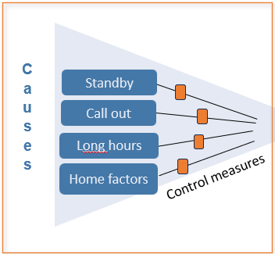
But let us start with sleep…
What is sleep-related fatigue?
This is complex and there are many definitions, but for this unit it might help us to keep it simple and think of this as the pattern of fatigue-effects that come from sleep disruption through:
working patterns (i.e. through shift work or on-call working)
wider life causes of sleep disruption (e.g. family life and ill health)
As you might expect (it’s not rocket science), our exploration into your working context revealed:
Sleep disruption as the most common cause of fatigue, specifically;
Standby, call out (night) and long shifts hours
+ home factors (e.g. caring responsibilities)
Notes:
Long hours - the longer you work the more likely your sleep will be affected (late to bed)
Standby – knowing you are on-call can disrupt the quality of your sleep
Emergency call out – working at night disrupts your physiological sleep cycle

Slide 7
Controls for sleep-related fatigue
Organisation level controls
Your organisation has the legal responsibility for controlling fatigue risks from shift patterns and shift management, which (at a minimum) should include
Clear controls on working hours e.g.
  Consecutive hours you can work in one shift
  How many nights you can be on standby consecutively
  Recovery time (e.g. at least 11 hours between shifts)
Clear guidance on what to do when
  You are (or are about to go) beyond one of the above controls
  You feel unsafe to work because of sleep-related fatigue
It would be ideal to be provided with good facilities for breaks/rest rooms
Notes:
Please edit to include your own organisational approach and controls as appropriate

Slide 8
Controls for sleep-related fatigue
What you can do
Make good decisions about your ‘fitness’ to carry on work by honestly reflecting on your current fatigue state: asking
“how tired am I now and (from your individual experience) how is this state likely to progress if you choose to continue working beyond the recommended duration”
Report your concerns when you feel your risks of sleep-related fatigue are likely to lead to unsafe levels
Off shift - Optimise your sleep with good ‘sleep hygiene’ and consider the possibility of any sleep disorder that will introduce an additional risk for you.

Slide 9


Thinking about his own fatigue, Alan wonders…
Sally the psychologist is here to help Alan understand his experience of fatigue
Is it normal to feel fatigued even after a good sleep?
Yes, it is a normal part of work-life to feel fatigued, even if you haven’t had any disruption to your sleep because inadequate sleep is not the only cause of fatigue.
Is it ok to report concerns about fatigue even if I am currently doing fine?
Yes, when you are on standby or working a very long shift, it is important to think about how you are likely to feel for the rest of the shift and returning safely home. Remember your priority is to get home safely after every shift!
We will come back to fatigue on your home journey and
good decision making in units 3 & 4.

Slide 10
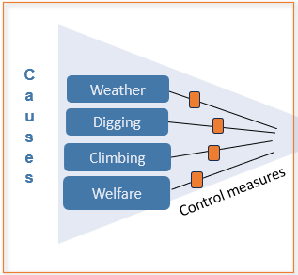
Thinking about physical fatigue:
This is also a complex process that involves the body’s physiological response to physical activity and the psychological processes that go along with this:
Feelings of psychological tiredness
Aversion to sustaining your physical activity
Bodily sensations e.g. muscle aches and increasing weakness
Physical work can lead to fatigue, but it is more likely
When the physical load is intense or prolonged
If you are less physically able (fitness or health reasons)
Our exploration into your working context found:
Reports of physical fatigue risks were less common that we might have expected but key physical causes were:
Weather (hot and wet conditions), heavy manual work, poor welfare

Slide 11
Controls for physical fatigue - Organisational
Organisation level controls
Your organisation has the legal responsibility to ensure you have the physical resources for you to work safely and sustainably – this should include
Appropriate and good condition PPE for the task and weather conditions
Well maintained tools to minimise the physical demands of the job as appropriate
Suitable welfare facilities
Notes:
Please edit to include your own organisational approach and controls as appropriate

Slide 12
Controls for physical fatigue
What you can do
Monitor your own level of physical fatigue to avoid increased physical risks of poor decision making, ask yourself:
“am I still working safely?
or do I feel so physically tired I am starting to cut corners?”
On-shift - When possible, to prevent accumulation of physical fatigue, redistribute or rotate physically demanding tasks within the team
On-shift - Take rest breaks as appropriate, to avoid the build-up of sustained physical work
On-shift – ensure you maintain good hydration during hot weather
Off-shift – Ensure you incorporate physical rest into your recovery period & engage in regular physical activity to maintain good health

Slide 13

Thinking about her own work, Deeta wonders…
Hmmm… this is very complex!
There are lots of different processes which contribute to this but…
1. One part of the explanation is that exposure to hot and cold add an additional workload to your physiological system, as your body works constantly to maintain a heathy internal temperature.
2. Another aspect of this is that the conditions make the work itself more difficult and sometimes more hazardous (think about digging or climbing in the rain)… This extra task complexity also increases the workload of a task.
Why do I feel more tired after working in bad weather?

Slide 14
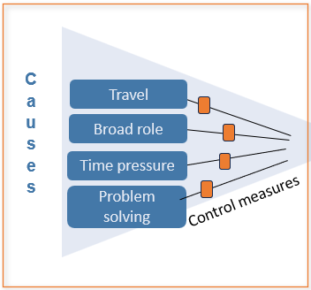
Thinking about mental fatigue:
Mental fatigue is the psychological state that develops from effortful engagement with mental work, it is characterised by:
Feelings of mental weariness, tiredness, disconnectedness
Aversion to sustaining your effort or task engagement
Our exploration into your working context found
Key causes of mental fatigue were:
Travel time – driving as a mental task load
Heavy and increasing range of role requirements (role complexity)
Time pressure
Accumulation of work demands
Safety critical tasks requiring problem solving
Notes:
For control engineers
Mental fatigue expressed by control room engineers from information overload (alarms, multiple phone calls) and immediate decision-making requirements (critical decision that are costly and safety critical)

Slide 15
Controls for mental fatigue - organisational
Organisation level controls
Your organisation has the legal responsibility to ensure your workload is risk assessed to minimise the risks to safety critical aspects of your work and your mental health
Organisation level risk assessment – including interventions to control risks
Manage working hours to reduce risk of overload
Review role requirements to ensure breadth of role is manageable
Notes:
Please edit to include your own organisational approach and controls as appropriate

Slide 16
Controls for mental fatigue
What you can do
Monitor your own level of mental fatigue to avoid increased risks of poor decision making in the field and on administrative tasks where mistakes are costly - again you can ask yourself
“am I still working safely?
or do I feel so mentally tired I am starting to cut corners?”
To avoid the onset of mental fatigue, taking rest breaks as appropriate or shift between more and less mentally demanding tasks
If possible, postpone (or get support for) important tasks for which you know your decision making is likely to be poor
Be aware (and vigilant) of the subtle and often subconscious shift towards risky decisions

Slide 17
Thinking about his own mental fatigue, Alan wonders…
The impact of different mental tasks on fatigue is a huge source of interest for psychologists – Understanding which mental tasks generate fatigue has helped us to understand what fatigue actually is.
Mental tasks known to be most likely to generate fatigue quickly include those that require our sustained attention – think about those tasks where you need to really concentrate and be focussed. This sustained attention may be most important in safety critical tasks, where distraction or wandering attention would lead to important consequences. When you are working on this sort of task, it is particularly important to take a break and monitor how you feel.
Why do some mental tasks make me much more tired than others?

Slide 18
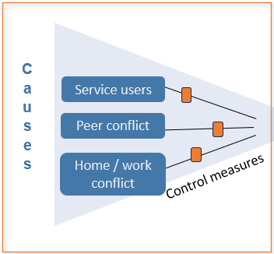
Thinking about emotional fatigue:
Emotional fatigue is less well understood and crosses over into realms of mental health, with links to anxiety and burnout.
However, there are risks for emotional fatigue in most working contexts as it can emerge follow engagement with emotional challenges.
It is characterised by:
Feelings of being emotionally drained or weary, interpersonally disengaged
Aversion to social contact, particularly supportive helping and active listening
Our exploration into your working context found
Key causes of emotional fatigue were:
Conflict with peers
Conflict with service users
Home-to-work conflicts

Slide 19
Controls for emotional fatigue - organisational
Organisation level controls
The processes for controlling emotional fatigue are a little different to the others
Training for effective engagement with service users and for dealing with adverse events – this will enhance resources to improve coping skills
Risk assessment to understand and control the risks from service users, particularly with regards to conflict: identify the situations in which staff can be exposed to abusive behaviours from clients and provide resources such as debriefing protocol
Foster team culture of respect and collaboration where conflict is addressed constructively, and provide clear process for addressing unresolved conflict within teams
Wider organisational support for wellbeing for staff experiencing high levels of emotional demand or difficulty (e.g. challenging home circumstances)
Notes:
Please edit to include your own organisational approach and controls as appropriate

Slide 20
Controls for emotional fatigue
What you can do
Reflect on the emotional demands of your day and more generally and consider the impact of these demands on your current state. Ask yourself
“how might my emotional state be affecting my interactions with my work?
Would I benefit from the wellbeing support offered to me through work?”
Within the team: try to resolve conflicts constructively and de-escalate tense situations through open and honest communication
Offer debriefing opportunities to other team members
It is ok to ask for help – seek support from trusted peers and/or manager when you need it

Slide 21

Thinking about his emotional fatigue, Alan wonders…
Again, this is complex. The impact of emotional demands (e.g. colleague conflict) on fatigue is perhaps understood in its interaction with sleep and mental workload:
Sleep effects - When we are dealing with emotional conflict, this can impact on our sleep, which then makes our pre-shift state less favourable – these effects can also accumulate, leading to the build up of a sleep debt over time.
Task engagement -There may also be on-task effects of immediate conflict, as our mental load is increased (through dealing with frustration and irritation). This makes the task more difficult, leading to a higher workload.
Why do I feel more tired when I’m working with some difficult people?

Slide 22

Our framework for managing fatigue risks
Consequences
Causes
E.g.
E.g.
Adverse weather
Injury
Fatigue
Long hours
Unsafe decision
Control measures
Mitigation measures
We now have identified a broad range of risks that we could add to our framework
This framework is good for identifying the range of causes and prompting us to explore how we might control or manage these risks

Slide 23

Our framework for managing fatigue risks
Consequences
Causes
E.g.
E.g.
Adverse weather
Injury
Fatigue
Long hours
Unsafe decision
Control measures
Mitigation measures
We now have identified a broad range of risks that we could add to our framework
This framework is good for identifying the range of causes and how we might control or manage these risks
Encourages us to over-simplify the process a little bit: these causes don’t usually occur in isolation: They usually co-occur, interact and accumulate.
Notes:
This model is very simple and encourages us to oversimply the fatigue risks.
It is unusual to only face one type of risk and the risks tend to interact in ways that are hard to understand and predict.
We can not consider this in its full complexity, but we can identify the specific risks and attempt to control them.

Slide 24
Training task
Think for a moment about the potential fatigue risks in your work.
Discuss in your group, how your different causes 'stack up' together to cause fatigue?
Are there any time points that you feel are vulnerable to multiple causes of fatigue that risk tipping you into an unsafe state?
What controls can you add to balance out your exposure to these risks?
​
rest
Resources
climbing
conflict
support
rain
Sleep deprivation
Long hours
insomnia
travel

Slide 25
Trainer notes:
Every role has different risks / causes to fatigue
Every person has different tolerances to the risks and patterns of fatigue
There is no right or wrong answer, but the aim is to explore what is meaningful to each individual.
Ensure you focus on the left-hand side of the bowtie for this module/tasks - the aim is to think broadly about the range of risks and how they occur and when they are likely to accumulate in ways with potentially significant consequences
It can be helpful to prompt on:
(1) emotional, physical, mental and sleep related risks
(2) what is a cause and how this is different to consequences - so long working hours would be a cause, a change in fatigue state could then lead an unsafe decision, which would be the consequence.

Slide 26
Summary unit 2:
Fatigue is not just about sleep!
There are other forms of fatigue: physical, mental and emotional
Fatigue can be triggered by various causes (e.g., working long hours, weather conditions, conflicts, accumulation of work) that can accumulate
We are all unique in our patterns of fatigue risks and our protective resources. It is helpful understand your own balance of work and circumstances.
There are things you and your organisation can do to manage these risks.
On your side, this requires an active and engaged reflection.

Slide 27
Useful Resources:
NHS tips to fight tiredness: https://www.nhs.uk/live-well/sleep-and-tiredness/self-help-tips-to-fight-fatigue
Study on acute aerobic exercise improving mental fatigue and cognitive function: https://pubmed.ncbi.nlm.nih.gov/34516957/
Safety training video on fatigue on the workplace: https://www.youtube.com/watch?v=nsxaD3Euz2Q
A longer video on sleep fatigue and how to improve performance: https://www.youtube.com/watch?v=RpaxxN8jTHo

Slide 28

Prepared by:
Centre for Human Factors, University of Hull
Please contact humanfactors@hull.ac.uk if you have any questions about our work in fatigue
Copyright © 2024 Centre for Human Factors. All rights reserved

