Slide 1

Trainer notes - overview
This course constitutes a series of five training units which have been designed to support staff in the energy networks industry with the management of work-related fatigue. The aim of this training is to improve health and safety by enhancing effective fatigue management.
Understanding fatigue is an essential component of effective management and these units aim to support a meaningful exploration of the complex elements of the fatigue process. All units are designed to support enhanced understanding of the causes and consequences of fatigue and offer guidance for well-informed decision making.
The units are comprehensive and explore the fatigue topic in detail. The materials are presented as Powerpoint packs, which are designed to support trainers in well-informed delivery of live training. Trainer notes are added to the notes (below slides as appropriate), with trainer guidance for delivering live exercises.
The packs are editable to offer a flexible resource for ENA member companies to incorporate internal policies and practices. It is also recommended that bespoke examples are included of any local best practice, incidents and near misses, to increase the accessibility of the content for trainees. This company-specific information will enhance the value of the training for each member company.
All units focus on the individual experience of fatigue, inviting personal reflections of experiences and individual differences. In addition, Unit 4 also includes a second version, which aims to support those who have decision making responsibilities for others, such as managers, supervisors and dispatch. Unit 4 (v2) invites relevant staff to consider factors influencing their own decisions about fatigue, as well as offering insight into the different drivers of fatigue decision-making in frontline staff.

Slide 2


Introduction to Work-Related Fatigue
Unit 1:
Fatigue as a complex challenge
Prepared by:
Centre for Human Factors, University of Hull
Commissioned and supported by:
Energy Networks Association
Copyright © 2024 Centre for Human Factors. All rights reserved

Slide 3

What this unit covers
Why fatigue matters
What can happen if we don’t manage fatigue
About this training course
Introducing Alan and Deeta
A framework for managing fatigue risks
Why fatigue is difficult to manage

Slide 4
Why does fatigue matter?
1. there are safety critical tasks with high costs of error - particularly to the health and safety of workers and members of the public
2. there is disruption to standard sleep patterns and/or periods of intense working with prolonged or complex demands
There are legal and ethical compliance requirements: Employers have a legal duty to manage risks from fatigue
Effective management of fatigue is a consideration in any work context, but most important where:
  Consequently, fatigue management is a core concern in the energy networks industry
But addressing these risks is far from straightforward…

Slide 5
Why is fatigue so difficult to manage?
Fatigue is a very complex state
Causes are broad and interrelated
Onset of fatigue difficult to predict
Difficult to measure
Our ability to assess our state deteriorates with fatigue
Consequences are not all visible
Notes:
Trainer notes:
The causes of fatigue are much broader and more interrelated than we think - most people think of shift patterns and sleep disruptions when considering causes of fatigue, but there are many aspects of working that can cause fatigue, irrespective of sleep and working time factors.
The emergence of fatigue is difficult to reliably predict - even though we know there are clear risk factors, humans are complex and fatigue doesn’t always develop in reliable ways
Fatigue is difficult to objectively measure – we currently don’t have any valid objective measures for changes in fatigue, we are reliant on proxy measures and subjective measures
The consequences of fatigue are not all visible / immediate - the effects of fatigue are sometimes delayed and sometimes we compensate for feeling tired by working harder
Our ability to assess our state deteriorates with fatigue - the more tired we are, the less likely we are to thoroughly and accurately assess our own state
We return to each of these complexities in more detail through the course.

Slide 6
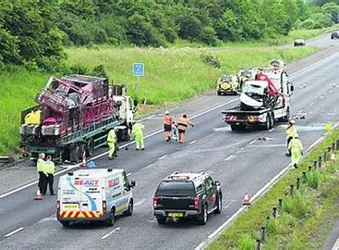
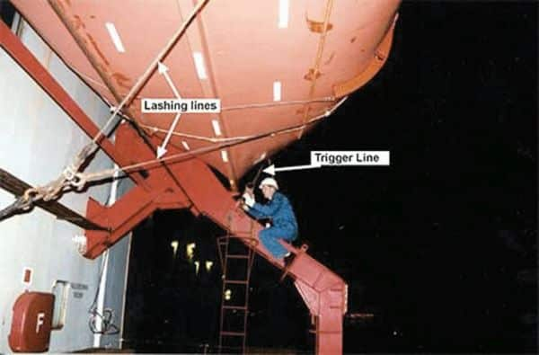
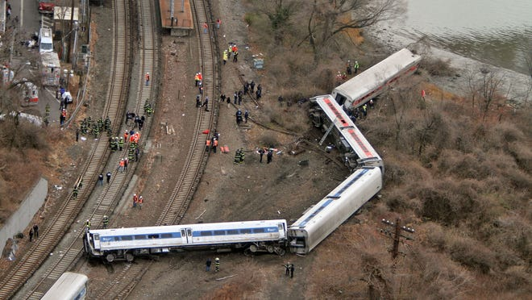
What can happen if we don’t manage fatigue?
Network Rail motorway crash, June 2014 , Reading, UK
Network rail crew members driving home from shift - crashed into the back of a lorry, killing 3 members
The Role of Fatigue: Employees working into early hours, decided not to use hotel and travel fatigued
Ship's Bosun accident, February 2019, USA
The ship was instructed to secure a lifeboat on sea, when carrying out work, lifeboat descended throwing bosun overboard - fatal incident
The Role of Fatigue: In the 24hrs leading to the incident, the bosun had only 4 hours off duty, so alertness and reactions would be affected due to fatigue
Metro-rail Derailment December 2013, Rye, New York, USA
Train crashed on a bend travelling at 82 mph, 3 x the speed limit; 4 passengers killed and 75 injured.
The Role of Fatigue: The controller with an Obstructive Sleep Apnoea had just started 5am shifts, affecting his sleep pattern. The governing body provides advice on sleep disorders and fatigue but not on OSA.

Slide 7
About this training course
This course has been designed by a group of psychologists with a background in the scientific study of work-related fatigue.
The content in the training units has been developed following engagement
with different groups of workers from the electricity networks industry
This informed the content of the units
Provided useful context and examples
Identified specific challenges - frontline, managers
control engineers
Notes:
We spoke to groups of people in roles like yours to understand fatigue in your work context
We explored the sort of work you do, the challenges you may face and the impact.
The insight gained through this engagement led to this training course

Slide 8
About this training course
You can make well-informed decisions about work and rest
You can understand and spot the many causes of fatigue
You understand what can happen when you are fatigued
You are clear about how to report any concerns
You are clear about your responsibilities
You and your team have a shared understanding of fatigue to support well-informed discussion
We aim to enhance your understanding of the state of fatigue so:
In short…
we aim to help you to be safer at work
Notes:
Your decisions about rest and work activities can be more well-informed
You have a fuller understanding of the range of fatigue causes so they can be more fully considered and controlled appropriately
Consequences of fatigue for the individual, the team, the work and the organisation can be mitigated appropriately
You are clear about your responsibilities
You are clear about our organisational approach to fatigue and how to report any concerns
You and your colleagues have a shared understanding of fatigue to support well-informed discussion

Slide 9


Meet Alan and Deeta
Alan and Deeta both care about their work and want to do a good job. But, like their teammates, they regularly feel tired at work.
Sometimes they feel tired:
at the end of a long day
when they are ready for a break
when they have been on standby or working at night
when they have faced conflict with colleagues or service users
or maybe when there are challenges outside of work
… sometimes they might feel tired and not really know why!
This is normal and healthy, and everyone feels tired sometimes.

Slide 10
Meet Alan and Deeta
Throughout this course we will hear more about Alan and Deeta and try understand some of their experiences and challenges.
We will think through some of their questions about fatigue, such as
Is tiredness the same as fatigue? (unit 1)
Is it normal to feel fatigued at work even if I’ve had a good sleep? (unit 2)
Why do I feel fatigue differently to other people in my team? (unit 2)
Why do I make mistakes when I am fatigued? (unit 3)
What happens if I don’t rest when I am fatigued? (unit 3)
What sorts of things should I think about when making decisions about
whether to carry on at work? (unit 4)
To get us started, we will begin to address Deeta’s first question:

Slide 11
Meet Alan and Deeta
Is this feeling of tiredness the same as fatigue?
The answer is not straightforward so we will come back to this later in the course, but in short, no...
Tiredness and fatigue are not quite the same!
It is helpful to think about tiredness as the feeling that is one part of the experience of fatigue…. But not the whole picture
Fatigue is a broader and more complex process than tiredness
It develops in response to effortful activity (engaging in some sort of demand – mental, physical or emotional)
It has another central characteristic of ‘aversion to further effort’: a drive to stop the activity which is making us tired.
It is also related to sleepiness, but not the same thing!
These are important things to understand, and we will come back to these ideas again later.

Slide 12
A framework for managing fatigue risks
It is helpful to have this ‘Bowtie’ framework to think about fatigue risk management
​
Consequences
Causes
E.g.
E.g.
Work pattern
Injury
Fatigue
Mental overload
Unsafe decision
Control measures
Mitigation measures
Through this framework we can consider a range of causes, a range of consequences and how we effectively manage these risks.
Notes:
Like any H&S risk, it is helpful to adopt a structure to thinking about the causes and consequences of fatigue. This then gives us a framework to reflect on existing and possible controls and mitigations.

Slide 13
Pause for reflection
In your job generally, think about….
1. The possible range of causes
2.The potential consequences
​
Consequences
Causes
E.g.
E.g.
Work pattern
Injury
Fatigue
Mental overload
Unsafe decision
Control measures
Mitigation measures
Can you think of lots of different causes?
Can you think of lots of different consequences?
Fatigue really is complex, and we hope to help you understand the cause and consequences better through the following units
Notes:
There are many different causes of fatigue.
These are different for each job, but to help organise and prioritise them, we find it helpful to think broadly in terms of categories of Mental, Physical, Emotional & Sleep-related fatigue.

Slide 14
Optional training exercise:
Review a case studies
Complete in guided discussion groups reflecting on bowtie model as a framework for fatigue management
Identify a familiar incident – or if preferred consider the renowned incident described here.
Explore and record the full breadth of possible causes (risk factors leading to the fatigue state)
Discuss how you think fatigue might have played a role – what about the state of the individual changed, what elements of fatigue led to event, e.g. change in attention to detail, shift towards risky behaviour, poor decision making?
What were the consequences / outcomes?
What lessons should be learned and what changes should made to improve fatigue management?
Context:
On June 19th, 2013, at around 5:30 AM, following a job that concluded at 3:40 AM, two welders were driving back on the A1 when their van veered off the carriage way into a layby, colliding with a parked lorry.
Tragically, this accident resulted in the deaths of both employees. The driver of the van had been reported to have worked for 26 hours leading up to the crash.
Notes:
A downloadable training exercise for frontline workshops
The aim of this activity is to extend the thinking from the previous reflection – thinking in broad terms about the risks and consequences/outcomes.
See notes on following slide to guide exercise.

Slide 15
Optional training exercise:
Trainer notes
Causes:
Situational
Long duty periods (had been working since the day prior)
Long periods of travel (travelled for 12 hours within the last day)
Waited for job to start – was then cancelled, giving a monotonous workload for both
Organisational
Lack of implementation of risk assessment to monitor fatigue
State:
Increased physiological sleepiness, with a strong drive to rest/sleep
Information processing: Reduced mental capacity, decreased decision-making capability and inattentiveness
Subjective state: Feelings of tiredness and sleepiness.
Consequences:
Increased risk of accident resulting from
Impaired performance
Falling asleep
Severe injuries or extreme cases such as this incident can lead to death
Lessons to learned:
Changes to procedures occurred in 2015, leading to a change in culture within the organisation
Focused more into the implementation of risk assessment procedures
Increased accountability on employers to demonstrate suitable arrangements in place to mitigate fatigue
Notes:
Trainer:
Try to elicit a range of fatigue risks to prompt discussion in this activity.
2. Try to guide trainees through to the range of consequences of being fatigued in this driving context.
The aim of this activity is to start to consider the risks as much broader than sleep–related factors.

Slide 16
Summary unit 1:
Fatigue matters because it has an important role in healthy and safe working
If we don’t manage fatigue, we are much more likely to adopt unsafe and riskier ways of working
Being tired at work is normal and healthy, but there are more implications to being fatigued than feeling tired
It is helpful to explore fatigue using a Bowtie approach, which can help us explore risks, consequences and controls
Fatigue is difficult to manage because it’s very complex and difficult to predict

Slide 17
Useful Resources:
HSE. (2023). Human factors: Fatigue. Human factors/ergonomics - Fatigue. https://www.hse.gov.uk/humanfactors/topics/fatigue.htm
Murray, S. L., & Thimgan, M. S. (2016). Human fatigue risk management: Improving safety in the Chemical Processing Industry. United Kingdom.
NASA. (2022). NASA views images, confirms discovery of Shuttle Challenger artifact. NASA. https://www.nasa.gov/history/nasa-views-images-confirms-discovery-of-shuttle-challenger-artifact/
NOAA. (2020). Exxon Valdez: Oil Spills: Damage Assessment, Remediation, and restoration program. Exxon Valdez | Oil Spills | Damage Assessment, Remediation, and Restoration Program. https://darrp.noaa.gov/oil-spills/exxon-valdez

Slide 18
Prepared by:
Centre for Human Factors, University of Hull
Please email humanfactors@hull.ac.uk if you have any questions about our work in fatigue
Copyright © 2024 Centre for Human Factors. All rights reserved

