Slide 1
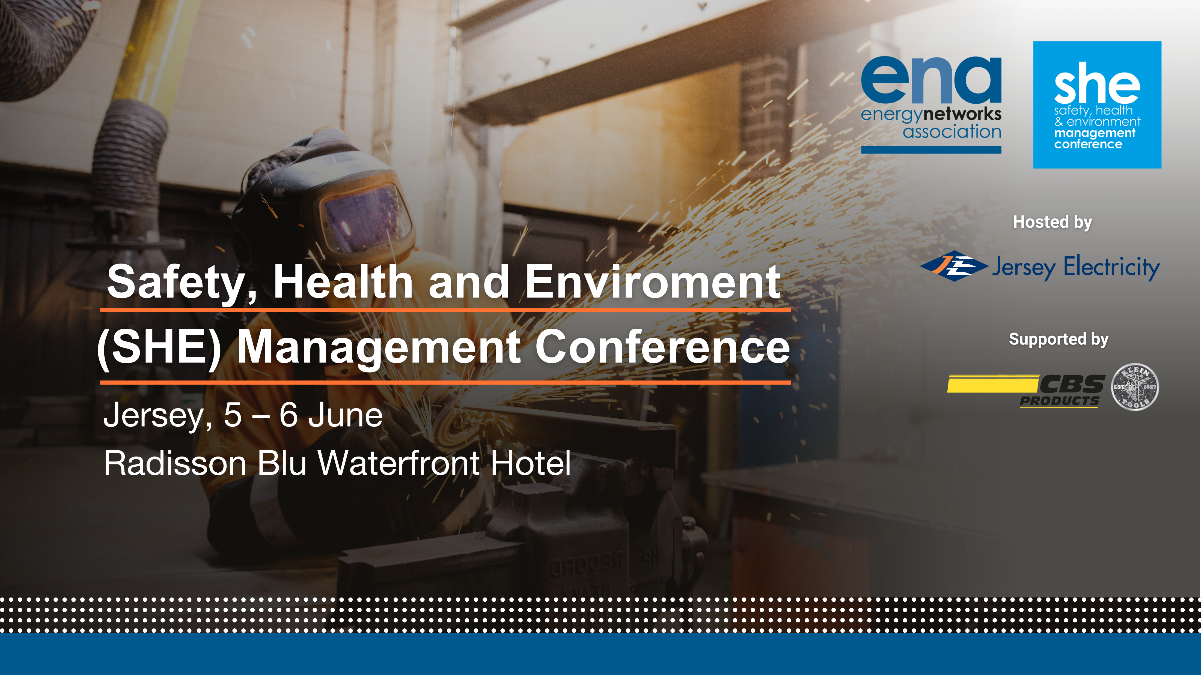
Session 4
Future challenges

Slide 2

Workforce Skills, Challenges & Initiatives
SP Energy Networks
18/06/2024

Slide 3
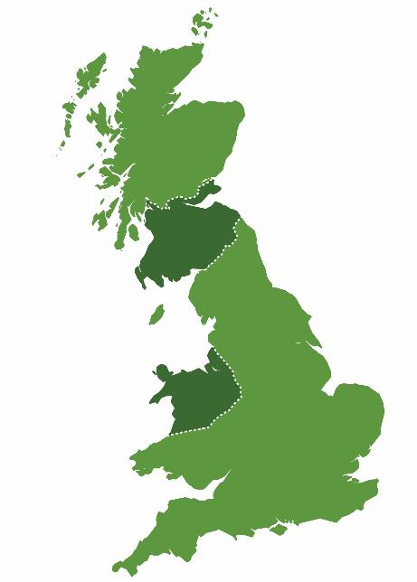
Transmitting & Distributing Electricity through our Network.
3.5 Million Customers in a broad mix of urban and rural geographies.
3,500 direct staff and 3,000 contractors
SP Transmission (SPT)
SP Distribution (SPD)
12,000 jobs indirectly supports in supply chain.
£1bn annual expenditure.
SP Manweb (SPM)

Slide 4
Our Workforce Strategy
Career Transition - Reskilling & Upskilling
Opportunity to support declining industries
Recruiting locally, training centrally
Attract new entrants into our industry through a diverse range of channels & collaborative working
Grow our own core talent through multiple channels
Inclusive recruitment from the communities we serve to build a diverse workforce
Safeguard the health and wellbeing of our people and support their needs as an inclusive employer
Strong platform
Talent Pipeline
Forecasting model
Key partnerships
Training centres
Next level – Centres of Excellence / Group schemes
Increased
female trainee intake 500%
STEM Activities
Sponsorships
Recruitment Campaigns

Slide 5
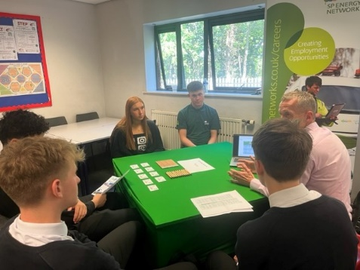
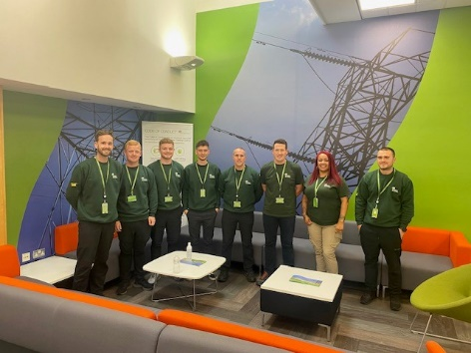
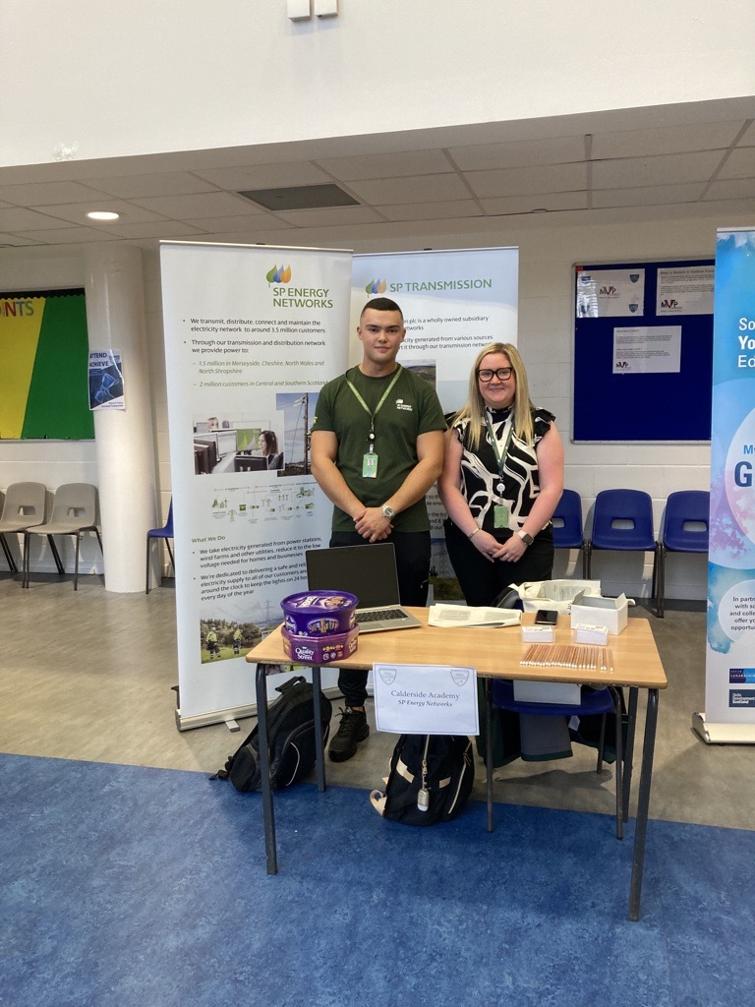
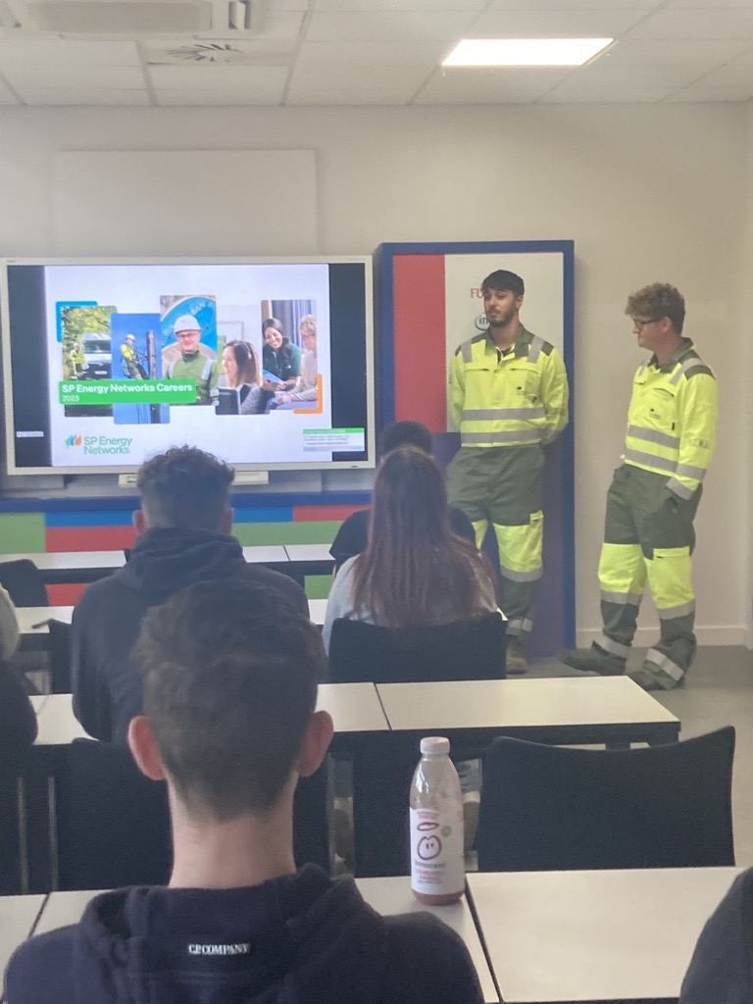
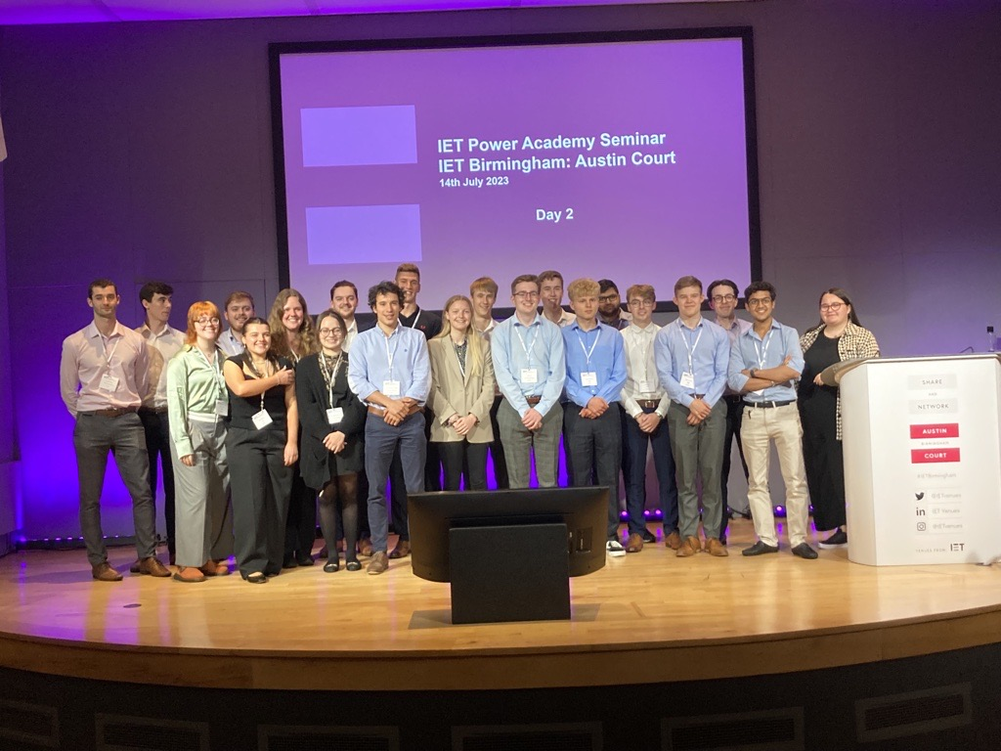
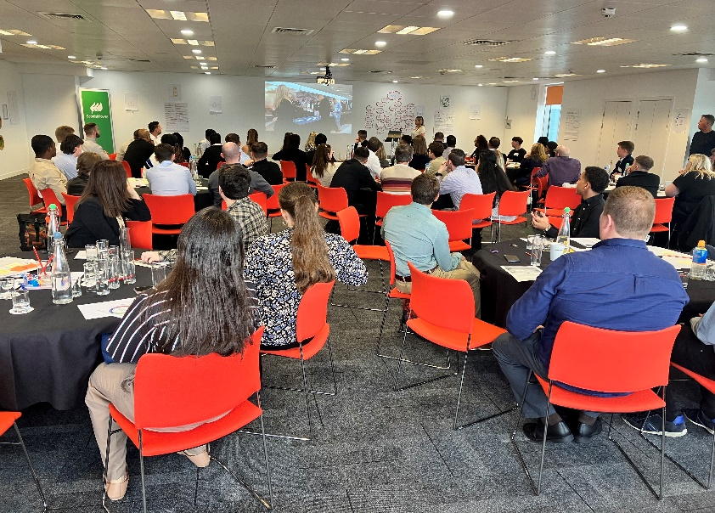
Workforce Renewal – our Journey
508 In-flight full-time trainees
30+ Trainee Programmes
50 Year in Industry
52 Summer Placements
44 Scholars
209 Recruited
180 Completed training
2024
2018
209 In-flight full-time trainees
5 Trainee Programmes
13 Year in Industry
20 Summer Placements
23 Scholars
98 Recruited
80 completed training

Slide 6
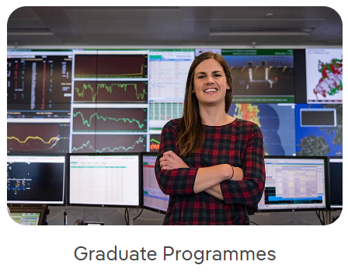
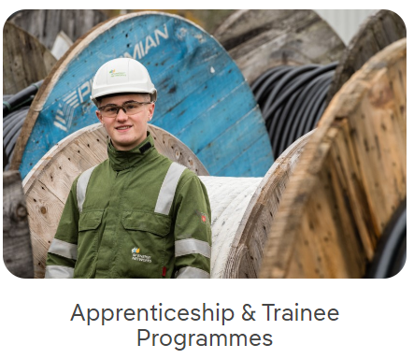

Our Trainee Programmes
Business & Commercial
Engineering
Civil Engineering
Power Systems Analysis & Design
Project Management
Land and Planning
Data, Technology & Cyber
Modern Apprenticeship
- Craft / Logistics
Higher Skills Apprenticeship
- Power Eng., Project Mgmt
Graduate/Degree Apprenticeship
-Cyber, Data, QS, Digital & Tech
Trainee Programmes (Craft, Engineering, Site Mgmt)
Pre-Apprenticeship
Summer Placement
Year in Industry Programme
Power Academy Scholarship
Master Scholarship
Returner Programme
Ex-Forces Programme

Slide 7
Our Future Skills Areas
Telecoms and Networking
Future Systems Strategy
Data and Digitalisation
Sustainability
Customer Service

Slide 8
Some of Our Skills Challenges
Increased Retirements
- Loss of Experience
Retention
Skills Shortages
Attracting Future Skills Areas

Slide 9
Our Initatives
Reskilling & Upskilling
Partnership with Council & Contractors
University Engagement –Graduate Apprenticeships / Advisory boards
Cross Sector Partnerships
Transitional Careers – Reskilling / Upskilling
North Lanarkshire Council – Reskilling Initiative
STEM – School Engagement
PACE Partnership
Supporting declining industries (e.g. Petroineso)
Ex-Forces
NSAP – Transmission & Distribution Group
Loop Survey & Employee Networks
ENA / Ofgem Industry EDI Steering Group
Future Skills Summit – SSE/NGED/Strathclyde University
Key partnerships
Developing training programmes – future skills
Research / Insight
Best Practice Sharing
Partnership
Stakeholder Event
White Paper

Slide 11
The life of an apprentice…
ENA SHE Management Conference 2024
Tito Ornelas and Cody O’Gorman

Slide 12
Tito Ornelas
Started apprenticeship 8 months ago
Role: Cable Jointer
Previous roles
Car mechanic; Further education for 3 years; Metal scrapyard; Jersey Electricity
Negatives – lack of opportunities, pressure to ‘get the job done quickly’, negative working environment.

Slide 13
Tito Ornelas
In 2022/23, the waste and recycling industry reported 7 fatal injuries​ (HSE.gov.uk)​.
Over the past five years, fatal injuries in this sector have varied slightly but generally remain in the range of 5-10 annually​ (HSE.gov.uk)​
Apprentices are 73% more likely to suffer a workplace injury (HSE.gov.uk)
Notes:
For example, the electricity sector reported an average of 1-2 fatal injuries annually over the past five years​ (HSE Press)​

Slide 14

Tito Ornelas
Working at JE –
Lack of pressure
Good atmosphere
Safe working environment
Opportunities to progress
Education and training
20% of the current workforce are expected to retire between 2022 and 2026
Notes:
You need us!!!!!

Slide 15






Company Values
SAFETY: We do everything safely and responsibly or not at all – nothing is more important than the safety of the public, our customers and our staff.
RESPONSIBILITY: We accept responsibility for everything we say and do, safeguarding the natural environment and the local community, as well as the interests of all our customers, shareholders and staff .
CUSTOMER FOCUS: We listen to our customers and seek to understand and respond to their needs, treating them the way we would wish to be treated, with respect and honesty.
EXCELLENCE: We strive to work in a way that is both effective and efficient, continuously improving everything we do – innovating where we can but keeping things simple .
TEAMWORK: We respect and value our colleagues as individuals and we believe we are stronger as a team, leading to better solutions and a more enjoyable and rewarding work life.
RELIABILITY: We are trustworthy, dependable and reliable, delivering on our commitments and always there when you need us.
Notes:
Safety is the top value for JE

Slide 16
Cody O’Gorman
Started apprenticeship 8 months ago
Role: Cable Jointer
Previous roles
Finance (Real Estate); Labouring in the Construction Sector.
Negatives – No progression, poor safety culture, same thing every day.

Slide 17
Cody O’Gorman
Working at JE –
Supportive environment
Education opportunities
Safety focused
Secure role
Excellent training in the UK
Notes:
Outside, challenging work, able to engage your brain, Safety Module as part of education.

Slide 18
Cody O’Gorman
Safety can feel a little overwhelming sometimes
Collaboration is key
Two-way feedback
What do we want as apprentices?
Collaboration & Engagement
Input
Psychological Safety
Notes:
Collaboration – need to stay current and competent on safety rules
After speaking with older colleagues, bit of a police force, thankfully that has changed
And we have a good safety culture. Safe systems of work and risk assessment input.
What do we want? I’ve talked with other apprentices and…
Psychological safety for JE, We feel comfortable to stop a job or challenge unsafe behaviour.

Slide 19



Thank you
Notes:
Collaboration – need to stay current and competent on safety rules
After speaking with older colleagues, bit of a police force, thankfully that has changed
And we have a good safety culture.
What do we want? I’ve talked with other apprentices and…
Psychological safety for JE, We feel comfortable to stop a job or challenge unsafe behaviour.

Slide 20


