Slide 1
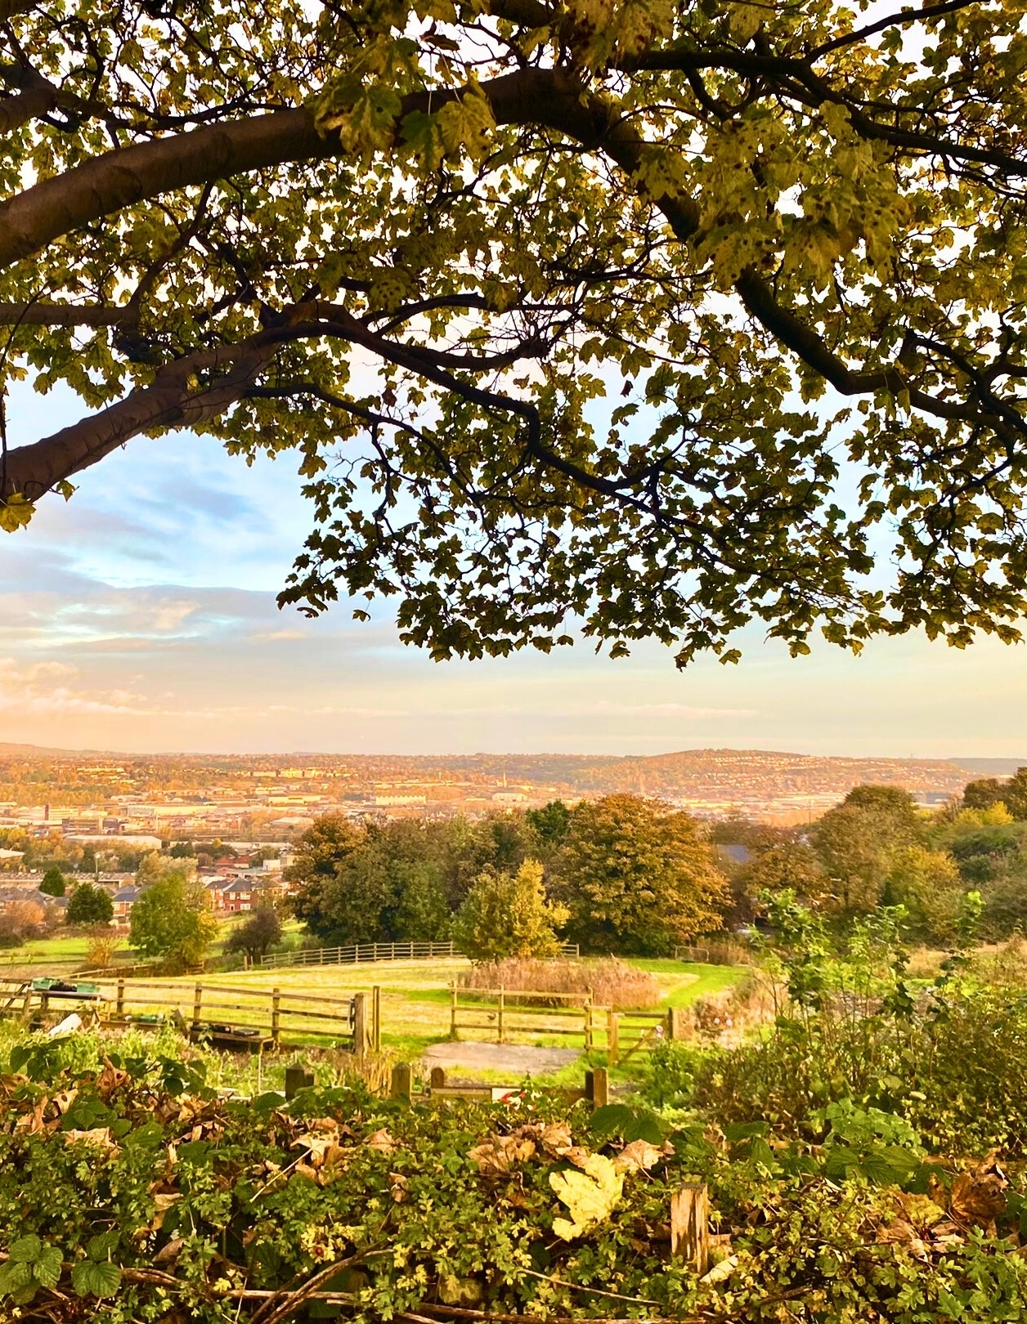

Nature North:
Investing in Nature for the North
Steph Hepworth | Tom Burditt
Nature North
info@naturenorth.org.uk
www.naturenorth.org.uk

Slide 2
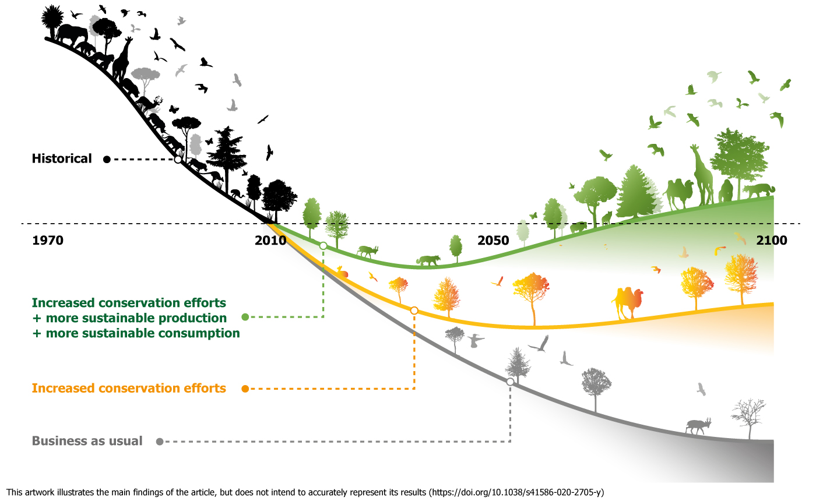
Why?
Nature-based infrastructure solutions can influence 79 per cent of all targets across the Sustainable Development Goals (SDGs).
Nature is critical infrastructure
How Nature underpins our ambitions in the North and elsewhere?
Positive impact seen here…and here..
Why the North?- proportion of natural capital, habitats and water
Notes:
A jarring image to illustrate nature’s catastrophic decline.
A study in 2022 found that humans are now living 9.7km away from a natural area, 7% further than in 2000. Europe has the highest distance…other areas now following this trend. (Cazalis, V., Loreau, M., Barragan-Jason, G. (2022). A global synthesis of trends in human experience of nature. Frontiers in Ecology and the Environment).
The UK has committed to protect and conserve at least 30% of land and sea for biodiversity by 2030, with further statutory nature targets in the Environment Act 2021.

Slide 3
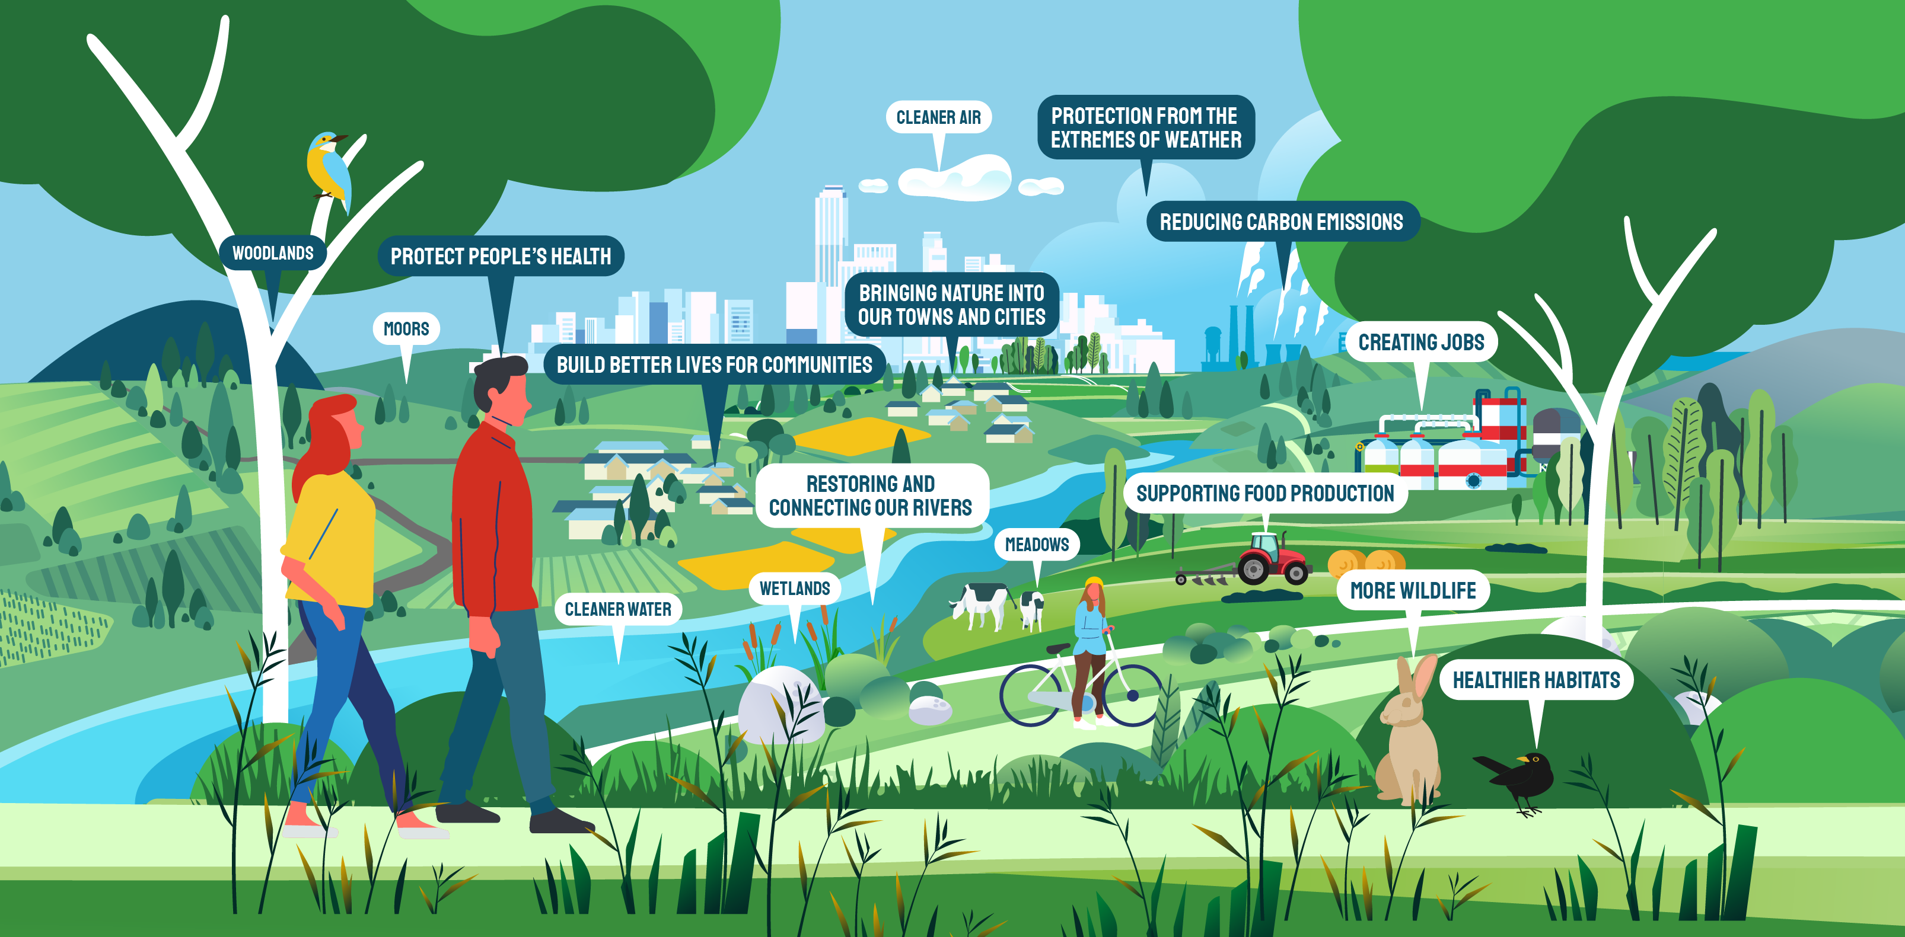

Nature delivers…
Notes:
recreation value of Northern natural capital valued at £2.75 billion per year.
It’s estimated that 22-114 jobs are created for every 100 ha of woodland planted and 30-56 jobs for every 100 ha of coastal habitat restored.
More than 28,000 farming businesses in the North

Slide 4
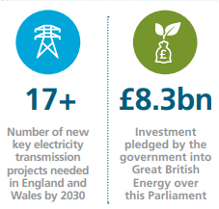
So, let’s flip that…
Nature-based solutions can influence 79 per cent of all targets across the Sustainable Development Goals (SDGs).
“While NbS cannot replace all grey infrastructure, if done well it is likely to be more cost-efficient than its engineered alternatives in certain areas such as flood protection.” (UNEP: Enabling Adaptation).
Nature is critical infrastructure
Nature underpins our ambitions in the North and elsewhere
More than half of the world's GDP is moderately or highly dependent on nature and its services
(World Economic Forum & PwC, 2020)
Nature degradation could cause a 12% loss to UK GDP
the Covid-19 pandemic cost the UK up to 11% of its GDP in 2020
the financial crisis of 2008 took around 5% off the value of the UK GDP
Comparable to the impact of climate change.
Nature depletion and climate change combined increase risk to our energy networks through extreme weather.
Can we work together so that our green energy ambitions also power our progress to 30 x 30?
Notes:
Treating nature as an underpinning infrastructure will enable better integration of policy, spatial planning and economic decision-making.
Nature-based Infrastructure: How natural infrastructure solutions can address sustainable development challenges and the triple planetary crisis is published by UNEP, UNOPS, and the University of Oxford; https://wedocs.unep.org/handle/20.500.11822/44022;jsessionid=8EFD155024FF2091F2CA07D1BEF4BA50

Slide 5
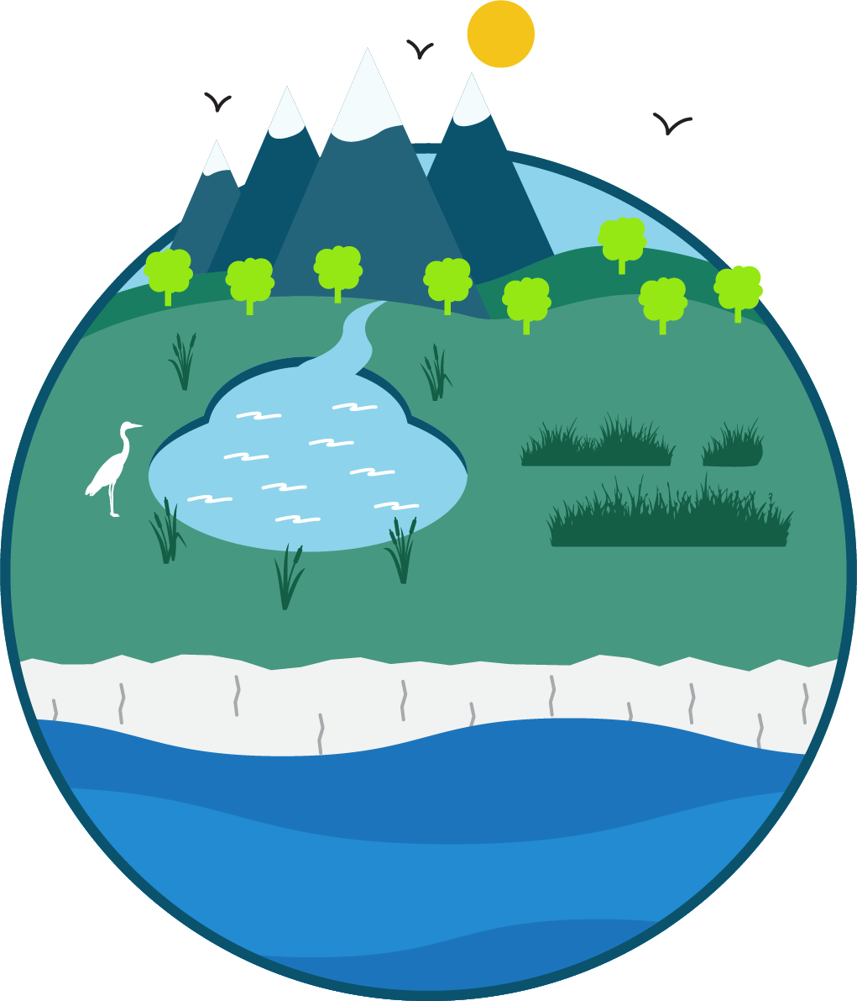
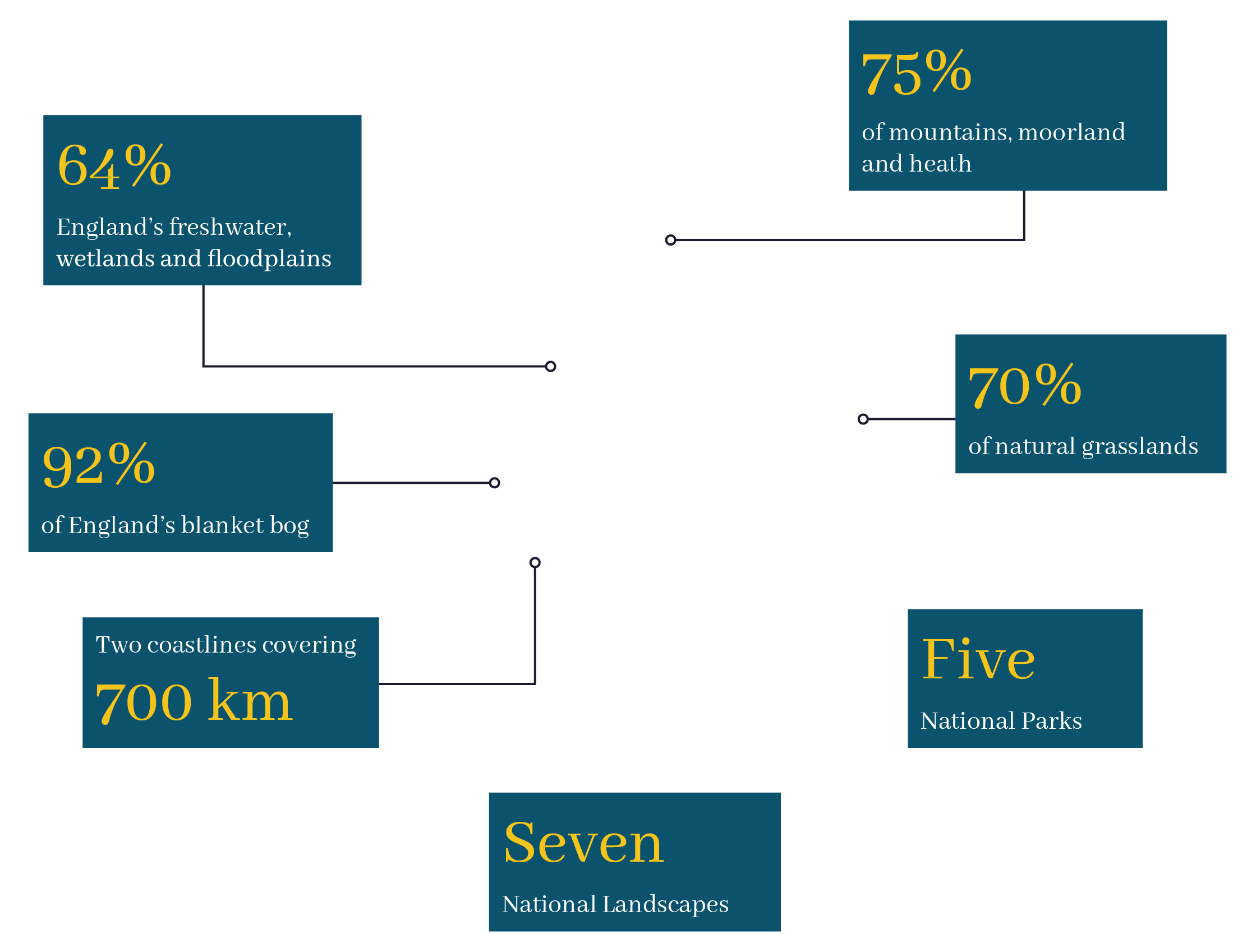

The North has broken new ground in the scale of our nature ambitions. The Great North Bog partnership aims to restore 7,000 km² of Northern peatland - an area four times the size of Greater London - and the Northern Forest plans to plant 50 million trees. Together, they have secured £220 million of the £700 million needed.
The North also leads England with the largest area of Nature Recovery Projects, covering 1,440 km, while Northern farmers and land managers have entered 98,000 ha into Landscape Recovery Projects through Environmental Land Management Schemes.
The North covers just under a third of England’s land area, yet has:

Slide 6












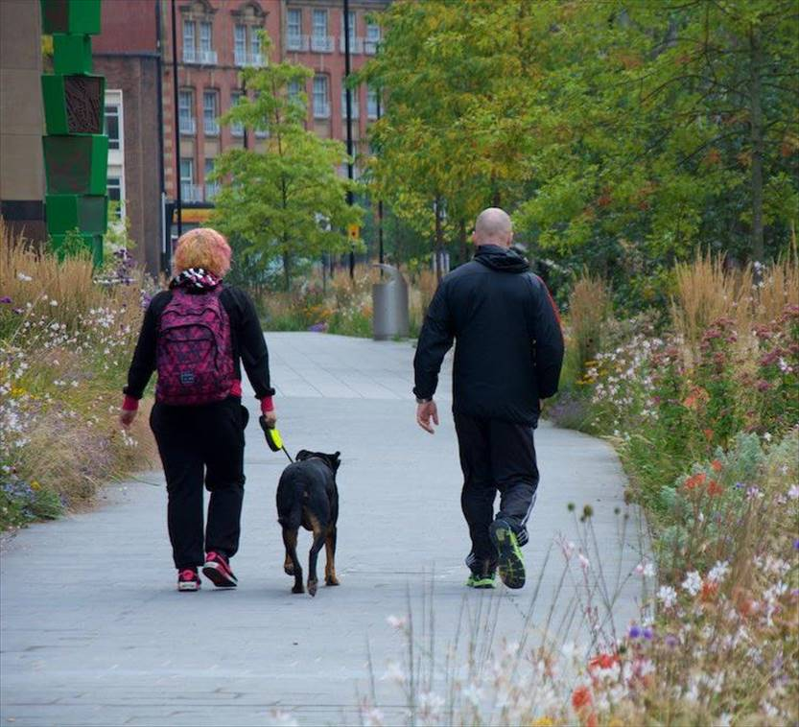
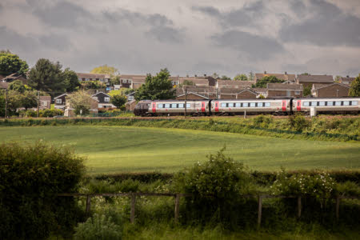
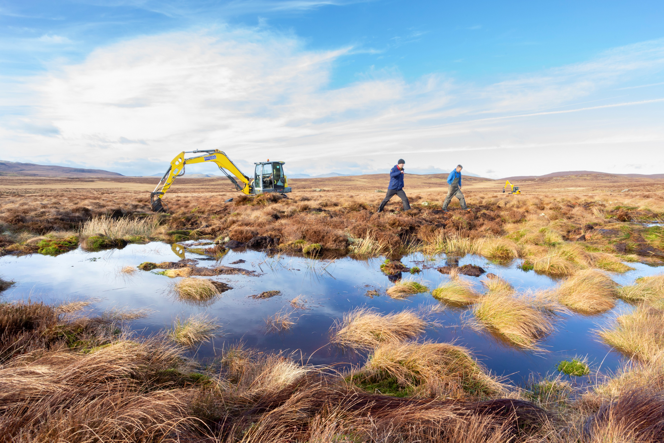
A Northern Partnership for Nature
Partnership Board
Advisory Group
Notes:
Nature North is a pan-regional cross-sector collaboration of more than 50 organisations, partnerships, agencies and businesses working for nature recovery across the North of England.
with ambitious plans to draw investment into large-scale and connected nature recovery.
We are working closely with a range of organisations through our Partnership Board, this includes the Wildlife Trusts who are an important partner bringing a wealth of knowledge and expertise.
But we know, Nature is also important to many other individuals and organisations.
Through our Advisory Group and Investable Propositions, we are working to build an effective cross-sector collaborative partnership for nature. This encompasses environment, business, infrastructure, health, education, culture, heritage, sport and tourism.

Slide 7
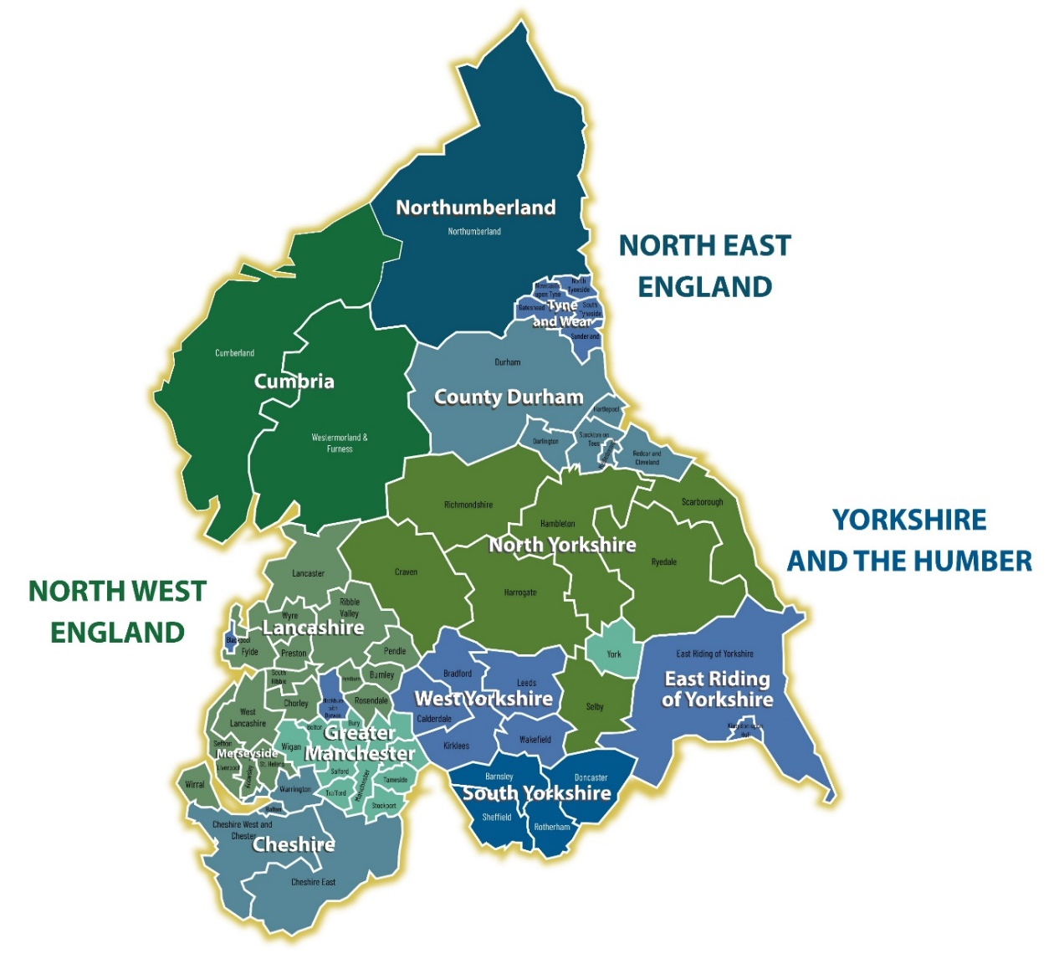
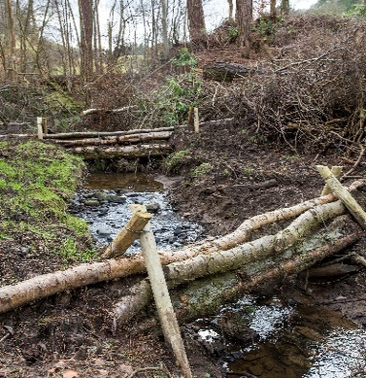
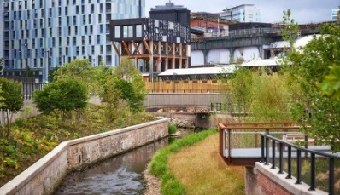
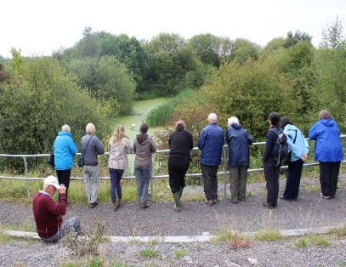
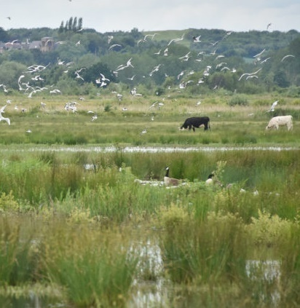
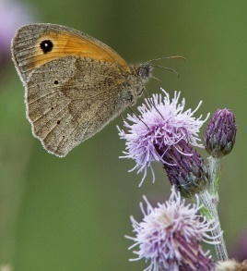
Nature recovery for places and people across the North of England
A pioneering cross sector collaboration, formed in 2020
Together we are working to:
Build a northern partnership for nature.
Embed nature and its benefits into policy in the North of England
Attract significant new public and private investment into large scale nature recovery, with benefits for the economy, green jobs, resilience to climate change and quality of life in the north.
Notes:
The Nature North collaboration formed in 2020.
The area covered is shown on this map, with blurry edge to enable work with neighbouring regions and across estuaries. Why a Northern approach?
The collaboration are working to…
Working to develop investable propositions that align the nature project pipeline to potential sources of funding, and create an ambitious vision of what we can achieve for the North if we invest in our natural assets.

Slide 8

VISION FOR A NATURE POSITIVE ECONOMY IN THE NORTH
Through collaboration, leadership and by making the most of our Northern advantages, we can create the UK’s first nature positive regional economy. A prosperous and thriving North, where nature’s recovery attracts investment and is integral to economic growth, resilient communities, improved health and better places to live. A region where every sector is doing their part for nature, and we work inclusively so everyone can benefit. A place that invests in people, skills and capacity, enabling green careers and a just transition. A North that is leading for nature, with outstanding nature recovery.
Notes:
Advocacy is vitally important – we work to influence those who can make things happen, one key way was the recent launch of our strategic plan for a Nture Positive Regional Economy. This was created collaboratively with over 400 individuals and organisations involved. It set our a clear vision and steps to take to secure our ambitions for the North. Please take time to read this. We are looking for people to work with us to make take this forward.

Slide 9
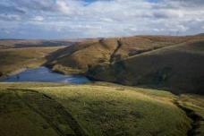
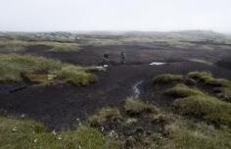
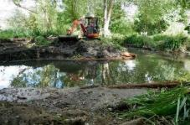
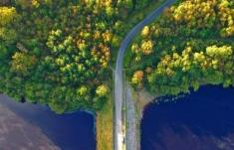
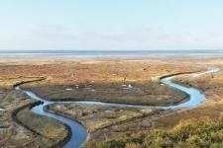
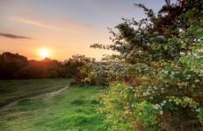
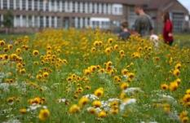
NATURE NORTH'S INVESTABLE PROPOSITIONS
Existing cross regional Investable Propositions
New cross regional Investable Propositions
Rivers
Nature North
Green Northern
Connections
Northern Coasts
and Estuaries
Northern Forest
Great North Bog
Woodland Trust and Community Forests
6 Peatland
Partnerships
Environment Agency
Wildlife Trusts
RSPB
The art of the possible:
Clear vision and ambitious target
Delivery costed at a high level
Benefits defined
Building on existing partnerships,
work and knowledge
Resilient Northern Farming
Urban Nature North
Natural England
National Trust
Notes:
Climate impacts can be mitigated by investing in the resilience of surrounding landscapes and catchments – this can also deliver all those extra benefits too.
The slide shown shows which organisations are facilitating the development of Investable Propositions, a collaborative approach, bringing in key stakeholders
Together we are developing partnerships to secure funding, build a pipeline project with project deliverers, use spatial analysis alongside ‘on the ground’ knowledge and develop relationships with existing and potential buyers, funders and investors.
Great North Bog – a landscape scale initiative supported by six leading peat restoration partnerships restoring 7,000km² of upland peat
Northern Forest – a collaborative initiative to create new woodlands and protect ancient ones across the north of England, establishing 50 million trees by 2043.
Rivers Nature North: Environment Agency Utilising nature based solutions to drive improvement in our rivers and other freshwater bodies.
Green Northern Connections: Wildlife Trusts Working with major transport and energy infrastructure developments to mitigate impacts and build in climate change resilience.
Northern Coasts and Estuaries: RSPB Use of nature based solutions to address economic and environmental decline in coastal areas
Resilient Farming North: Natural England Supporting farmers to make a sustainable transition through changes in subsidies, markets and climate through with nature based solutions.
Urban Nature North: National Trust Addressing health and productivity inequalities and drawing people back to towns and cities through green space.

Slide 10
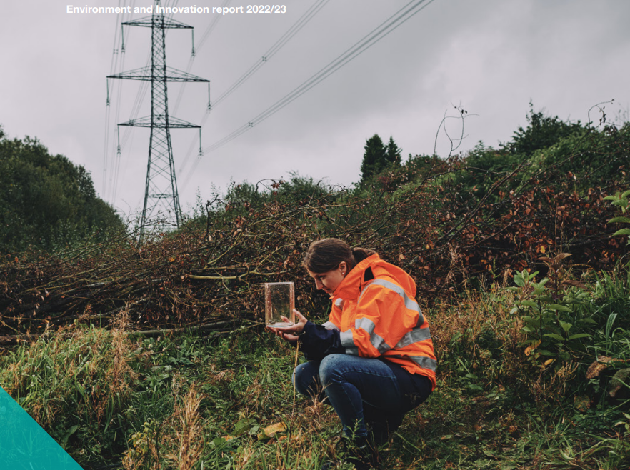
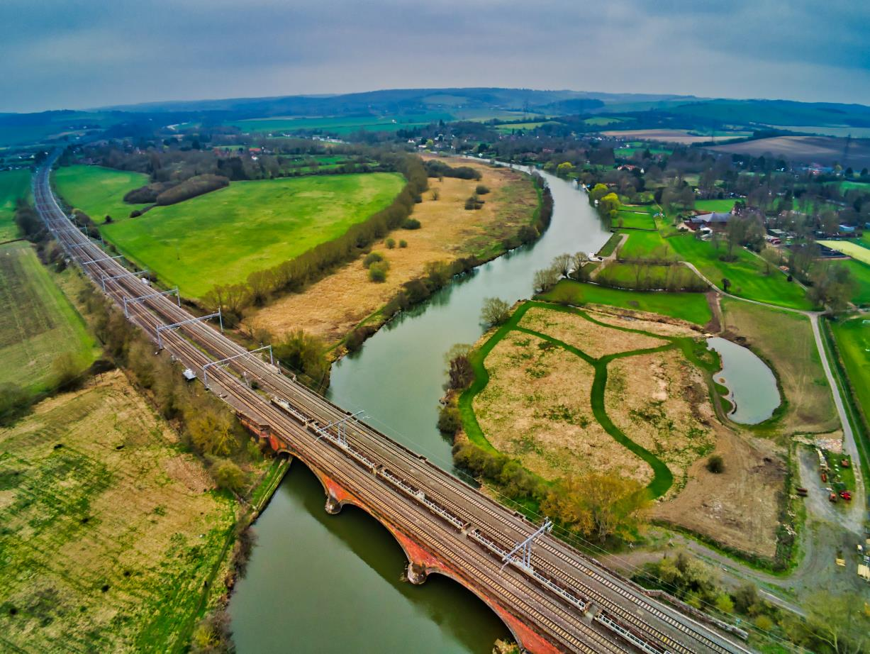
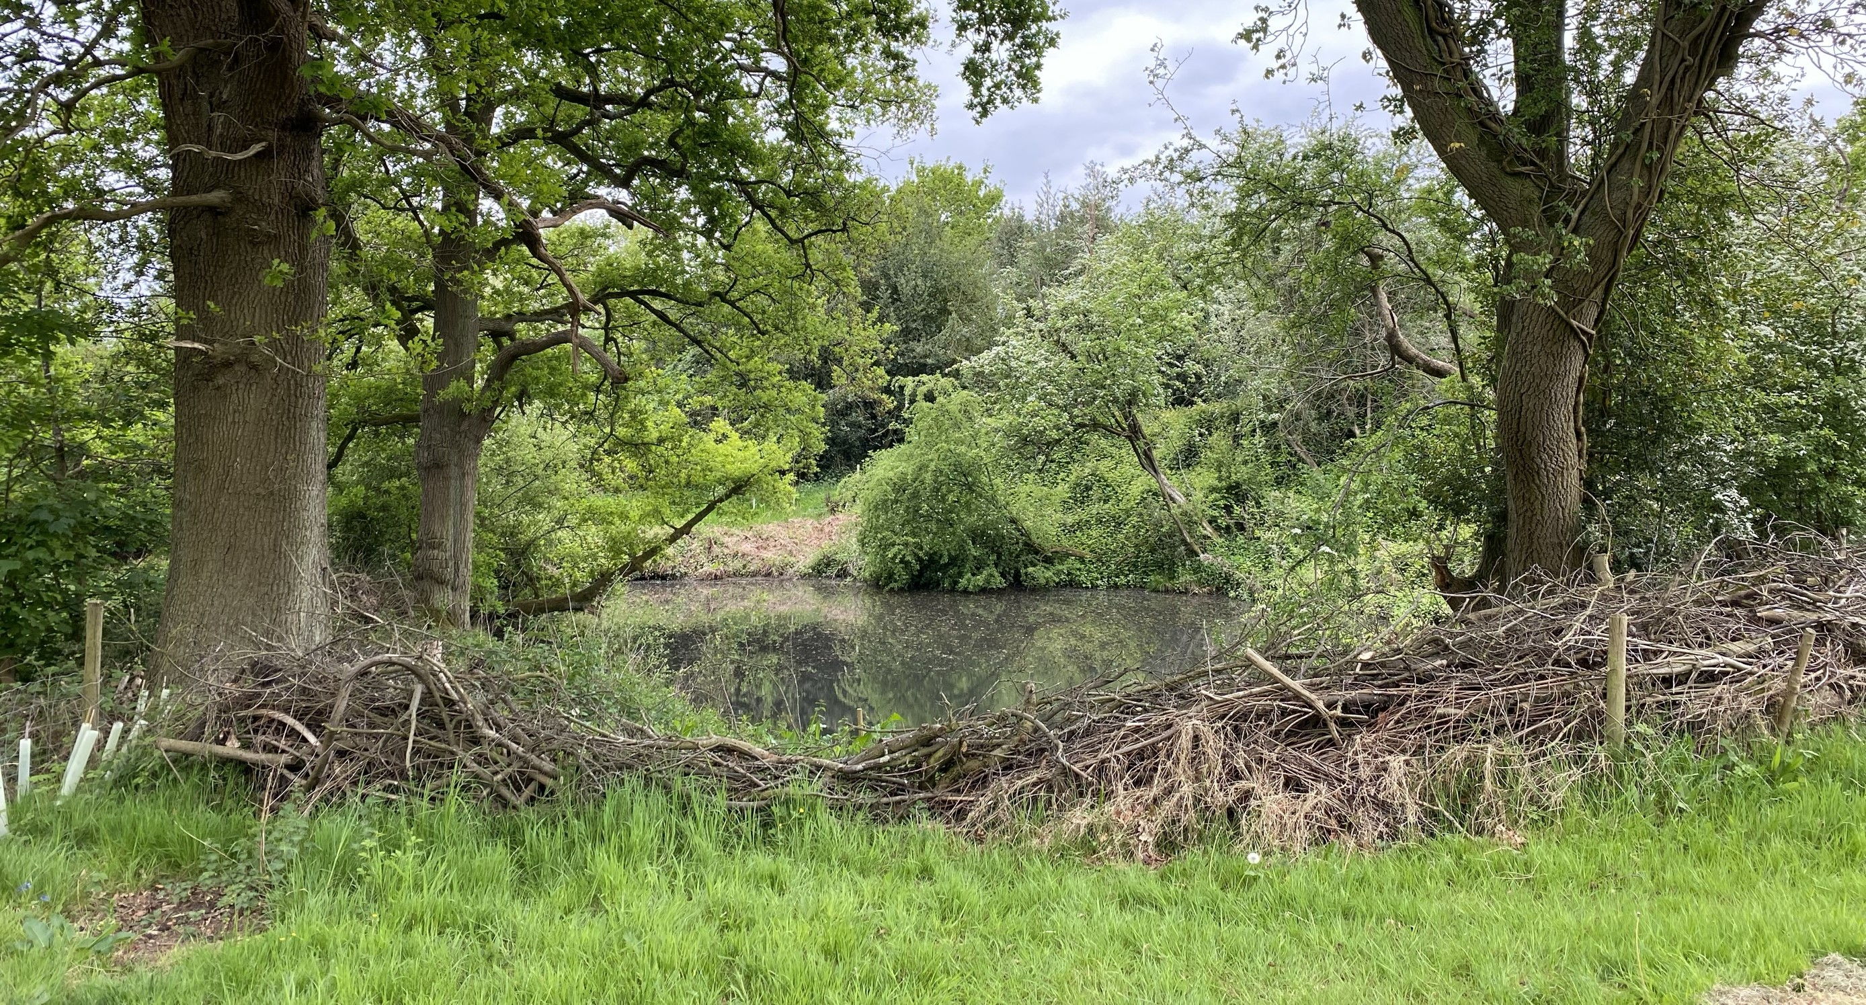
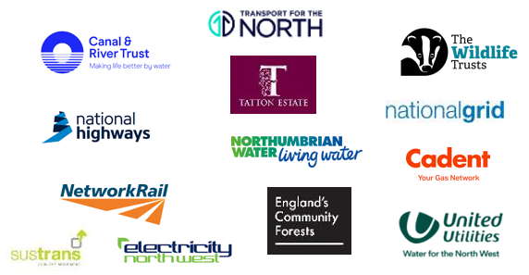

Green Northern Connections
Partnership Building to drive integrated approaches
“Greener major infrastructure developments like transport and energy that (more than) mitigate their impacts, build in climate change resilience, and which provide opportunities for improved nature connectivity and public benefit at landscape scale”
Notes:
We are working together with linear infrastructure authorities to restore degraded, or create new, habitat. This pan northern co-ordinated approach can improve ecological connectivity and biodiversity whilst also contributing to net zero targets and increasing infrastructure climate resilience.
Build a northern project opportunity list…spatial analysis, data sharing, setting project parameters, funding pilot projects
Co-ordinate activity to create a more joined up approach across our region
Secure better outcomes for biodiversity and ecological connectivity
Contribute to organisational targets on net zero
Increase network resilience
Advocating for this approach with policy- and decision-makers

Slide 11
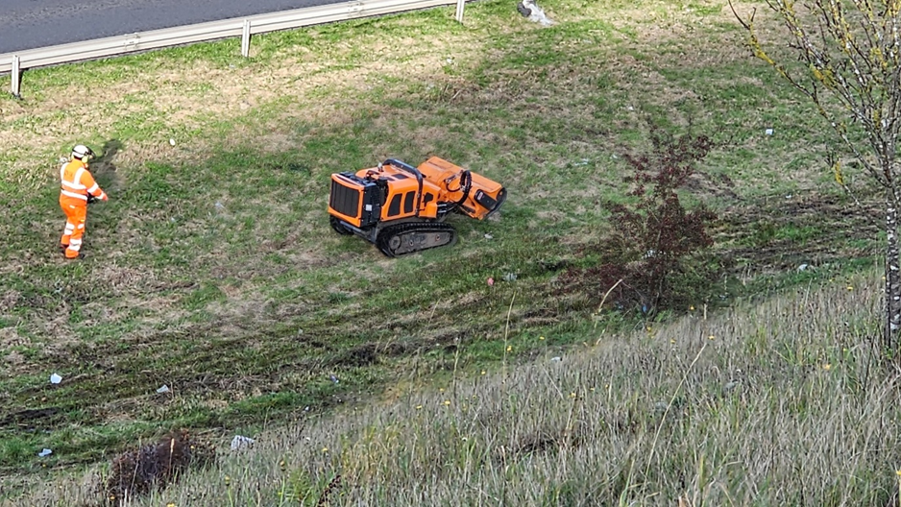
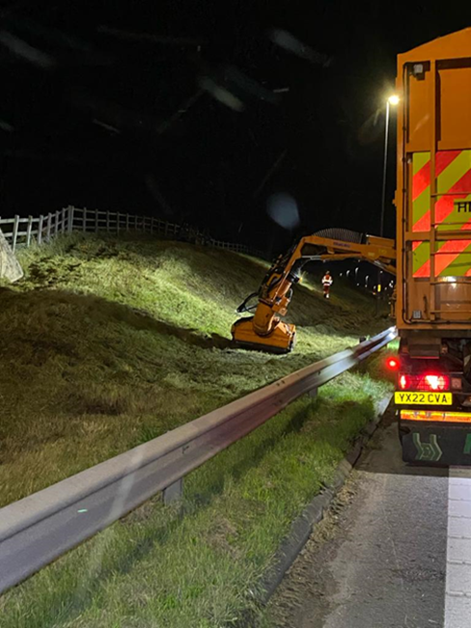
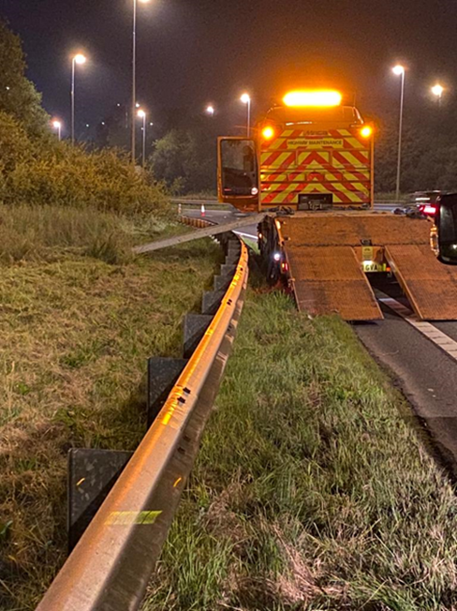
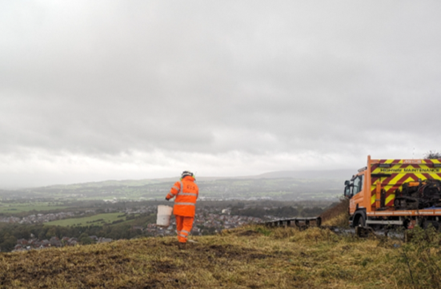
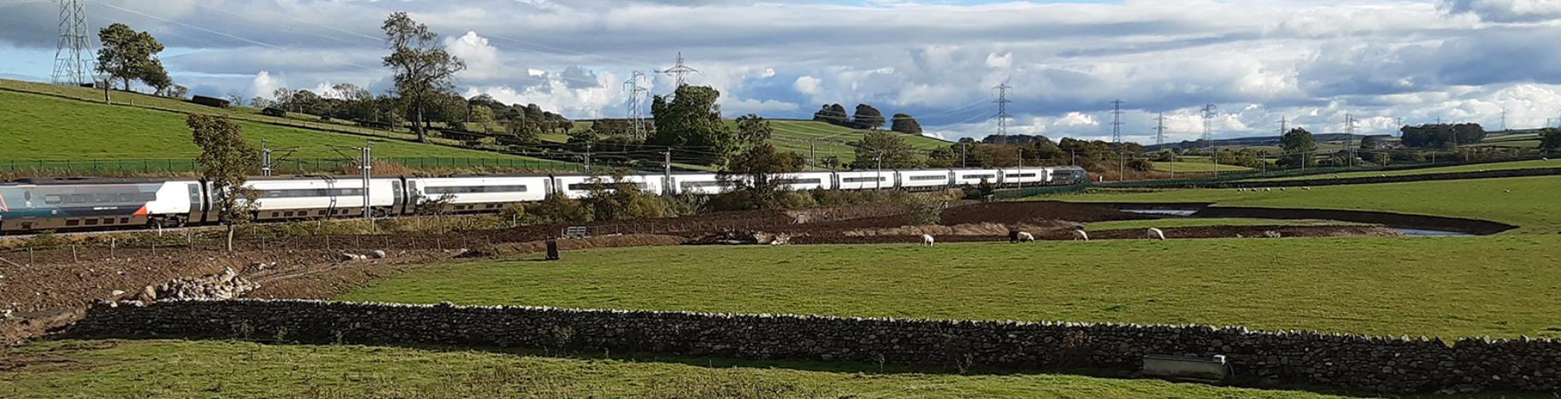
Green Northern Connections
Critical infrastructure operators across the North have already made commitments towards mitigating climate change and improving biodiversity on land that they own - and through operations and services - as part of the UK’s national and global commitments.
We know we can use nature to de-risk our road, rail, energy and water services, boost resilience to disruption and avoid costs linked to a changing climate and environmental risk (e.g. flooding, drought, pollution).
Habitat recovery also provides the opportunity to mitigate the impacts of infrastructure build and operation.
If properly planned and coordinated, we can do all this in a way that enables greater ecological connectivity: enabling species to move around the region as easily as people can!

Slide 12
Green Northern Connections
Partnership Building to drive integrated approaches
Reduce risk/s to infrastructure through Nature based Solutions
Maximise positive impact on biodiversity
Enabling collaborative work and sharing of best practice
Seed fund project development across the North
Remove or address barriers to ecological connectivity
Co-ordinate activity to create an integrated approach
Designing scheme to make offsetting / improving biodiversity on adjacent land easier
Advocating for this approach with policy- and decision-makers
“Greener major infrastructure developments like transport and energy that (more than) mitigate their impacts, build in climate change resilience, and which provide opportunities for improved nature connectivity and public benefit at landscape scale”
Notes:
We are working together with linear infrastructure authorities to restore degraded, or create new, habitat. This pan northern co-ordinated approach can improve ecological connectivity and biodiversity whilst also contributing to net zero targets and increasing infrastructure climate resilience.
Build a northern project opportunity list…spatial analysis, data sharing, setting project parameters, funding pilot projects
Co-ordinate activity to create a more joined up approach across our region
Secure better outcomes for biodiversity and ecological connectivity
Contribute to organisational targets on net zero
Increase network resilience
Advocating for this approach with policy- and decision-makers

Slide 13
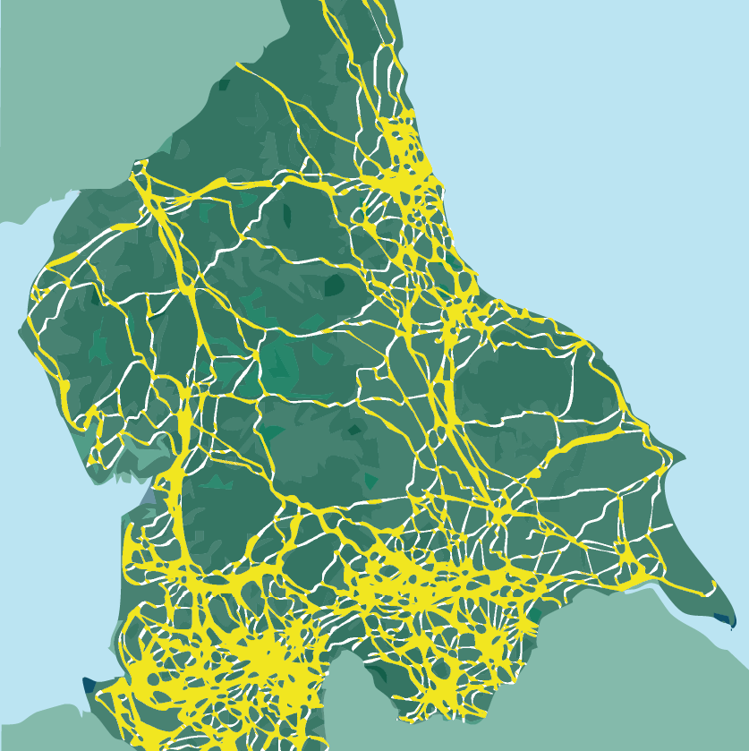
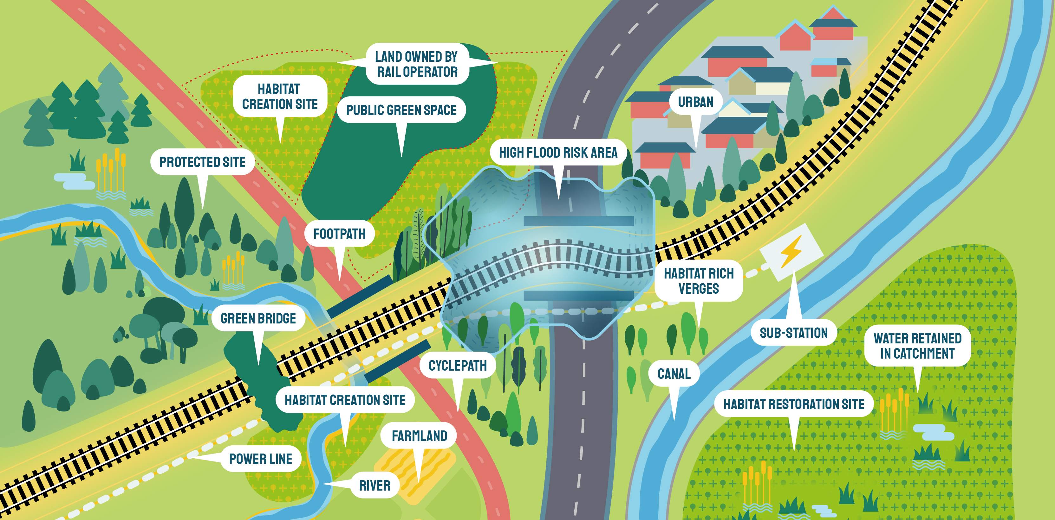
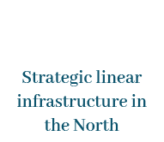
Green Northern Connections concept
Notes:
Green Northern Connections is a pioneering Northern collaboration for nature recovery and infrastructure resilience, hosted by Nature North. Northern infrastructure providers – including rail, highways, energy and water companies – are investing in nature recovery to ensure their assets are resilient to climate change, and to meet net zero and biodiversity targets. Through Green Northern Connections they are building new working relationships, sharing priorities, knowledge and data, finding opportunities to coordinate activity and developing a more strategic and integrated approach to nature recovery on and around their estates across the North.

Slide 14
Why are infrastructure organisations working with us?
Help meet – and target – biodiversity commitments for maximum impact | Reductions in pollution and impact | Increased resilience and reduced risk to the network
CSR and above statutory commitments | Noise and light | Natural flood management | Good news stories
Insetting BNG | Air and CO2 | Increased tolerance to heat and drought (nature cools and dampens) | Enabling collaborative work and sharing of best practice
Offsetting BNG (5000ha needed across the North) | Water | Creative practical solutions, e.g. trackside ponds for signals | Escrow compliance for offsite works
Sales of BNG | Nature-based routes to net zero | Coastal and riverine erosion | Bring in funding to tip cost benefit analysis in favour of green not grey solutions
Management of existing mitigation sites |  |  | Management advice e.g. grass cuttings
Notes:
We are working together with linear infrastructure authorities to restore degraded, or create new, habitat. This pan northern co-ordinated approach can improve ecological connectivity and biodiversity whilst also contributing to net zero targets and increasing infrastructure climate resilience.
Build a northern project opportunity list…spatial analysis, data sharing, setting project parameters, funding pilot projects
Co-ordinate activity to create a more joined up approach across our region
Secure better outcomes for biodiversity and ecological connectivity
Contribute to organisational targets on net zero
Increase network resilience

Slide 15
Mapping opportunities to improve ecological connectivity and network resilience
Mapped areas of Northern England where habitats are the most fragmented – and with high densities of linear infrastructure
(i.e. where infrastructure assets and verges could have the biggest impact on creating nature networks (“the natural grid”).
Blue = wetland, Green = grassland, Purple=heathland
Also mapped areas of poorest infrastructure resilience to assess opportunities where restoring nature could protect assets (see next slide).

Slide 16
Historic flooding within area (blue)
Network rail flooding incident (red dot)
Red = National Highways
Green = Network Rail
National Grid = Blue
Orange = Sustrans
Black = Canals and Rivers Trust

Slide 17
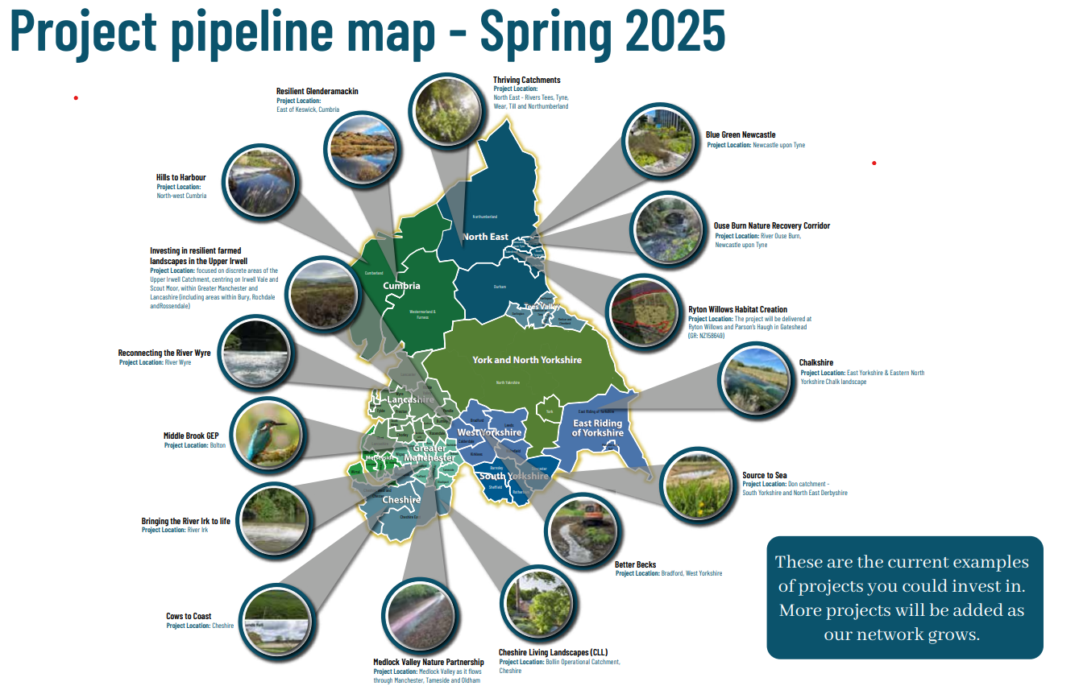
Working with local Wildlife Trusts to identify a pipeline of potential projects on or adjacent to infrastructure land
Example from the
Rivers Nature North Prospectus
The project pipeline will help infrastructure providers to more easily prioritise biodiversity and BNG projects.
We aim to bring in additional funding to swing resilience projects in favour of nature based solutions or encourage NbS in addition to traditional engineered solutions, e.g. to reduce erosion risk or flooding.

Slide 18
THANK YOU
We’d love to hear from you if…
You have exciting nature-based projects that you feel we should hear about
You have a need for BNG, mitigation or other ideas for collaborative work
You want to know how nature could help the resilience of your asset or network
You want to know how you can ensure your work has maximum positive impact for nature connectivity
Additional information here
info@naturenorth.org.uk www.naturenorth.org.uk

