Slide 1
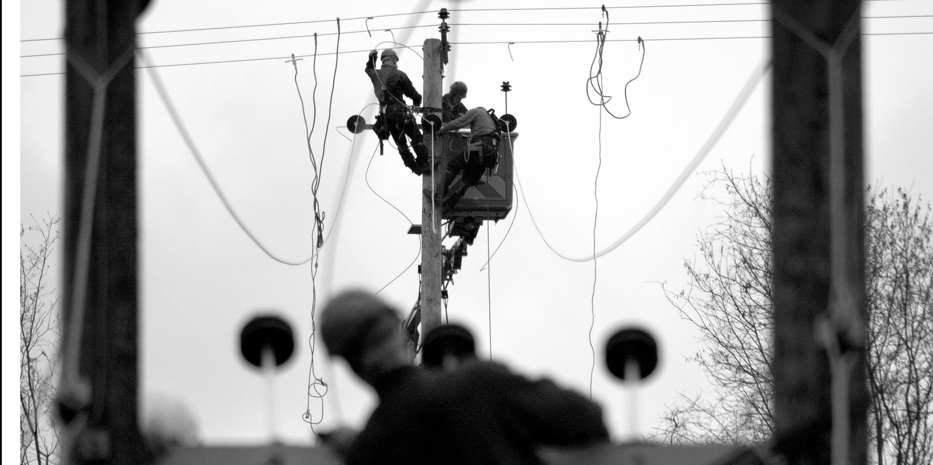
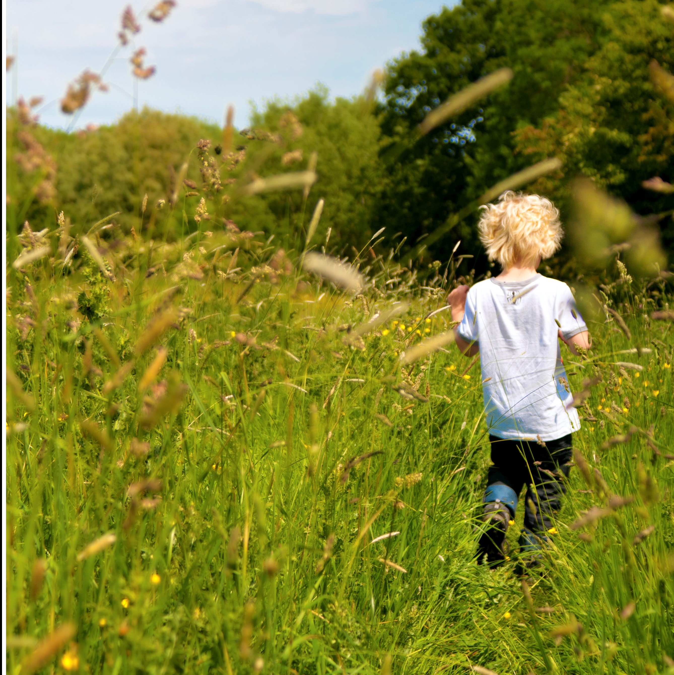

Andy Martyr-Icke
01
Lead Environment Advisor
National Grid Electricity Distribution
Notes:
Points from KM for your talk:
Unlike when protected species are involved, welcoming more biodiversity onto substations need not been seen as a constraint and may help with climate adaptation. It’s also going to be there for NGED staff to enjoy!
Disturbance is a really important ecological process – it’s how nature renews itself and creates diversity. Getting the right amount can be tricky though.
We took over from our natural large animal disturbance creators five thousand years ago and also took away their regulating predators – which is not that long ago if you’re bramble…….

Slide 2

Right thing for us and our environment
Right thing for our business
Right thing for our network

Slide 3
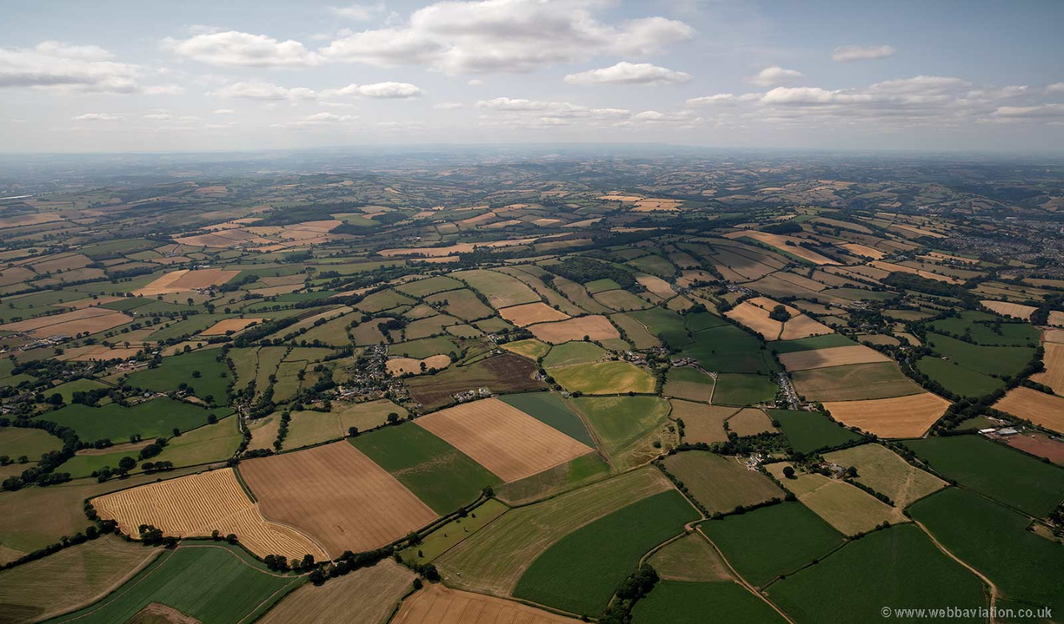

Slide 4
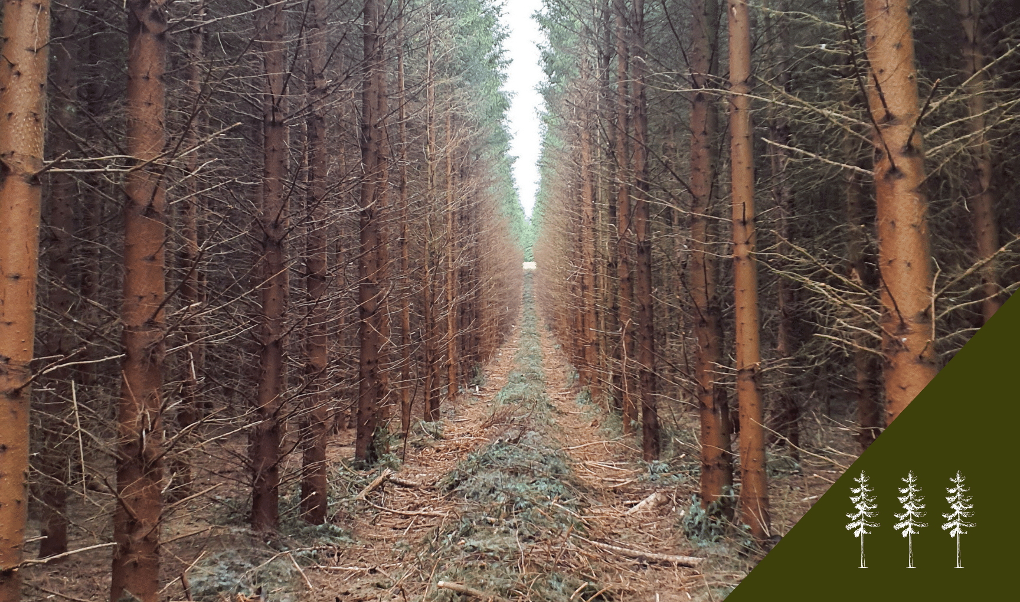

Slide 5
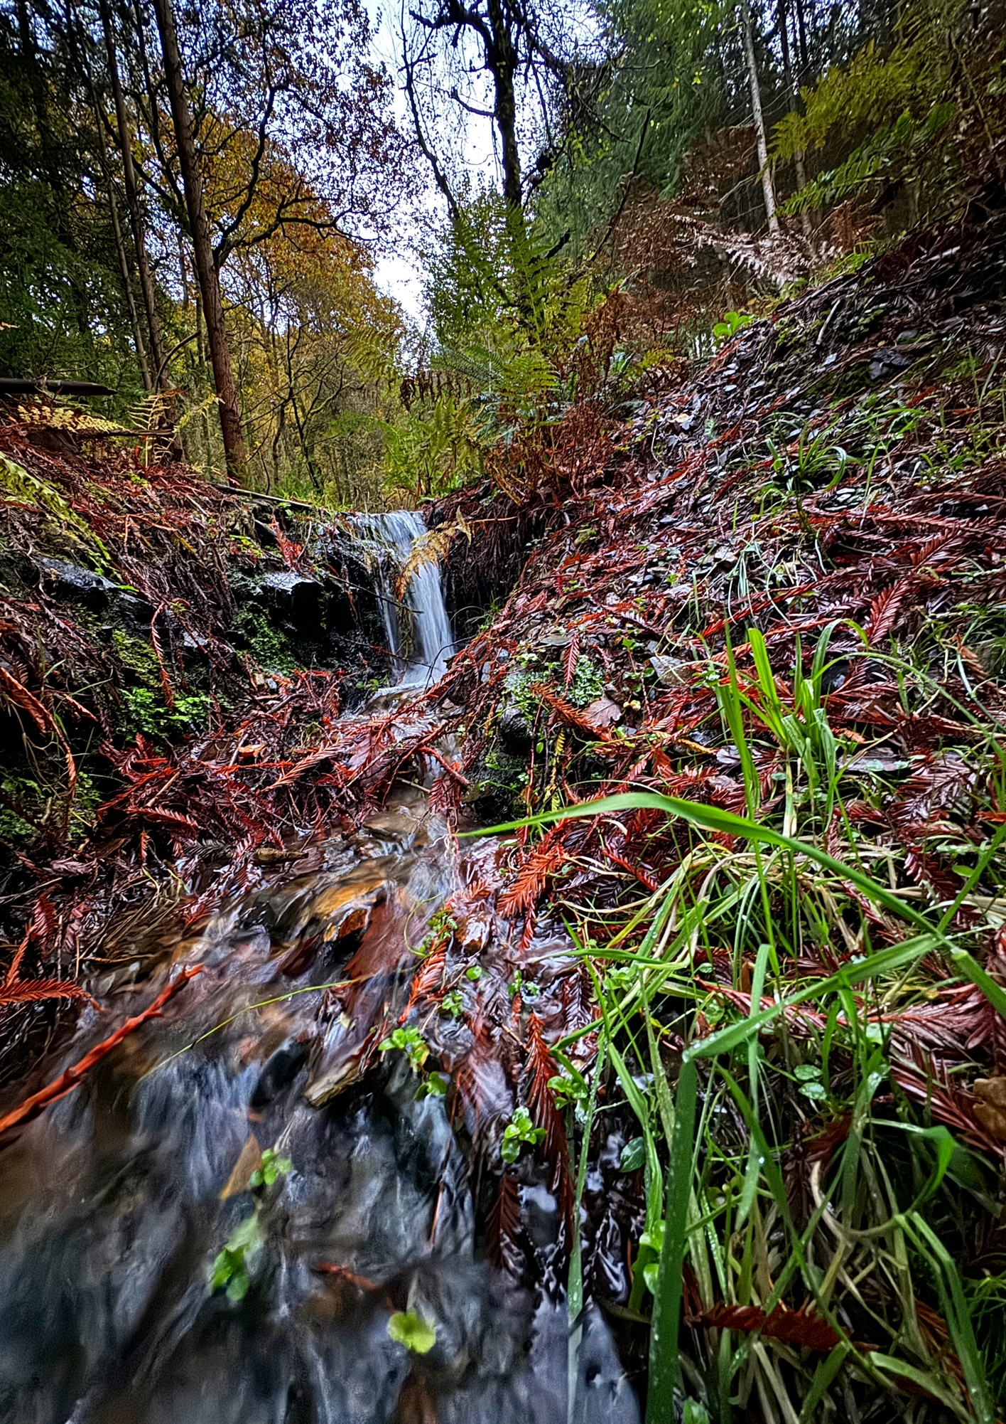
95%

Slide 6
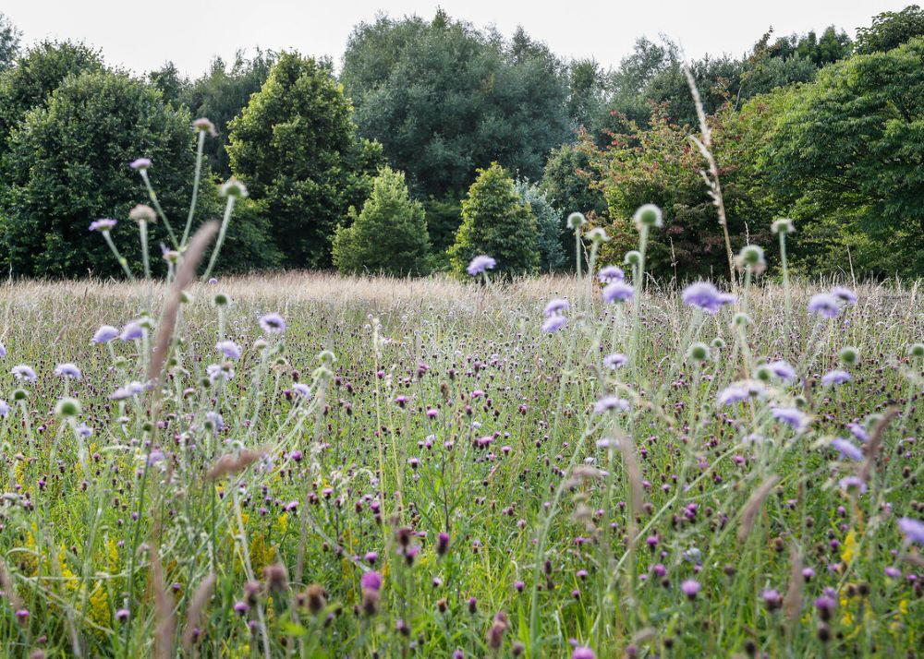
97%

Slide 7
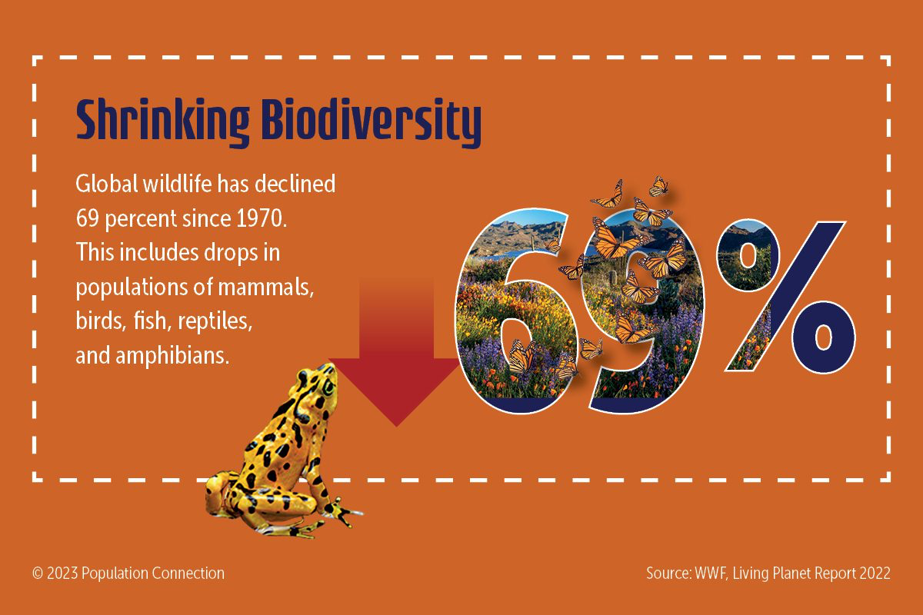

Slide 8
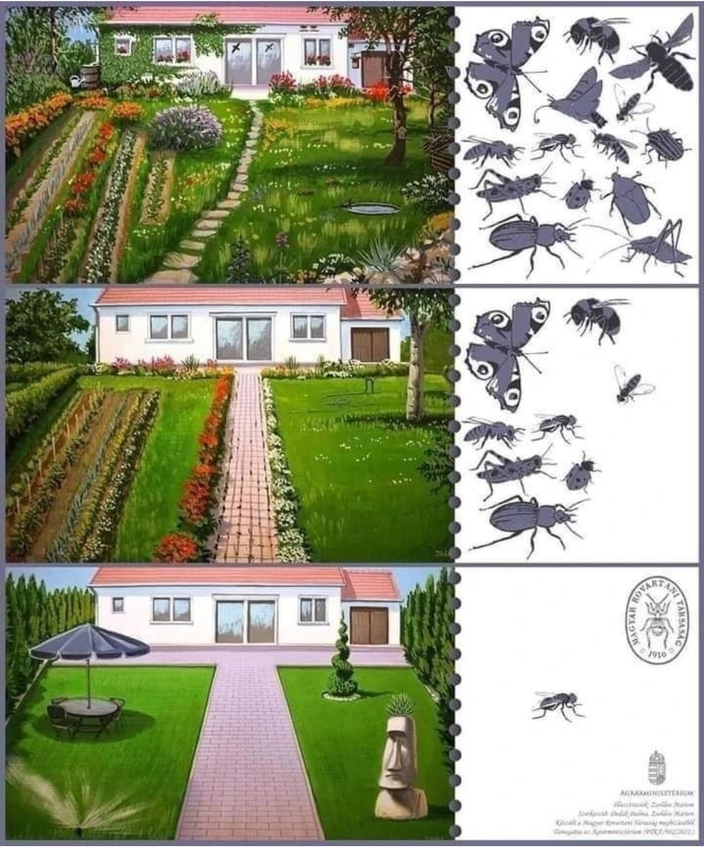
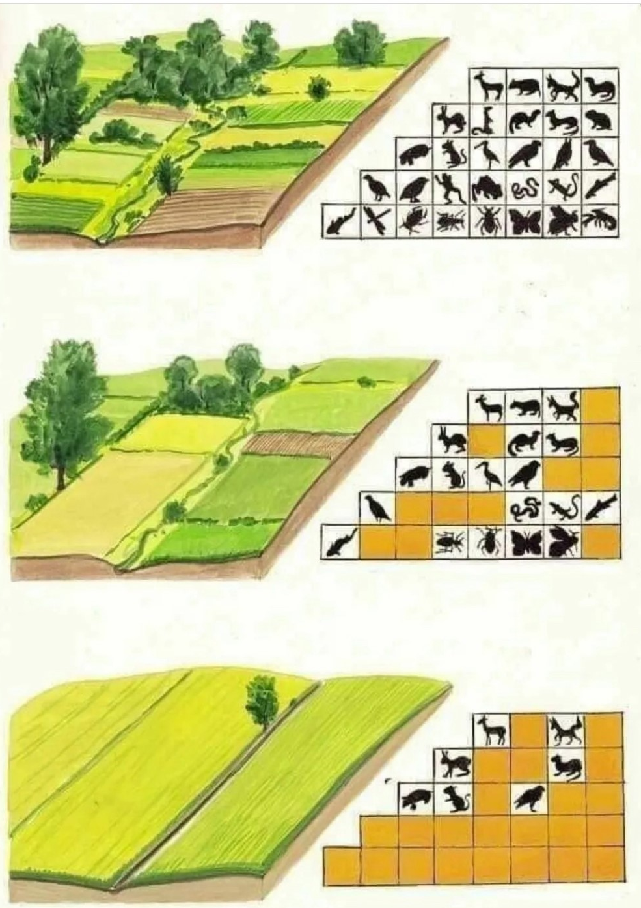

Slide 9
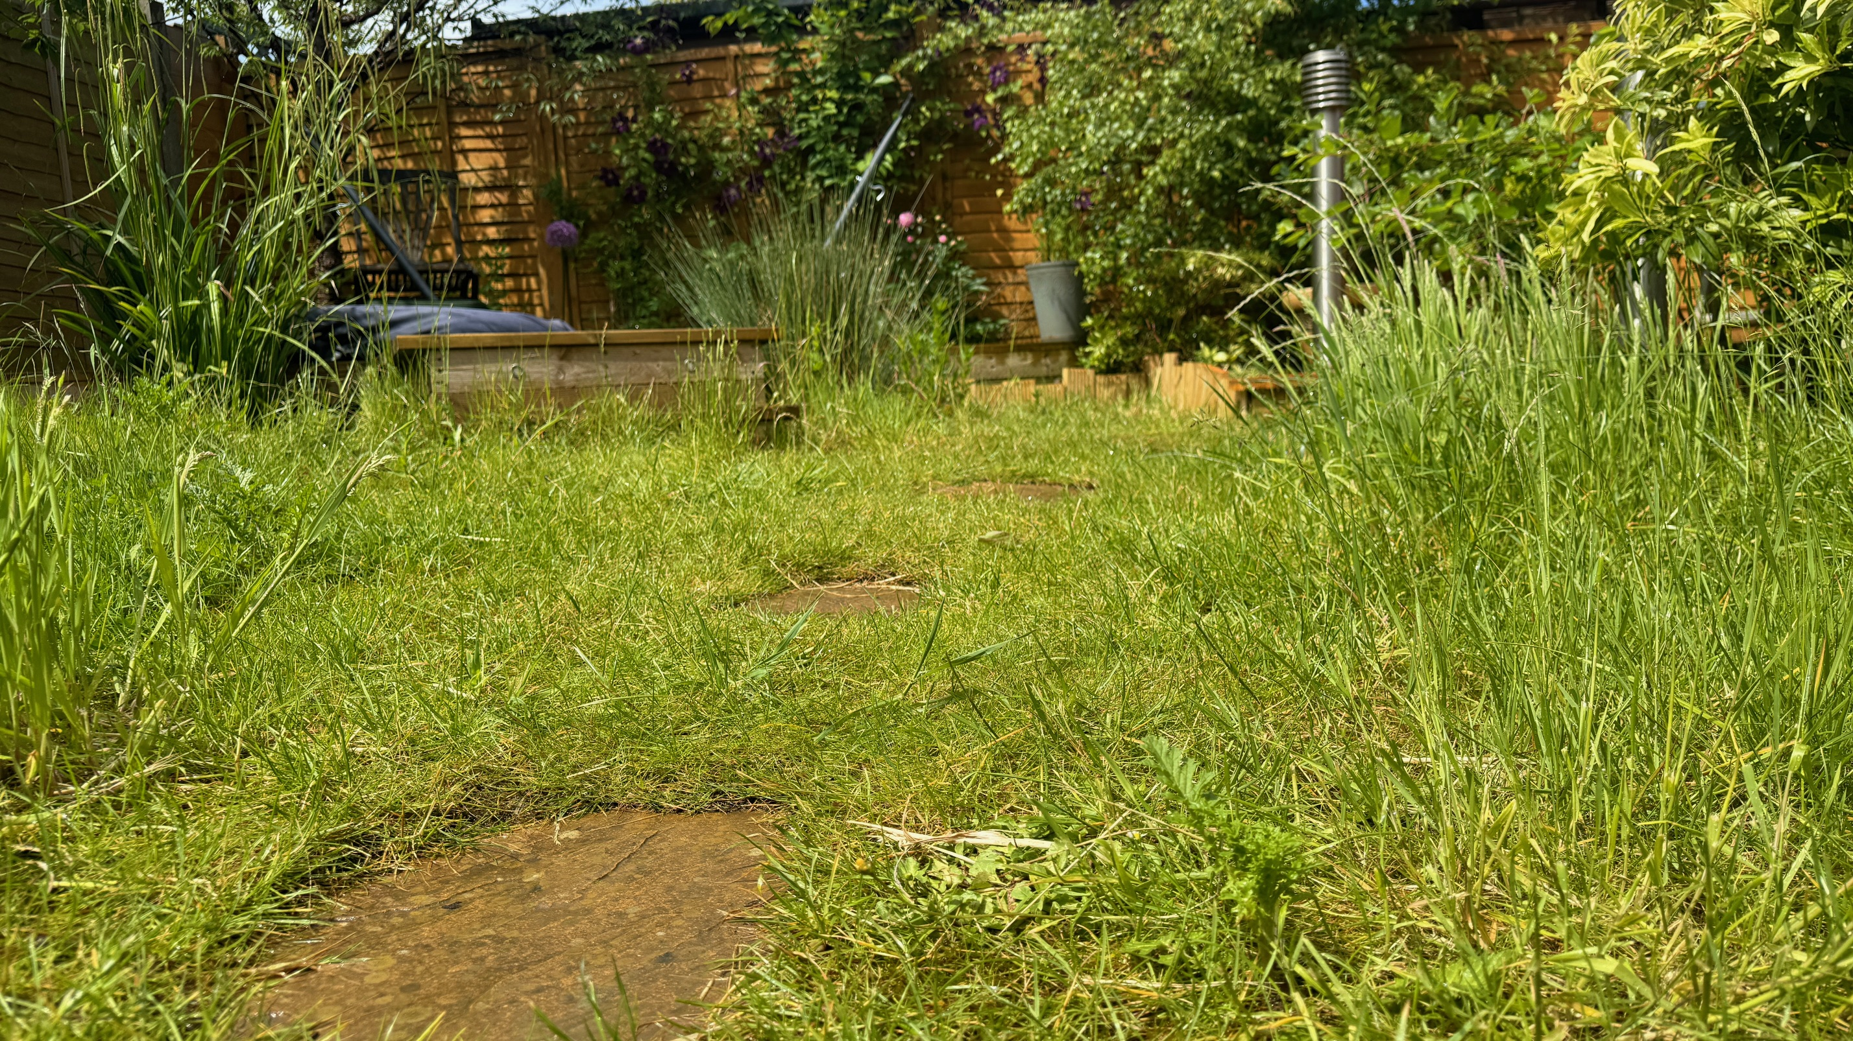

Slide 10
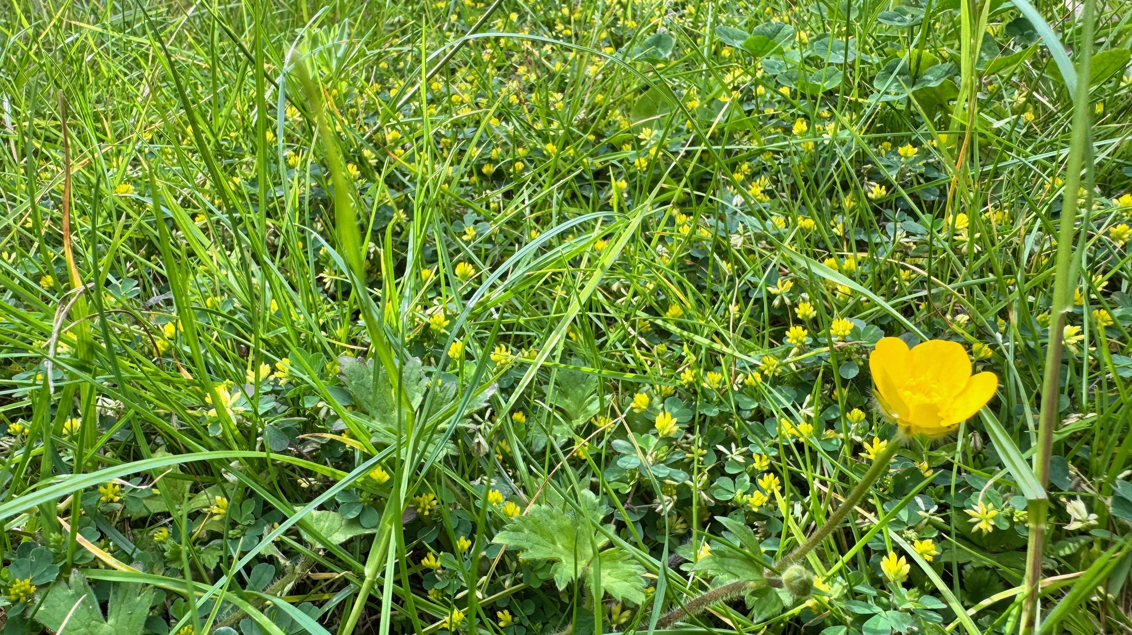

Slide 11
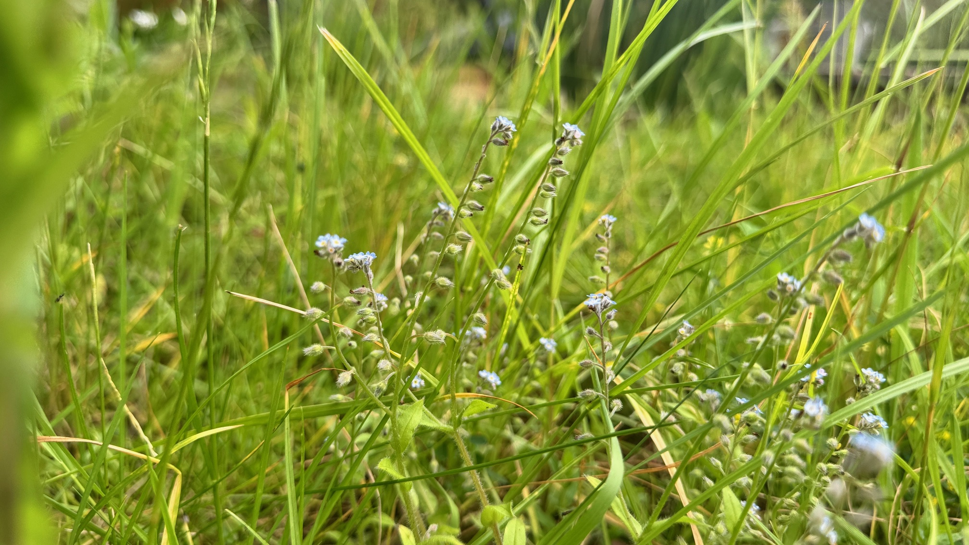

Slide 12
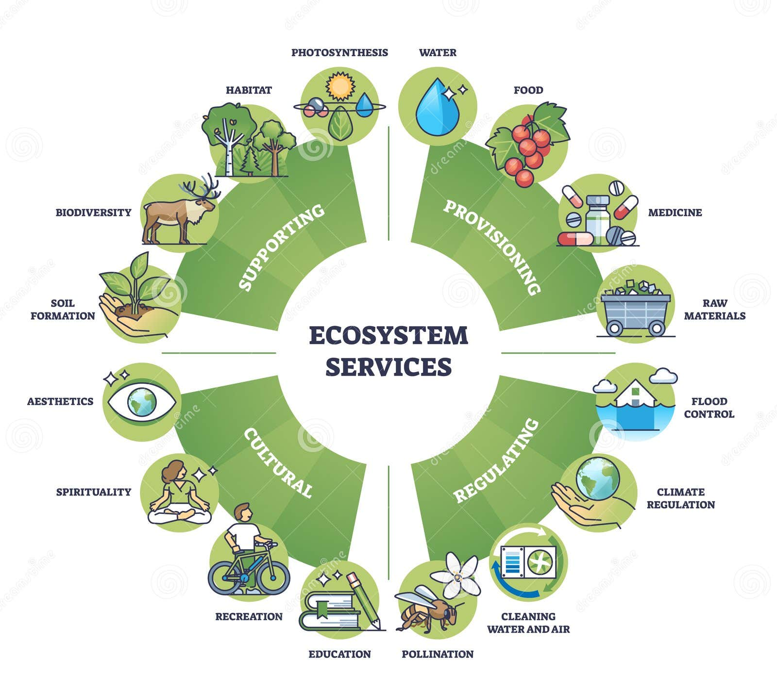

Slide 13
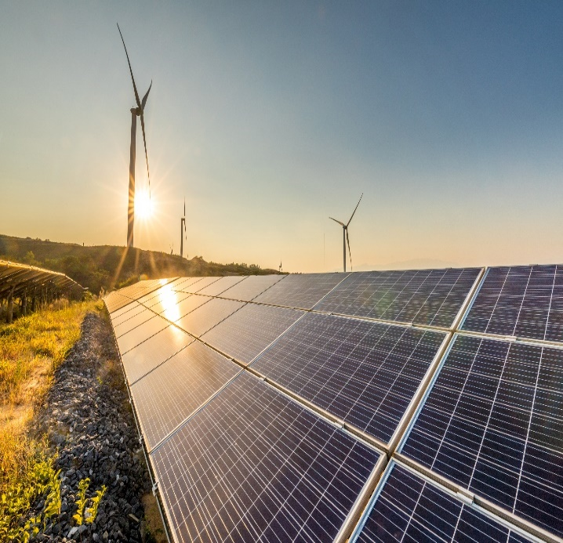
ED2 Environmental Commitments
OPERATIONAL CHANGE
Follow target of 1.5c to limit the climate impact on our activities
Reduce oil leaks by 50% on fluid filled cables and replacing worst leaking circuits
20% reduction in SF6 losses
Zero waste to landfill by 2028 and 30% drop in tonnage of waste produced
a verified Science Based
FLEET AND BUILDINGS
Replace as much operational fleet with EVs by 2028 as possible
Install EV infrastructure at all sites
Install solar generation at all suitable operational depots to meet demand
Reduce energy use in buildings
Increase use of small scale battery powered generation where appropriate, reducing reliance on diesel generation
a verified Science Based
A NEW LANDSCAPE
Removing at least 50km overhead lines in AONB and National Parks
10% net gain in biodiversity for major new projects and selected primary and grid substations
a verified Science Based
CONTINUAL INNOVATION
Using innovation to improve processes and show positive carbon impact – bringing £95m efficiencies
Enhance customers’ access to data and tailoring it to their individual needs

Slide 14
ED2 Environmental Commitments
Removing at least 50km overhead lines in AONB and National Parks
10% net gain in biodiversity for major new projects and selected primary and grid substations
a verified Science Based

Slide 15
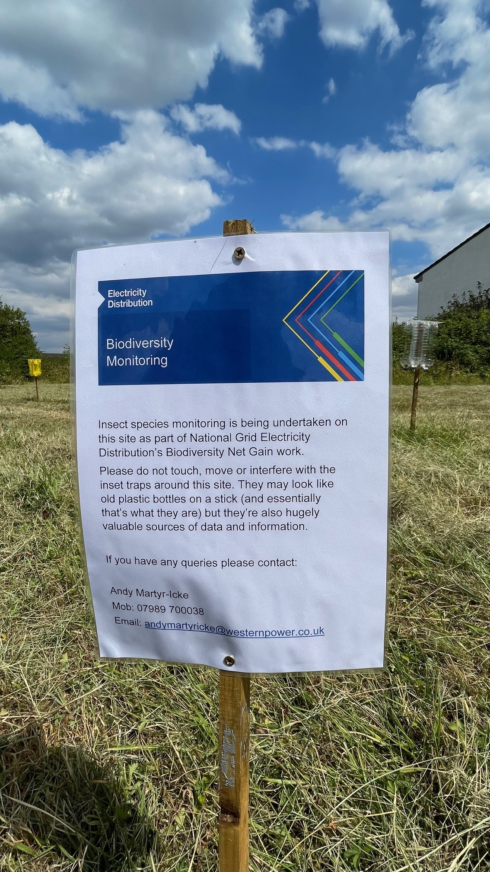
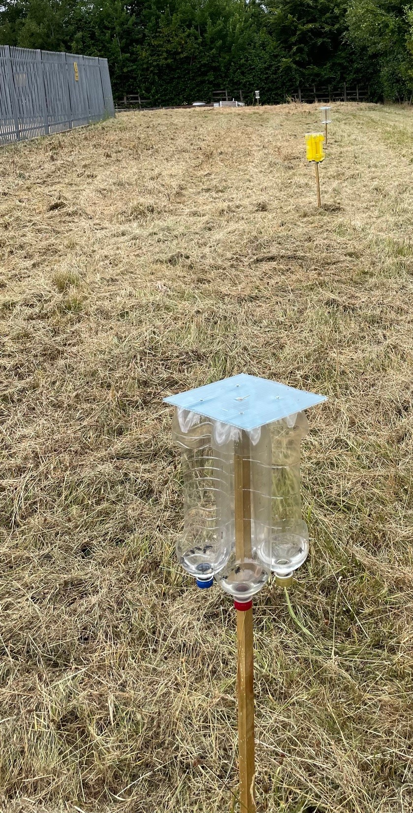
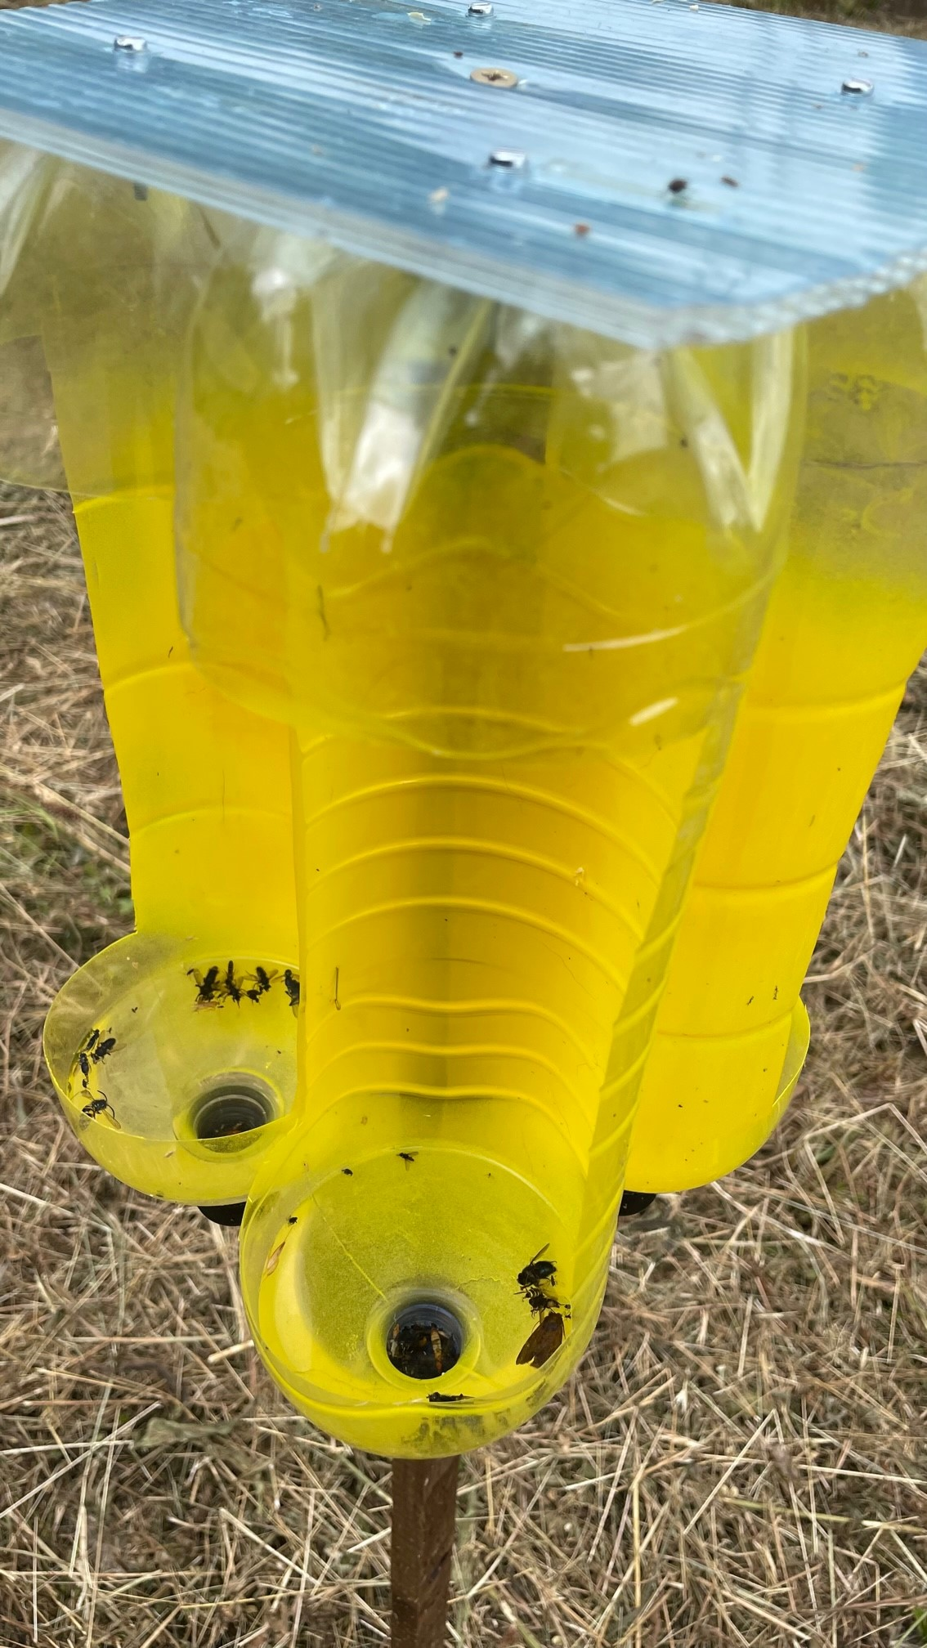

Slide 16
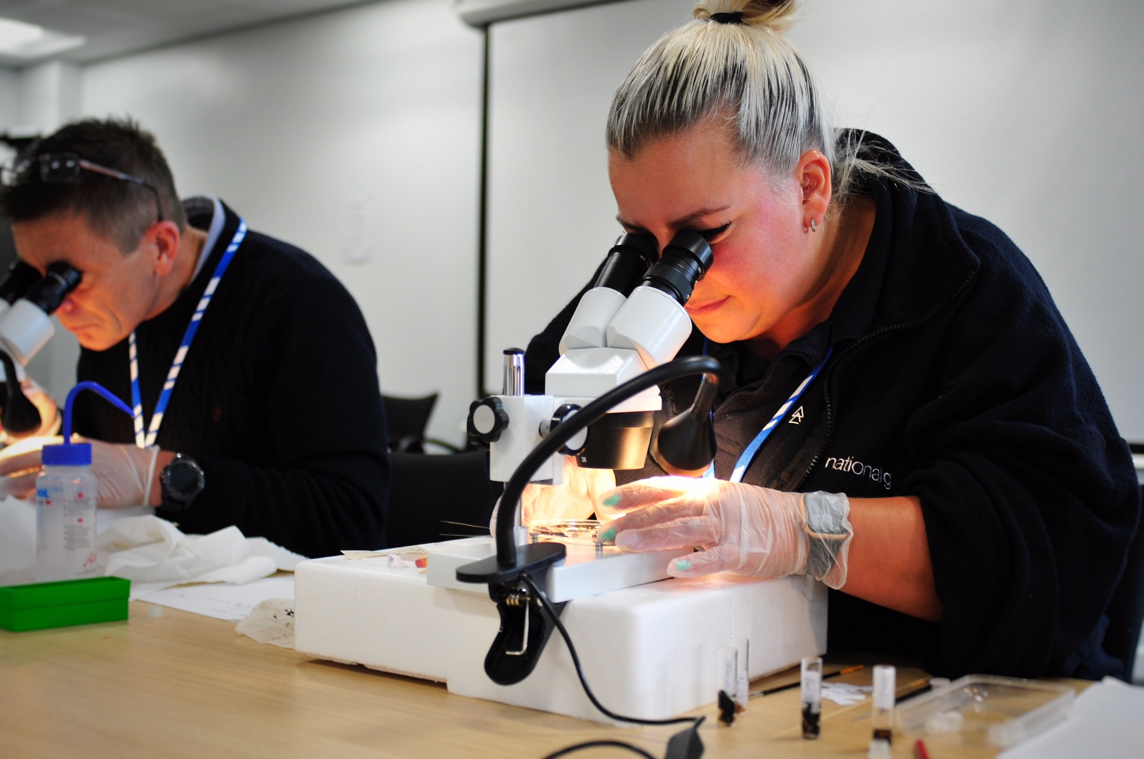
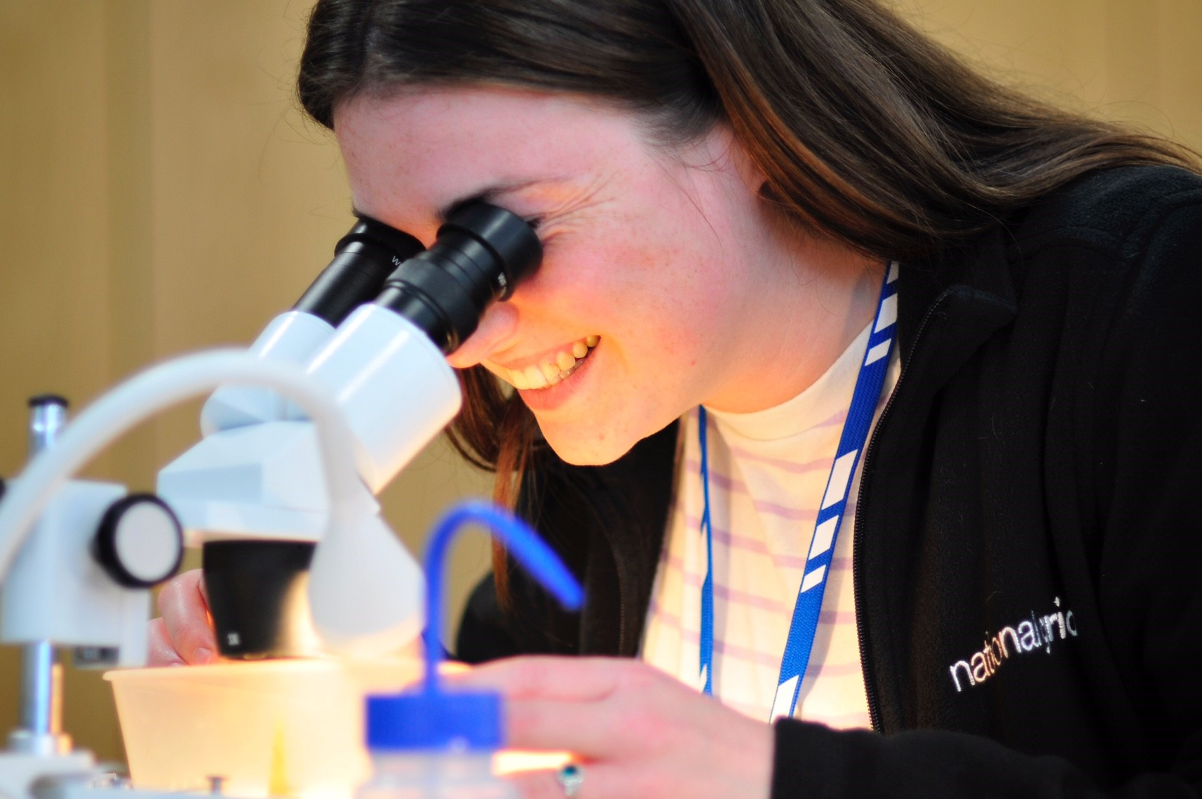

Slide 17
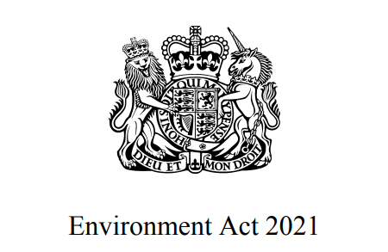

Slide 18
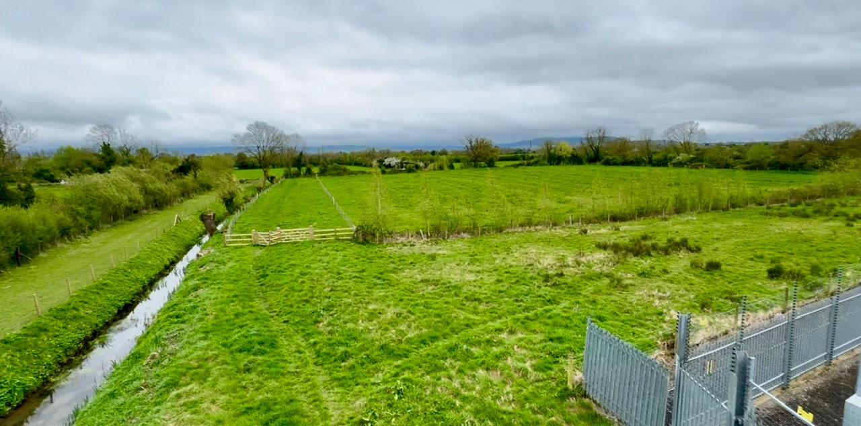

Slide 19
Baseline Results
South West | 175 Units
West Midlands | 20 Units
East Midlands | 151 Units
Value | 346 Units

Slide 20
Post Intervention Results
South West | 175 Units | +160 Unit Uplift | 335 Total
West Midlands | 20 Units | +19 Unit Uplift | 39 Total
East Midlands | 151 Units | +143 Unit Uplift | 294 Total
Value | 346 Units

Slide 21
Post Intervention Results
South West | 175 Units | +160 Unit Uplift | 335 Total
West Midlands | 20 Units | +19 Unit Uplift | 39 Total
East Midlands | 151 Units | +143 Unit Uplift | 294 Total
Value | 346 Units | 322 Unit Uplift | 668 Total

Slide 22
Potential Values
Total gain if project fully implemented | 322 Units
Average current market value for a Unit | £30k-£35k
Potential value of uplift | £9.6M - £11.2M

Slide 23
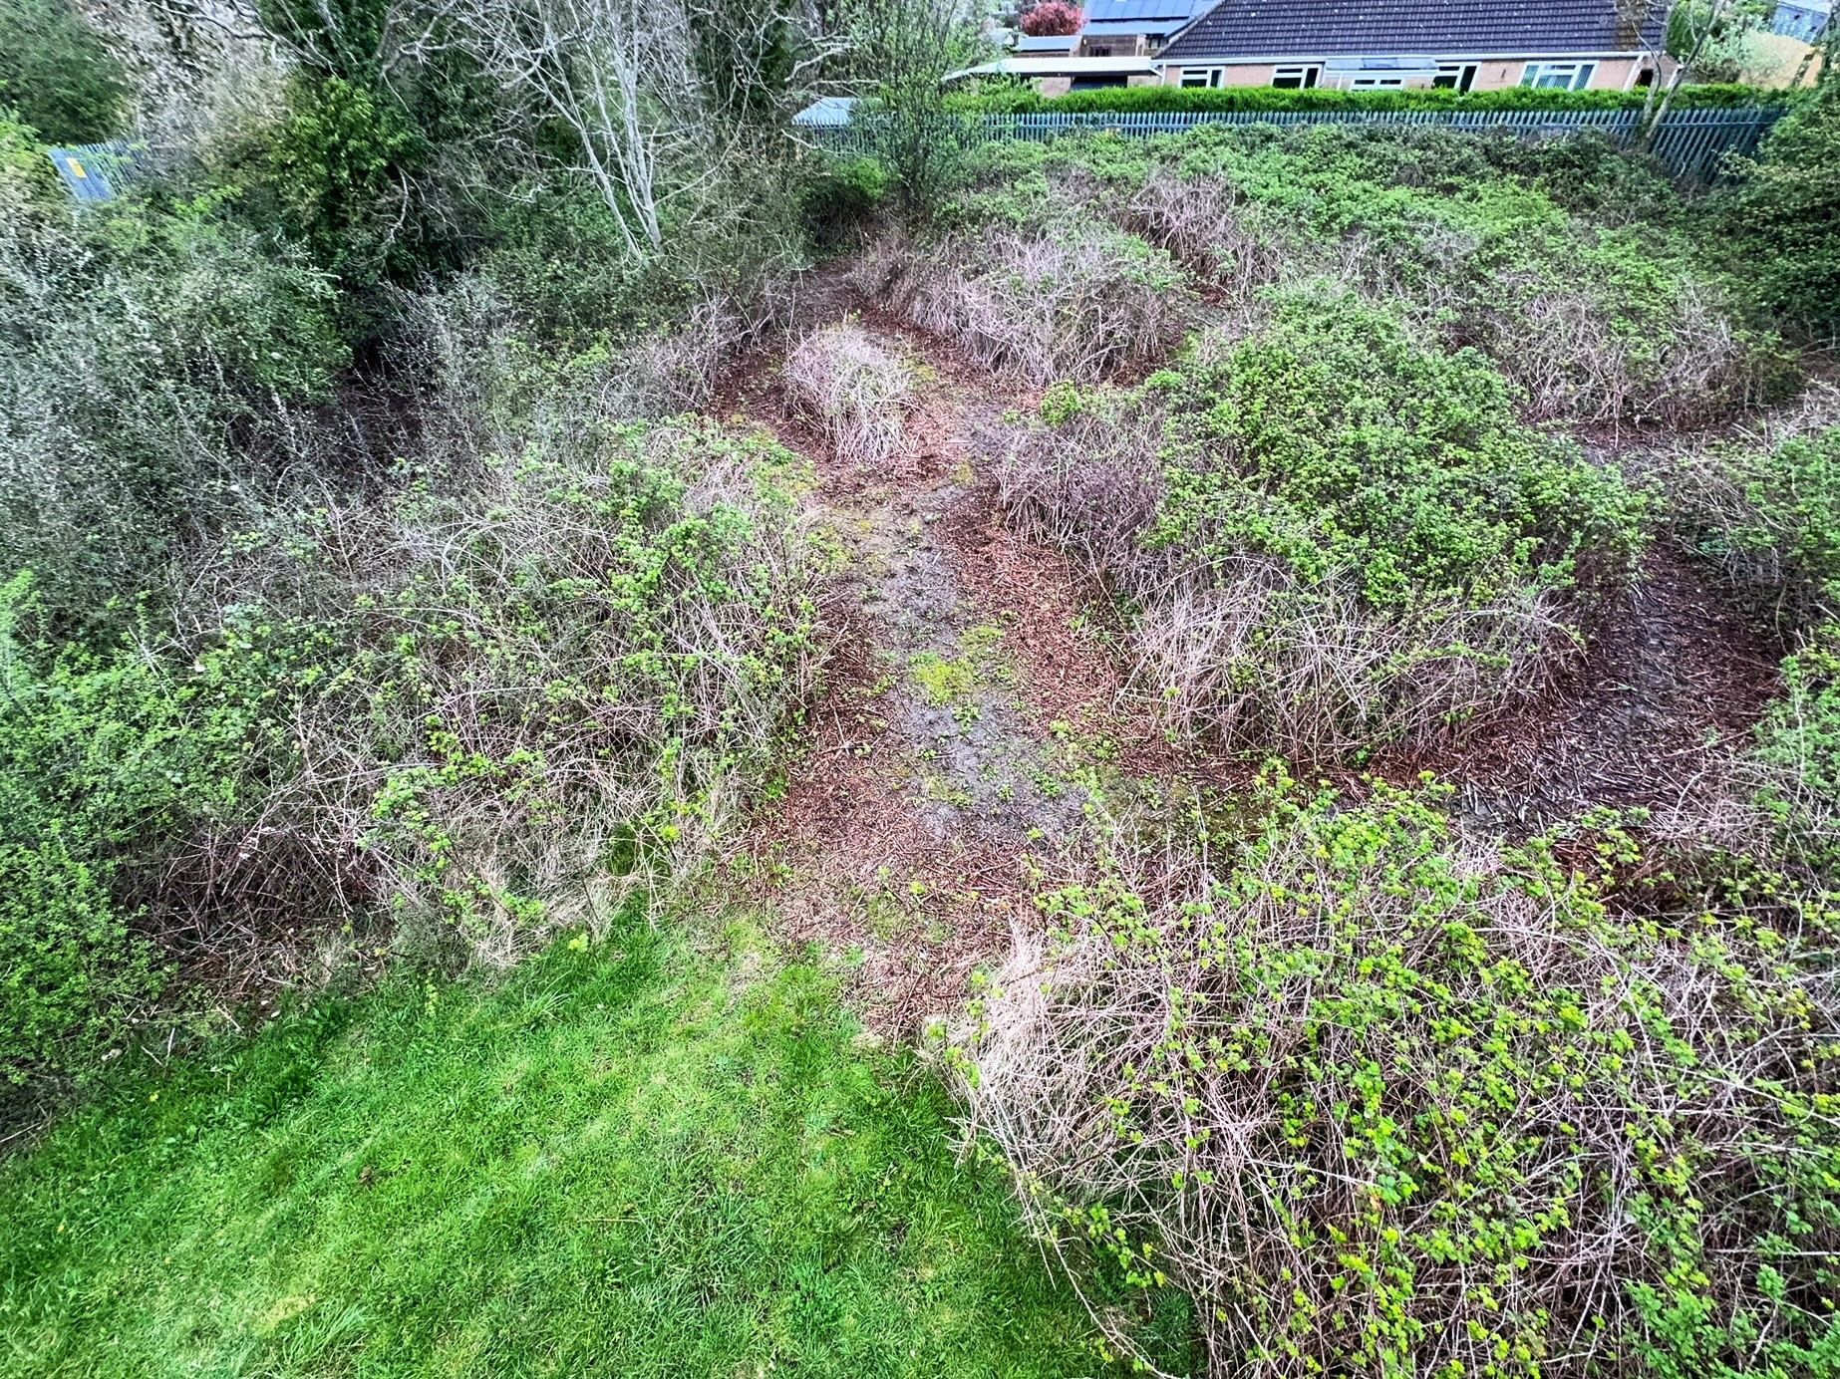

Slide 24
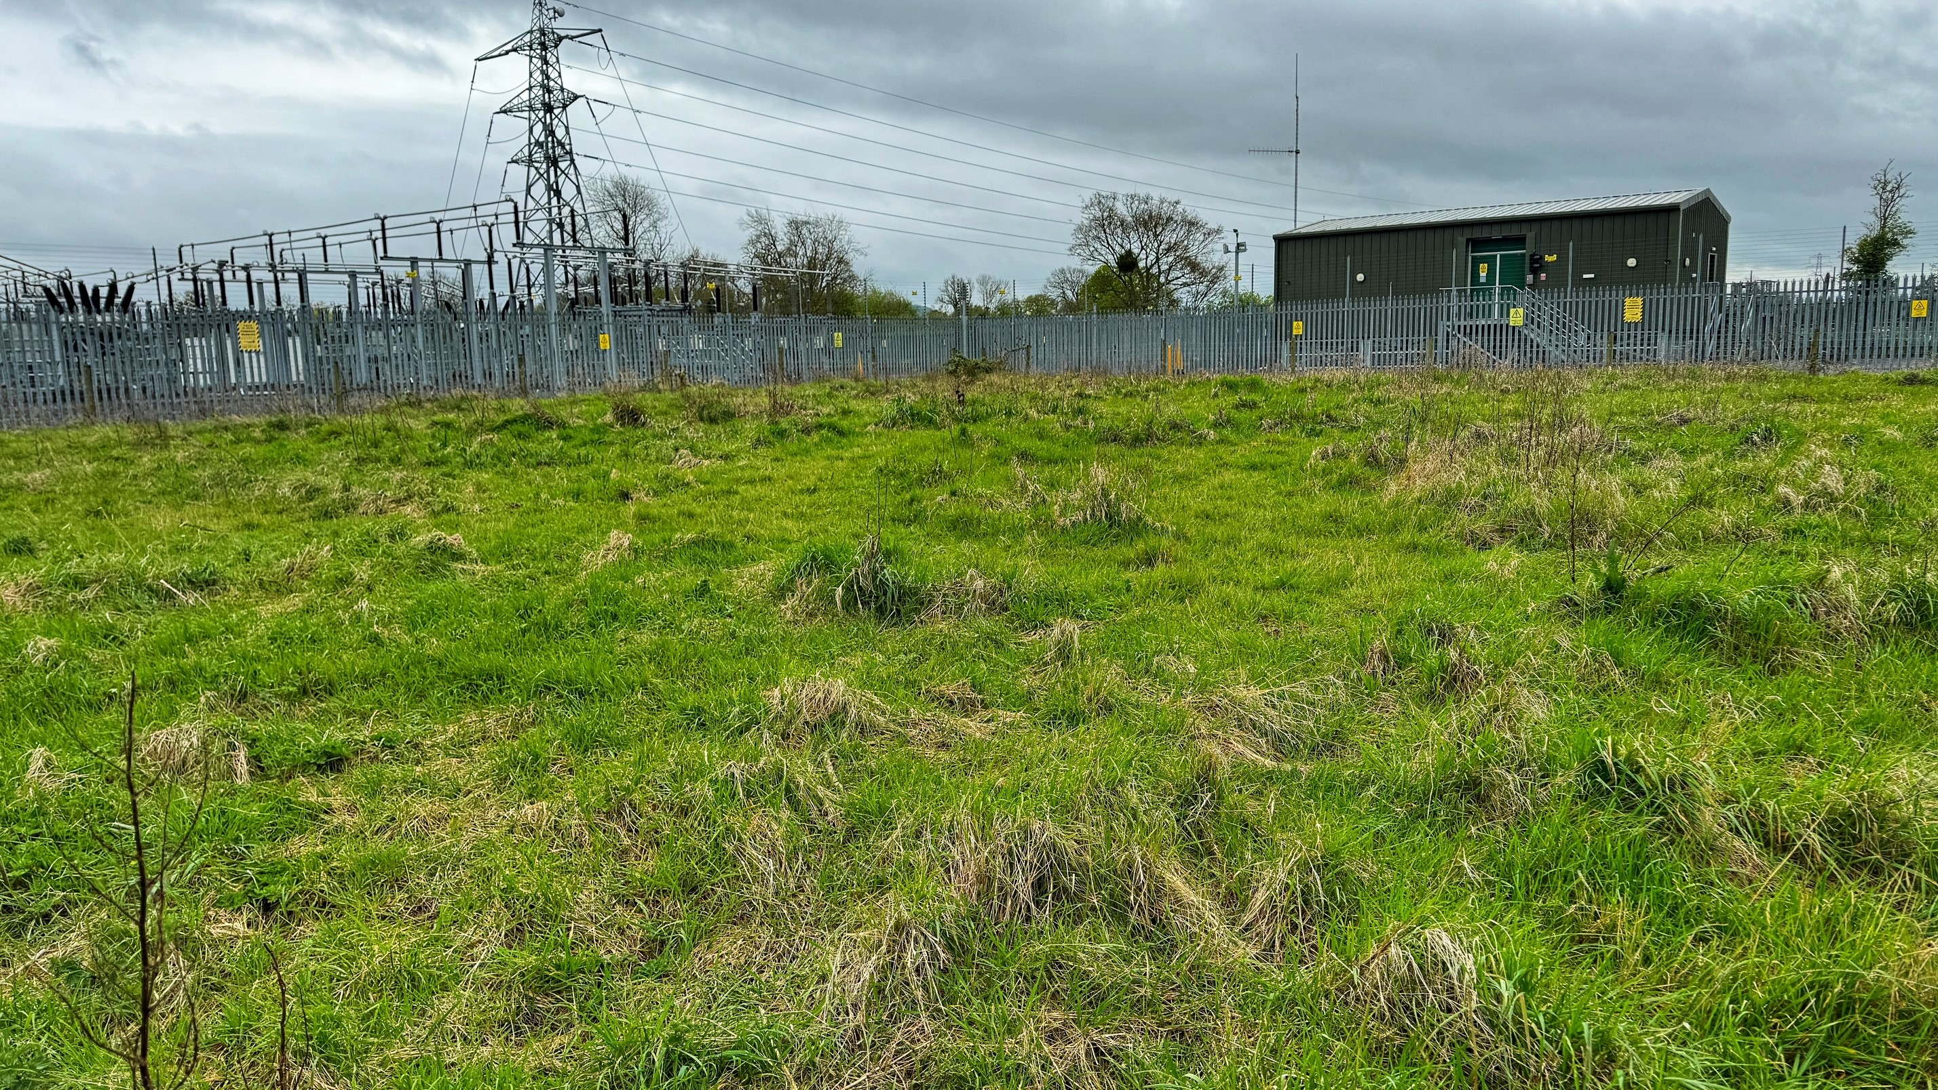

Slide 25
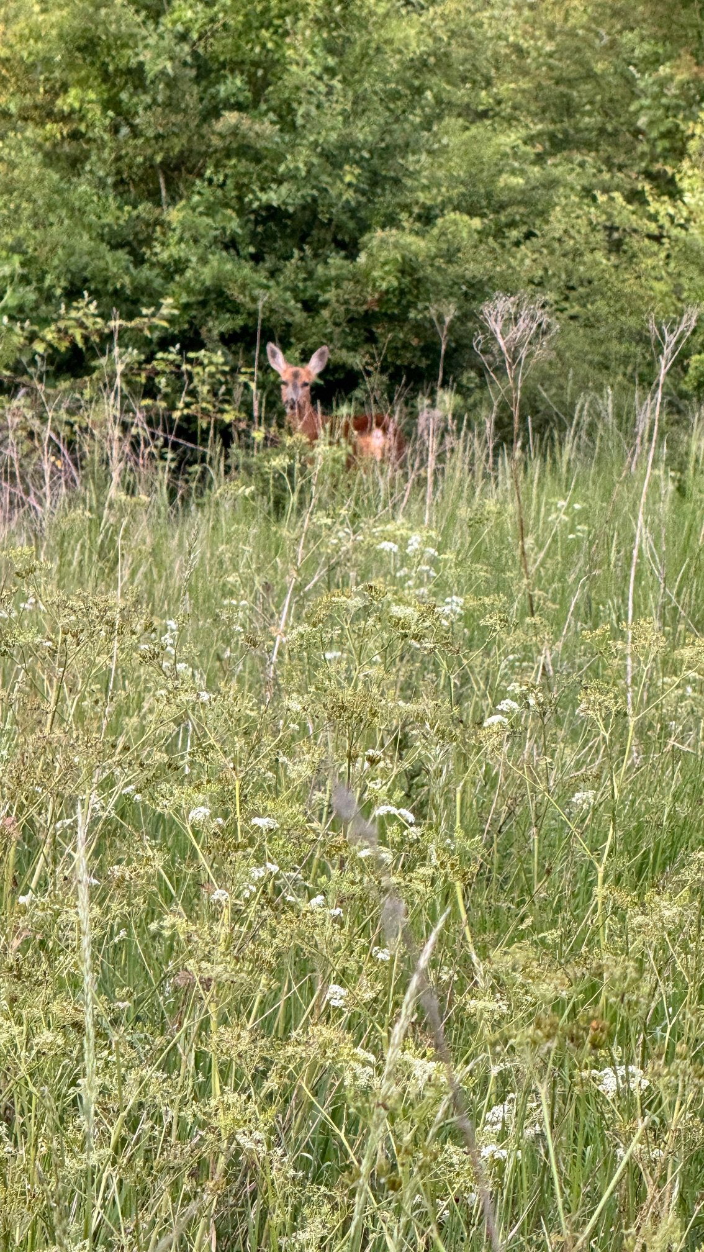
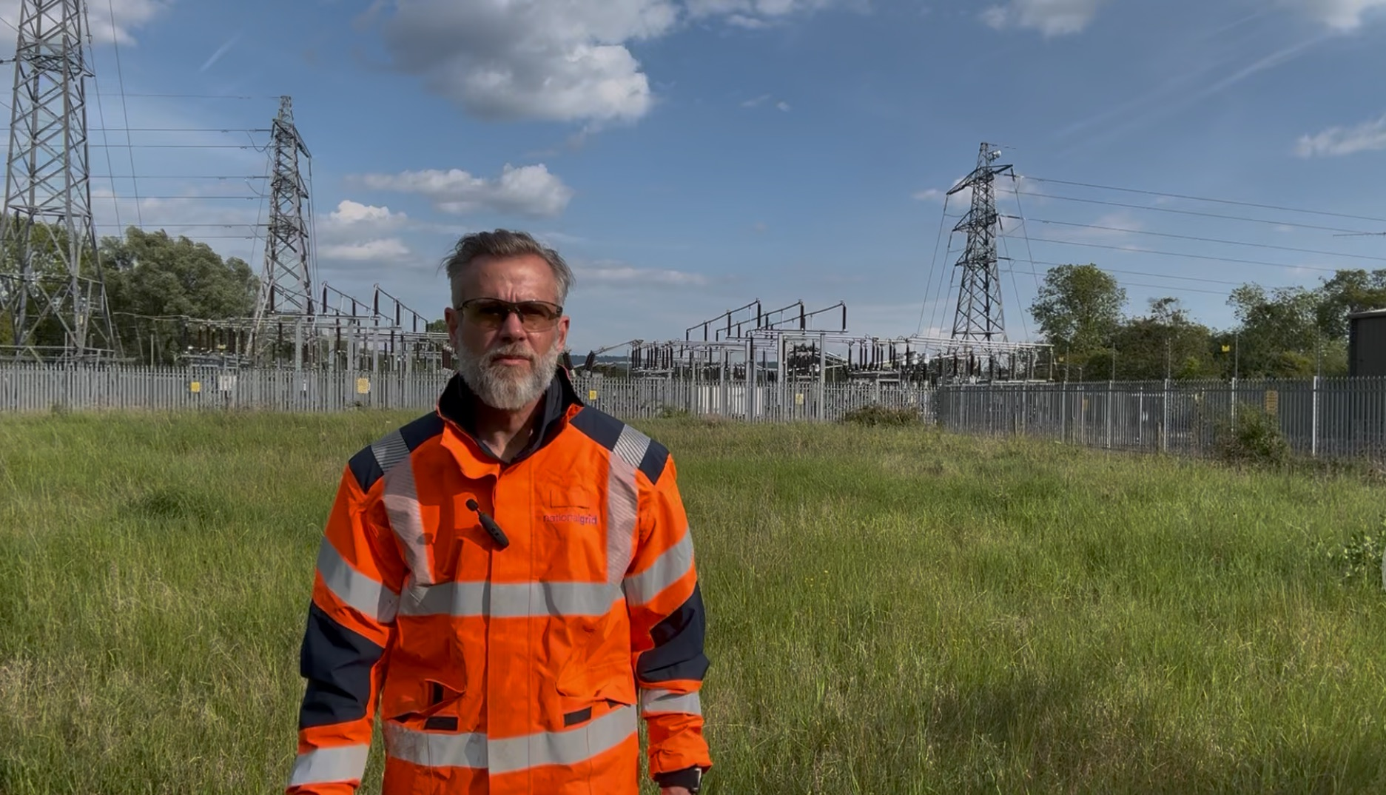

Slide 26
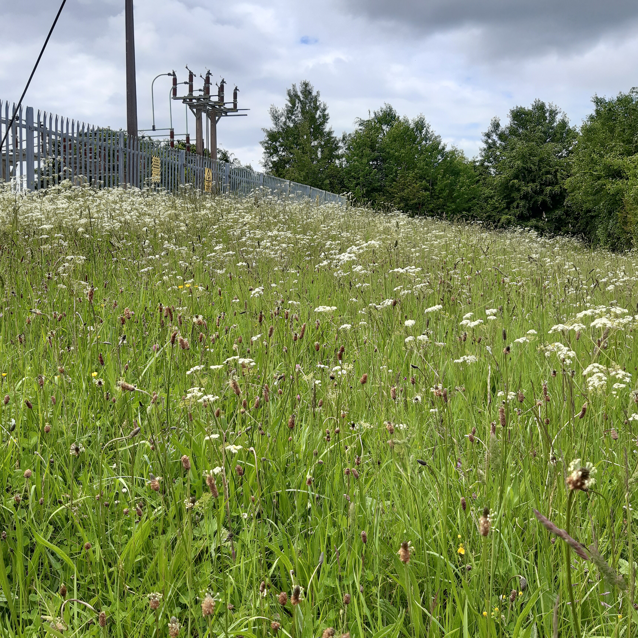
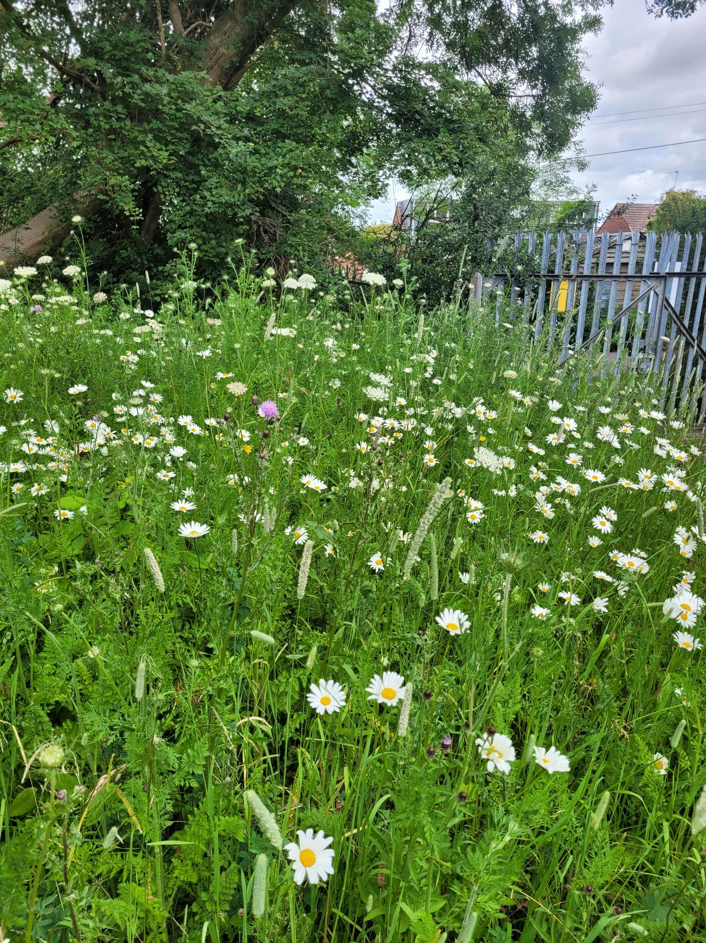
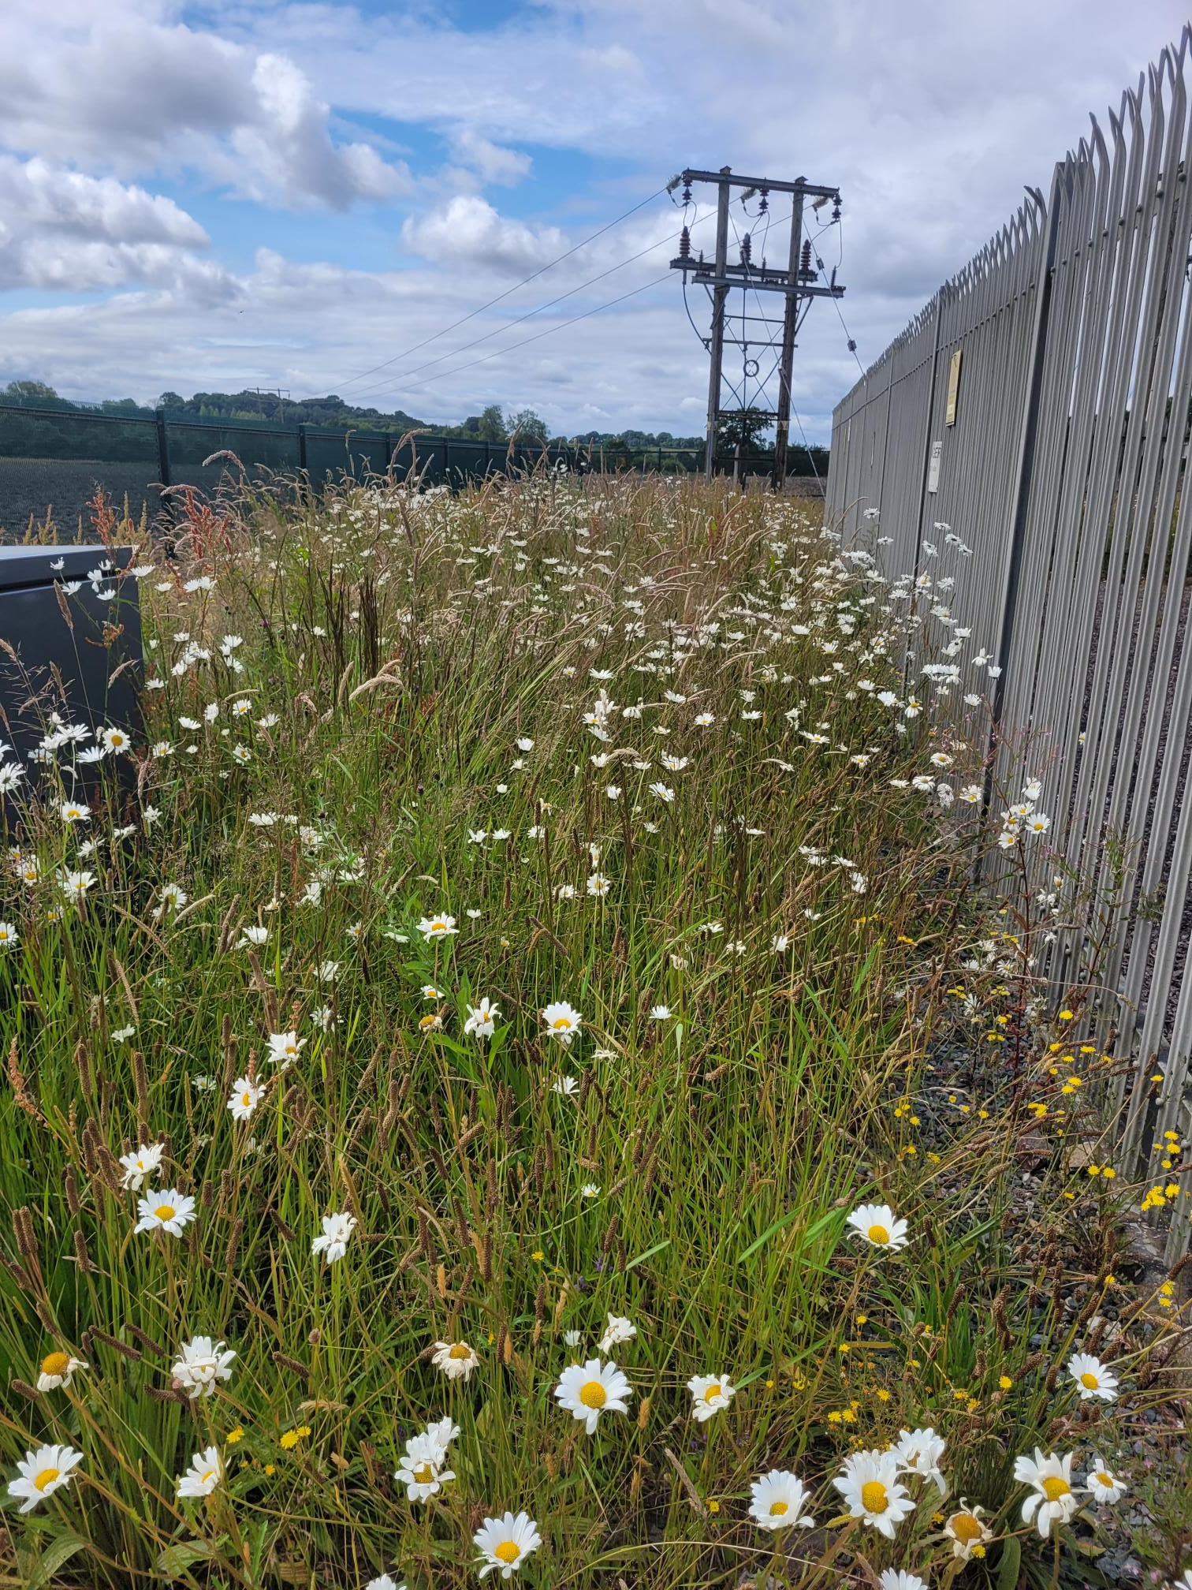

Slide 27

Higher temperatures will shorten asset life while LCTs will require a sustained load profile
OH Lines will be re-profiled reducing clearances while tree growing season increases
Increased flooding and sea level rise will put substations at increased risk
Ground temperature rise and droughts will effect cable ratings, and earthing

Slide 28
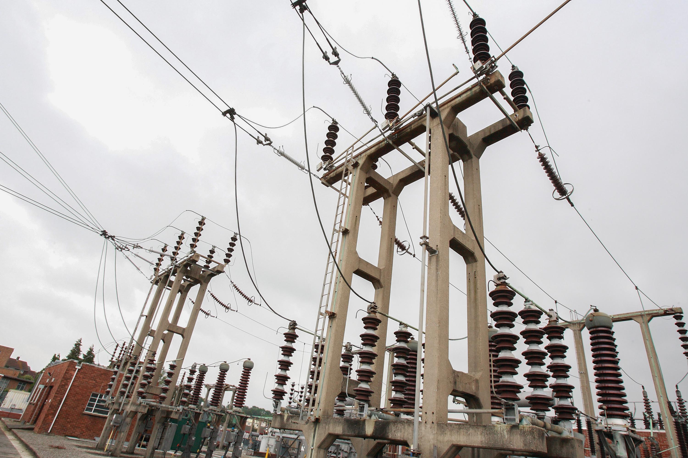

Slide 29
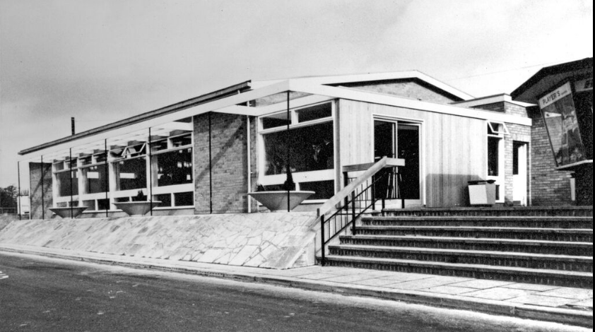

Slide 30
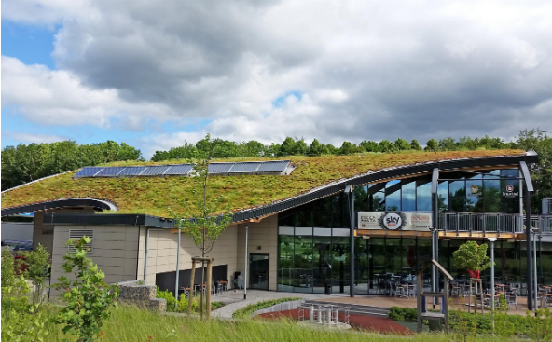
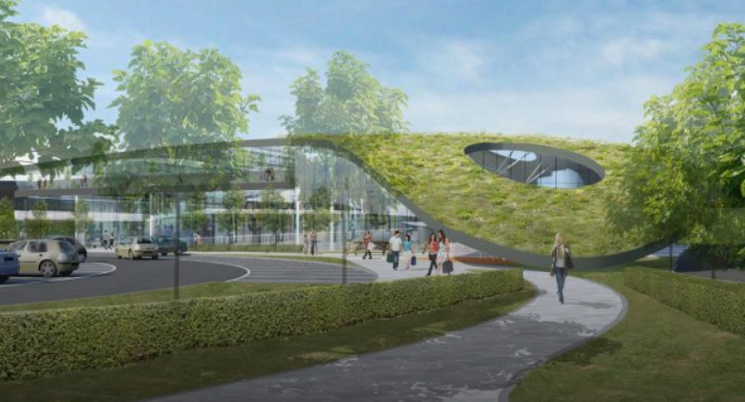

Slide 31

Investing in the Future:
Sailing close to the winds of change
Ed Gillespie
CityWire
November 2021

