Slide 1
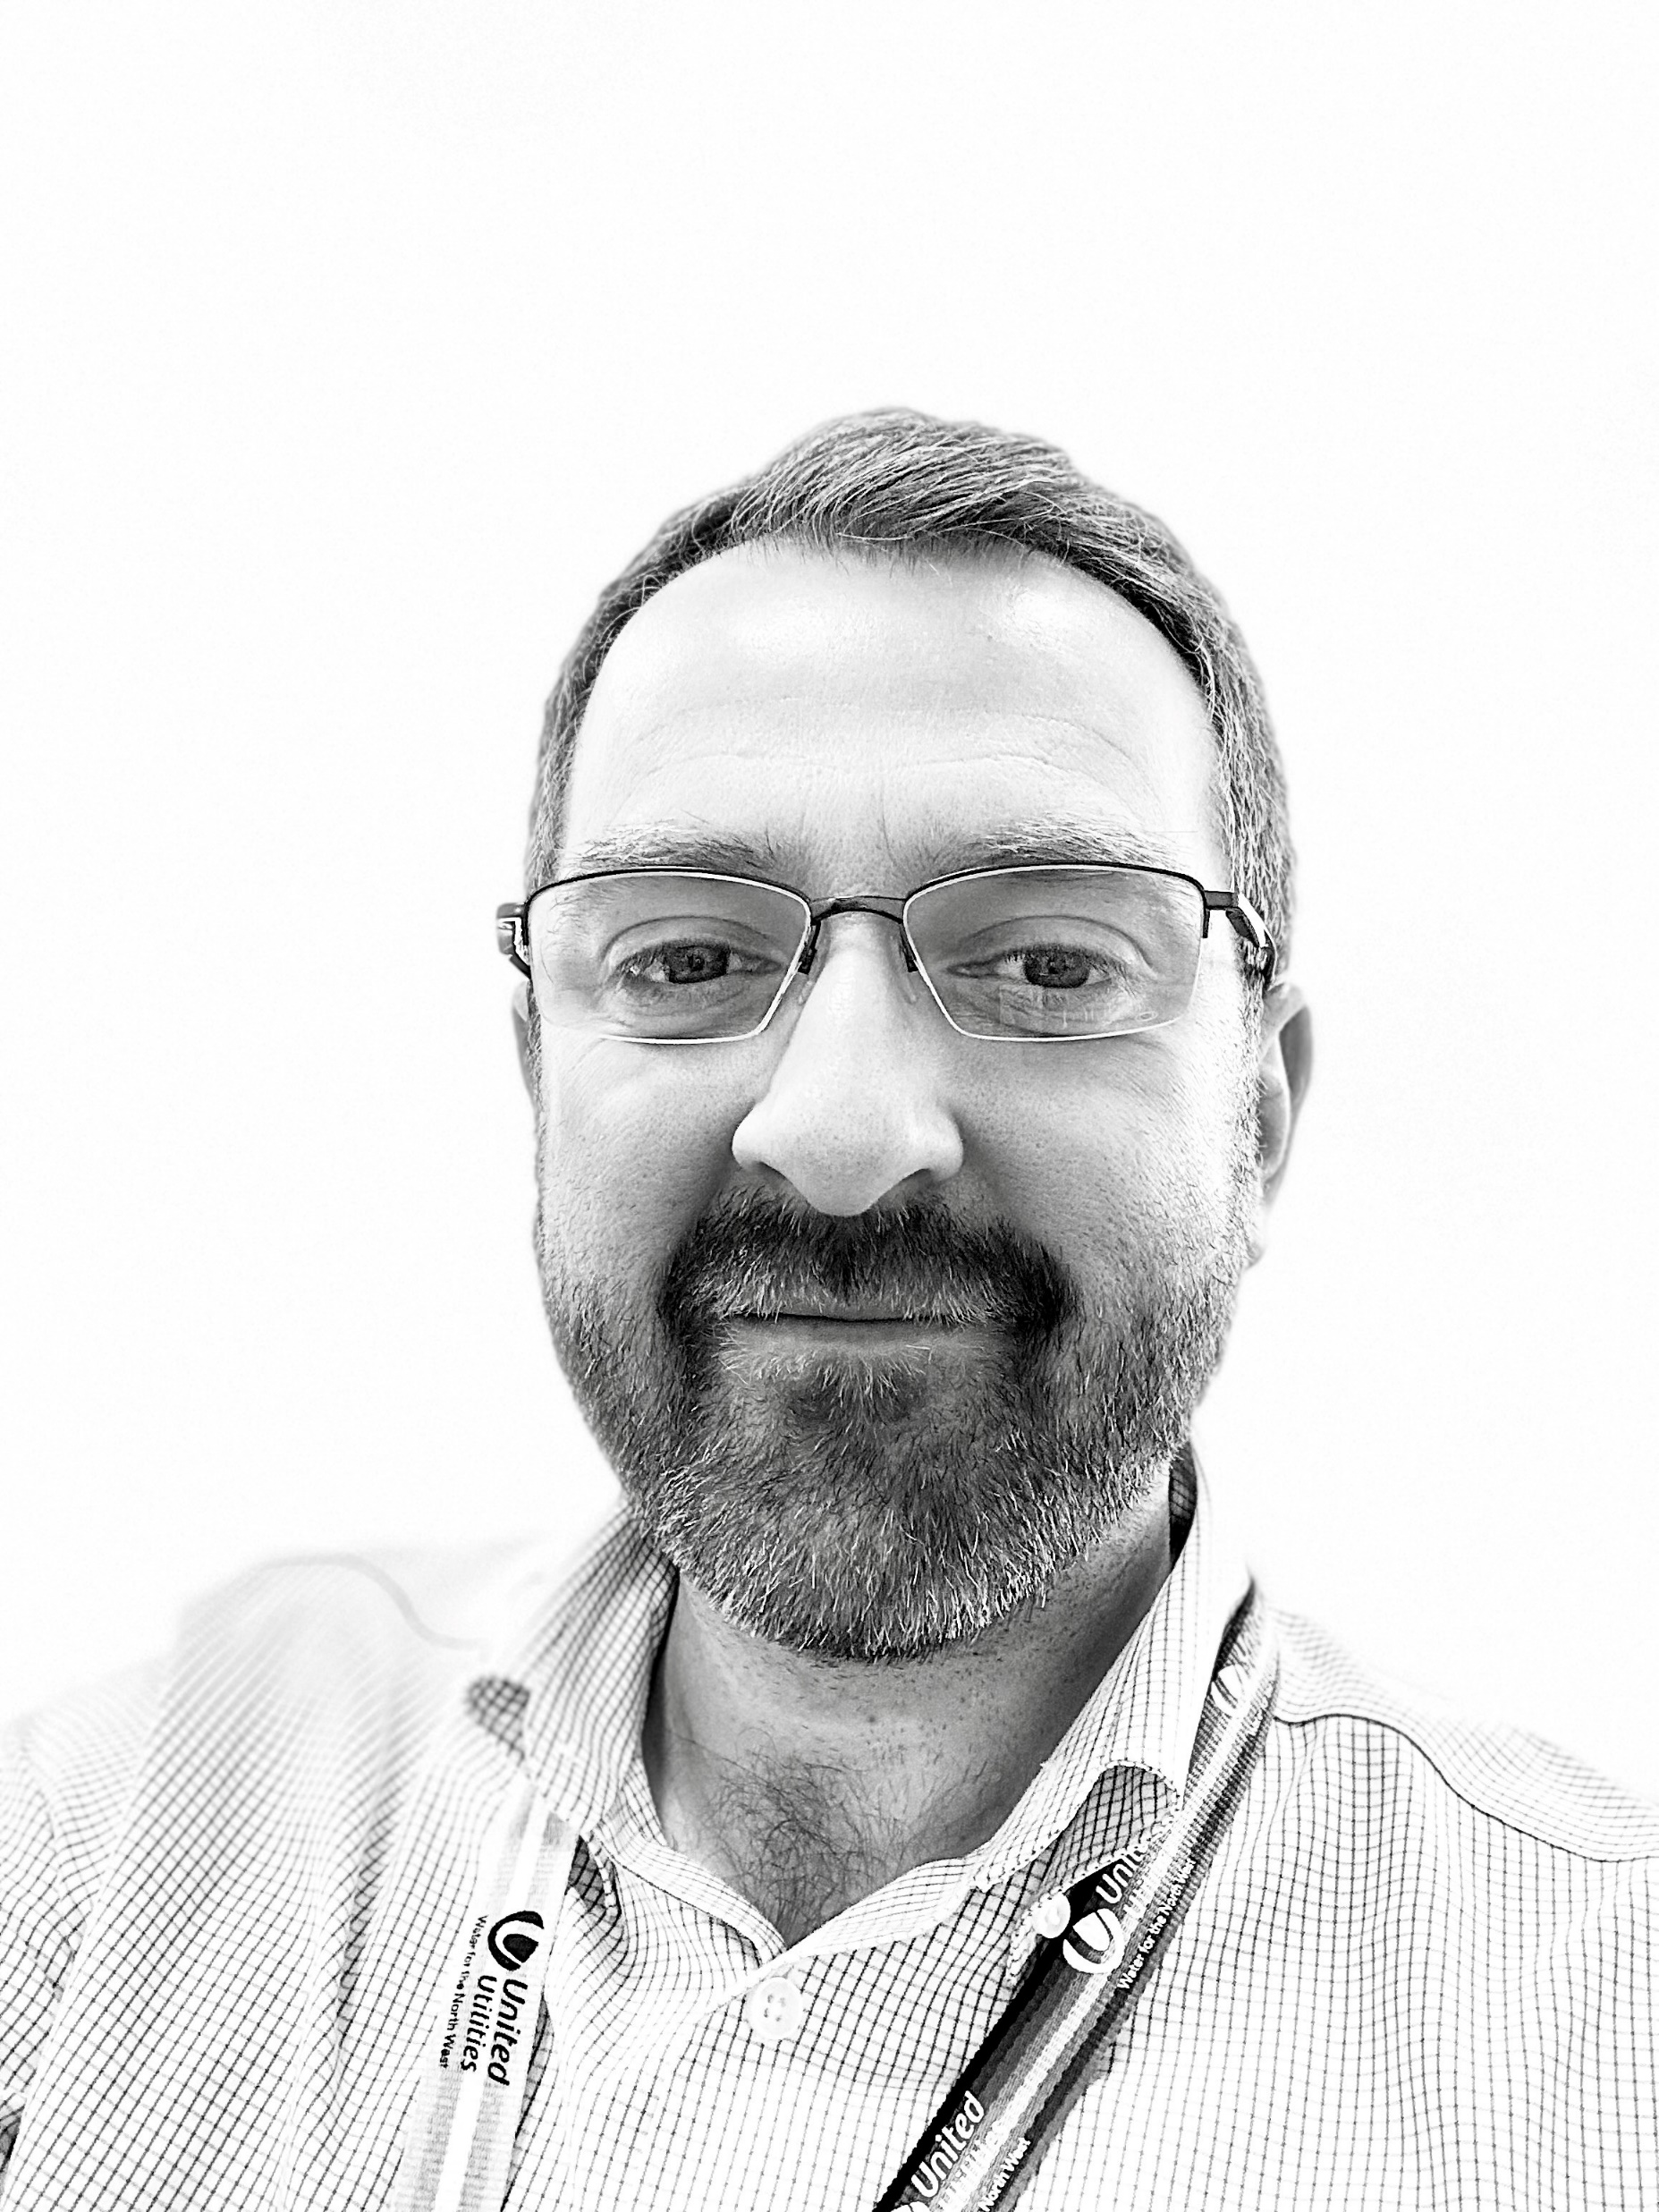
Sustainability – A water company view
Adam Lechmere
Head of Sustainability, United Utilities

Slide 2
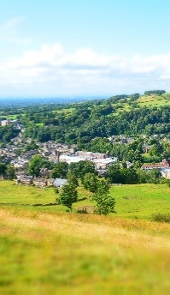
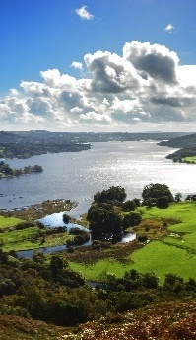
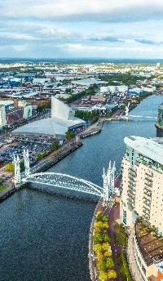
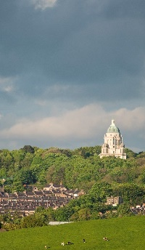
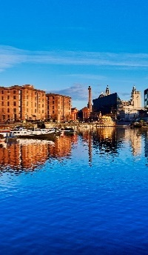
Introducing United Utilities
  Providing our services
7 million customers and over 200,000 businesses
86 water treatment works
43,000 km of water pipes
79,000 km of wastewater pipes
584 wastewater treatment works
200,000 tds of sludge treatment capacity
Supporting over 22,500 skilled jobs across the region
  Focus on the North West’s five counties
Building our plan for Cheshire, Cumbria, Greater Manchester, Lancashire and Liverpool City Region, delivering outcomes for people in the places where they live.
  But we also manage…
56,000 hectares of catchment land (34% of land in the region has environmental protection)
2,200 storm overflows
170 reservoirs (one of which is older than the USA)
2 mines and 3 quarries
Access for 65 recreational clubs at our reservoirs
1 pigeon tower
Historic Romanesque Terraced Gardens
Permits for filming and photography on our landholdings (including for Mission Impossible, Game of Thrones and Star Wars)

Slide 3
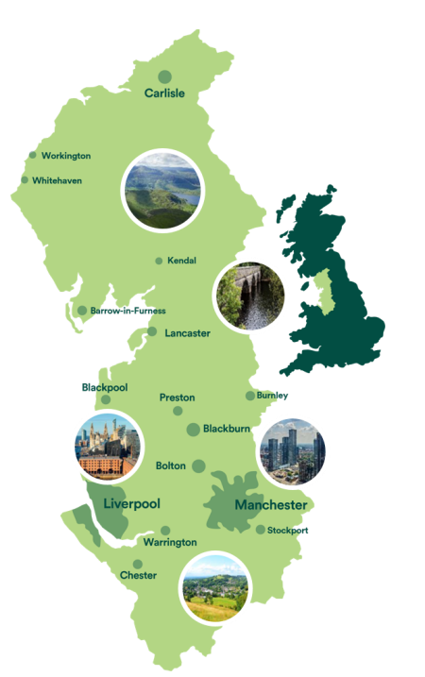
Sustainability – A water company view
Why are we here:
We are a regional infrastructure service provider – we just move water (and waste) rather than electrons
We share a similar regulatory regimes (e.g. BNG, Net Zero)
We have interdependencies on energy systems
We all have lessons and experience to share

Slide 4
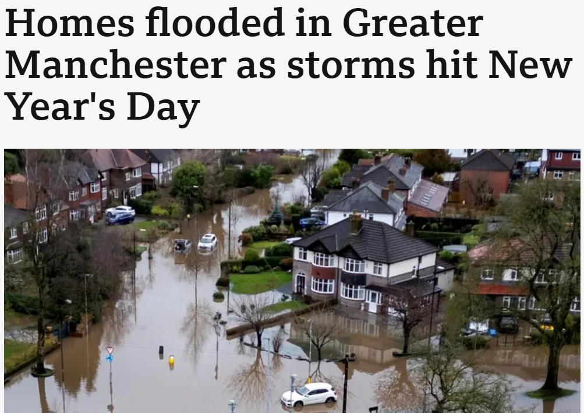
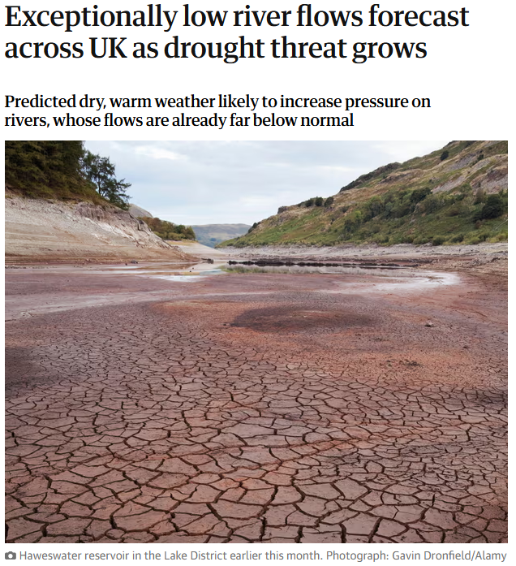
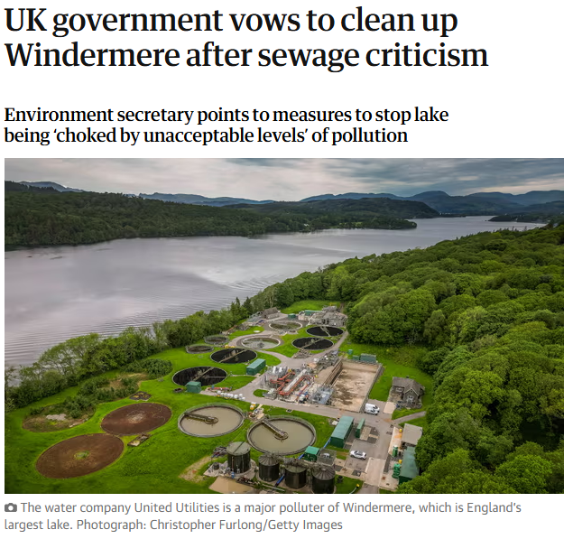
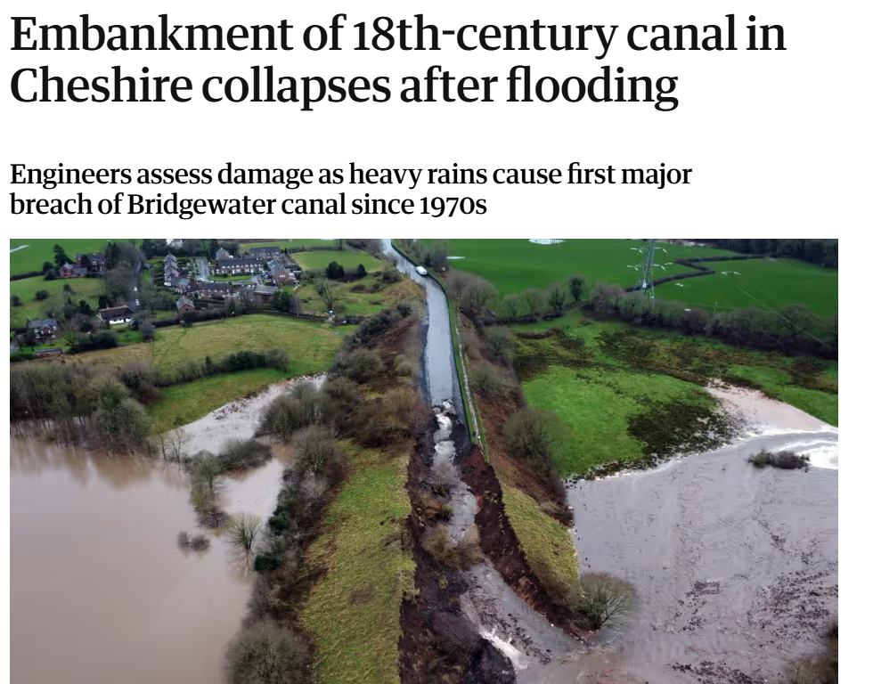
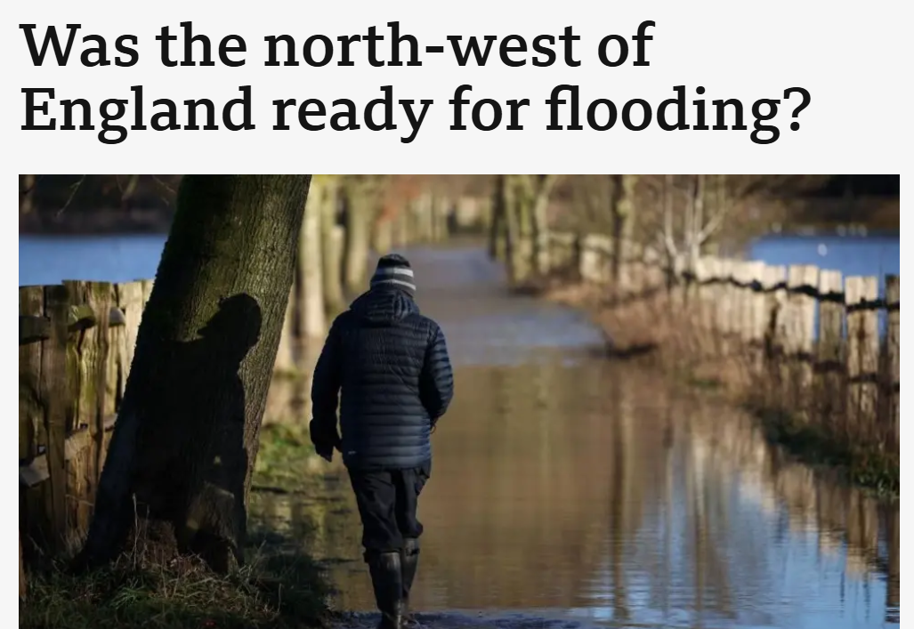
Challenges facing our region
A growing population
1 million more people over the next 25 years
Climate change
More severe rainfall events
Diverse communities
Differing levels of prosperity across the region’s communities
Environmental requirements driving unprecedented levels of investment over next 30 years
Growing expectations
Notes:
Too much, too little and too dirty water.

Slide 5

Our Challenge
Supporting the growth of the North West
Operating sustainably
Improve service resilience
Keeping the bill affordable
Meeting customer expectations
Investability
Delivering regulatory expectations
Delivering Net Zero objectives
Timeframes
Deliverability

Slide 6
Regulatory Challenges
  Regulatory regimes create challenges and tension….
5-year settlements can stifle long-term planning and solutions that take longer than 5 years to deliver
Multiple regulators with conflicting views can result in mal-aligned regulatory commitments
They like certainty
There is a lack of information on the costs and effectiveness of alternative strategies (such as Nature-based solutions)
Incentivisation (and penalty) mechanisms are punitive and can drive the wrong behaviour
But there are indications that things are changing….
This can result in investment decisions favouring solutions that have certainty in delivery, in the time frame permitted, that maximise incentives (or minimise penalties).
This often incentivises short cycle investment decisions rather than cheapest whole life cost or best value solutions.
And yet there is hope….

Slide 7
Regulatory opportunities
Regulators (at least in the water sector) are becoming more aware of the challenges of climate change and the opportunities that nature-based solutions can deliver.
They are also increasingly taking a longer term view of investment plans.
At PR24 (for the period 2025-2030) Ofwat, for the first time, explicitly funded:
Climate change adaptation
Sustainable solutions to address rainwater
Net Zero enhancements, and
Incentivisation of Biodiversity credit creation
They also supported sector wide research and trials into Mainstreaming Nature-based Solutions, with a view that this will influence future submissions.
Biodiversity Performance Commitment:
Aims to incentivise water companies to conserve and enhance biodiversity in the exercise of its functions. ​
Measures the net change in the number of biodiversity units on nominated land per 100km2 of land in the company's area​
Units are via surveys every 4 years, measured using Defra’s Statutory Metric Tool ​
Nominated land can be company owned land as well as other land where habitat is improved via water company activity
Units are incentivised at £28k – once a minimum threshold has been achieved above a baseline assessment. The total potential prize is approx. £20m per annum in year 4 and 5 of this asset management period.

Slide 8
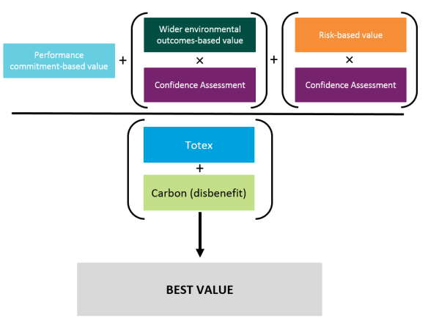
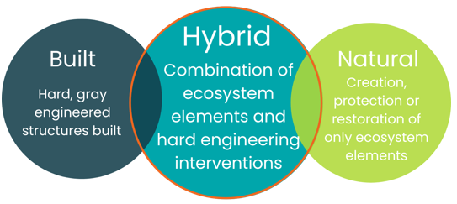
Best value assessment
Having values that are supported by regulators, such as the Biodiversity performance commitment, enables companies to complete best value assessments.
Conceptual model of our Best Value assessment tool used in the development of our business plan
The tool allowed us to assess the relative value of delivering Built / gray solutions over hybrid and natural
Notes:
Regulators (both environmental and financial) rightly require protections to customers bills to be put in place to ensure that money is correctly invested.

Slide 9
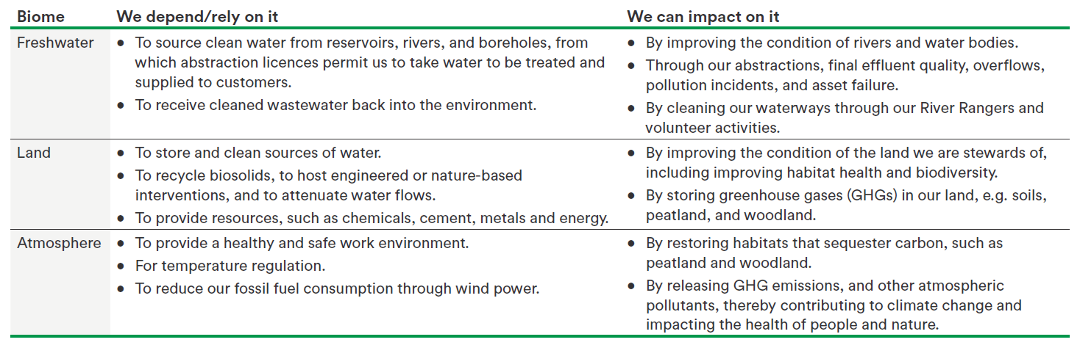
Nature forms the foundation of what we do
We receive key eco-system services from it that enables us to deliver essential services everyday.
In maturing our awareness to the dependencies and impacts on nature, using a framework such the Taskforce for Nature related Financial Disclosures (TNFD), it creates visibility and awareness of the risks which can drive investment (and attract investors).
The table is taken from our integrated annual report 2024 and summarises our key dependencies on nature
Notes:
“Nature forms the foundation of the world’s economy. Our economies are closely connected to nature, not separate from it. However, many companies, investors and lenders today are not considering their impacts and dependencies on nature and the related risks and opportunities to their organisations.” TNFD

Slide 10
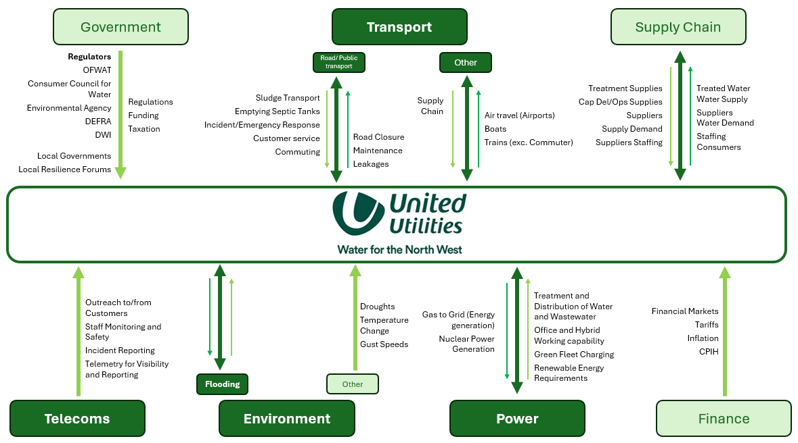
We need to work together
As well as having a key dependency on nature, we also have key dependencies on other infrastructure and service providers.
Did you know that in the calendar year 2024 that 50 reportable pollution events we attributed to a DNO a loss of power?
We have shared ambitions, operate over similar regions, are likely to be drawing on similar resource, supply chains and facing similar skills challenges. We can learn a lot and deliver more by working together

Slide 11
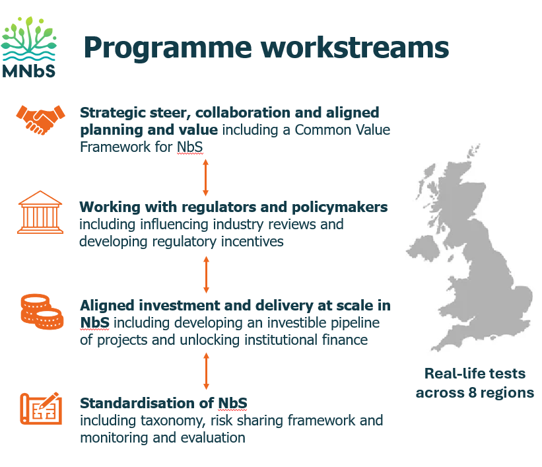
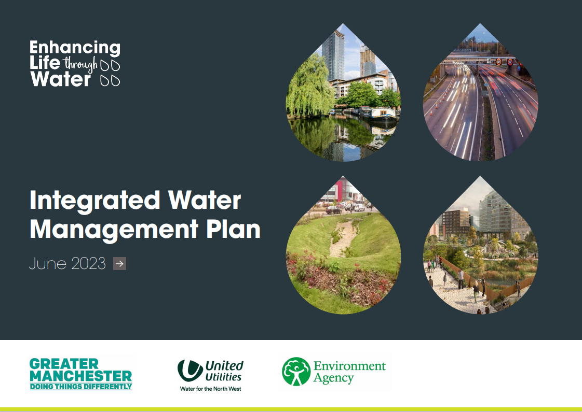
What’s next
Mainstreaming Nature-based Solutions
Working together to deliver common goals

Slide 12










What is in the plan?
Halving our leakage performance by 2050 (from our 2017/18 baseline)
Reducing the demand for water to 110 litres per person per day by 2050
Maintaining supply interruption performance at an average of 5 minutes
Reducing sustainable water abstraction by
131 megalitres per day by 2050
Halving
the risk of a hosepipe ban by 2031
Increasing water resources by
25 megalitres per day by 2033
Continuing to deliver upper quartile pollution performance
Delivering <10 spills from storm overflows per year (on average) by 2050
Investing £426m in rainwater management, including £50m partnership funding to remove surface water
Delivering a 32% reduction in internal sewer flooding by 2030
Investing in back-up power resilience at some of our sites vulnerable to power outages
Assessing assets at risk from flooding and preparing future investment strategies to protect services
Restoration of 4,764 hectares of peatland to improve water quality
Approximately 22% of the energy used is generated directly, and with partners, from low carbon sources.

