Slide 1
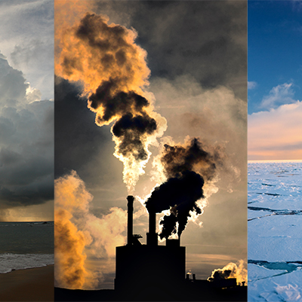
Environment & Sustainability
Martin Baxter
Deputy CEO
m.baxter@iema.net
@mbxsustain.bsky.social
We’re soon to become the Institute of Sustainability and Environmental Professionals (ISEP)

Slide 2
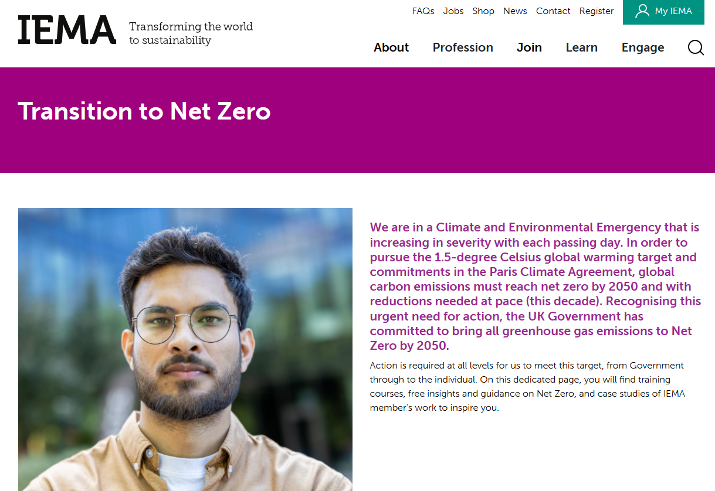
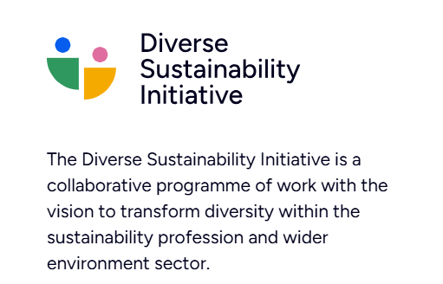
IEMA
We are the membership body for sustainability & environmental professionals
We’re soon to become the Institute of Sustainability and Environmental Professionals (ISEP)
We provide individual and corporate members with:
Professional recognition & Chartership
Learning & development
Knowledge & policy insight
Community & networking
Formal training and qualifications
Workforce development support for corporate partners

Slide 3
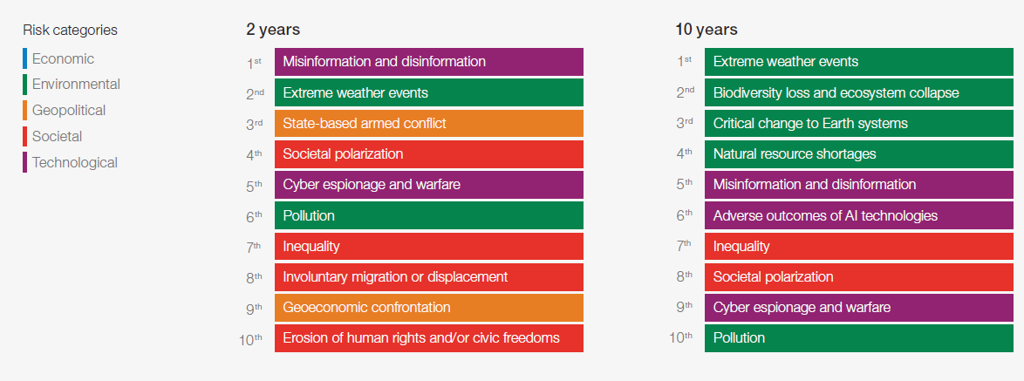
Global risks ranked by severity over the short and long term
Source: World Economic Forum (2025) Global Risks Report

Slide 4
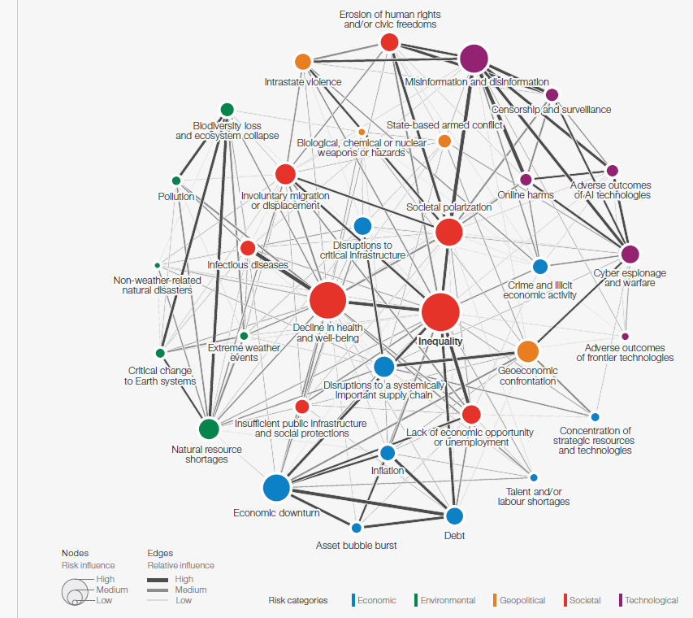
Global Risks - interconnections
Source: World Economic Forum (2025) Global Risks Report

Slide 5
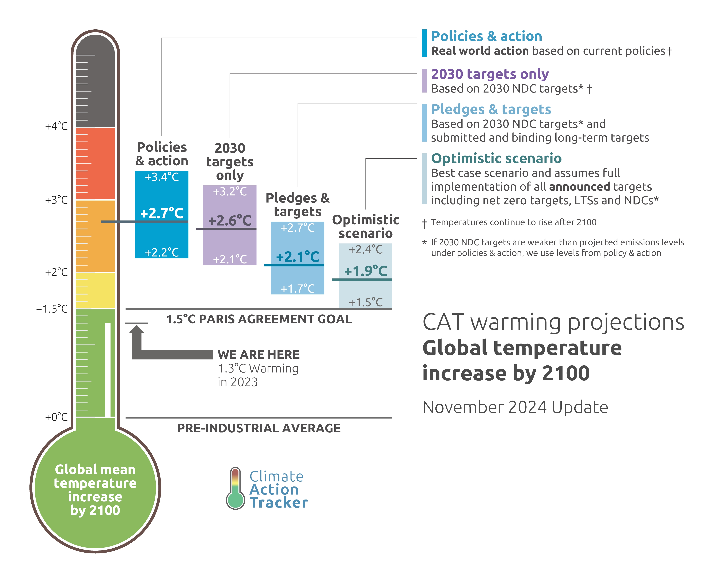
Climate Change – trajectory
We’re not on track to achieve the Paris Agreement goal of 1.5C or well below 2C warming compared to pre-industrial levels.
The weather events we are currently experiencing are the least extreme we will see in our lifetimes.
https://climateactiontracker.org/

Slide 6
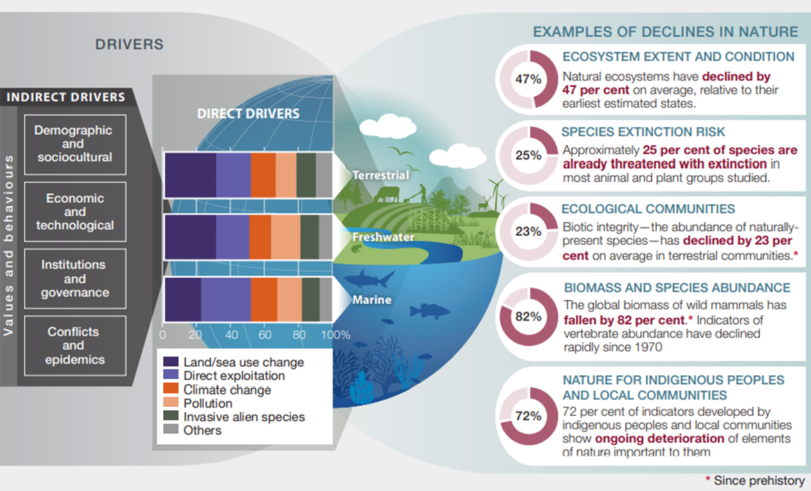
Biodiversity in Crisis
“The health of ecosystems on which we and all other species depend is deteriorating more rapidly than ever. We are eroding the very foundations of our economies, livelihoods, food security, health and quality of life worldwide.”
Sir Robert Watson
Intergovernmental Science-Policy Platform on Biodiversity and Ecosystem Services. (2019).
Summary for policymakers of the global assessment report on biodiversity and ecosystem services (summary for policy makers). IPBES Plenary at its seventh session (IPBES 7, Paris, 2019). https://doi.org/10.5281/zenodo.3553579

Slide 7
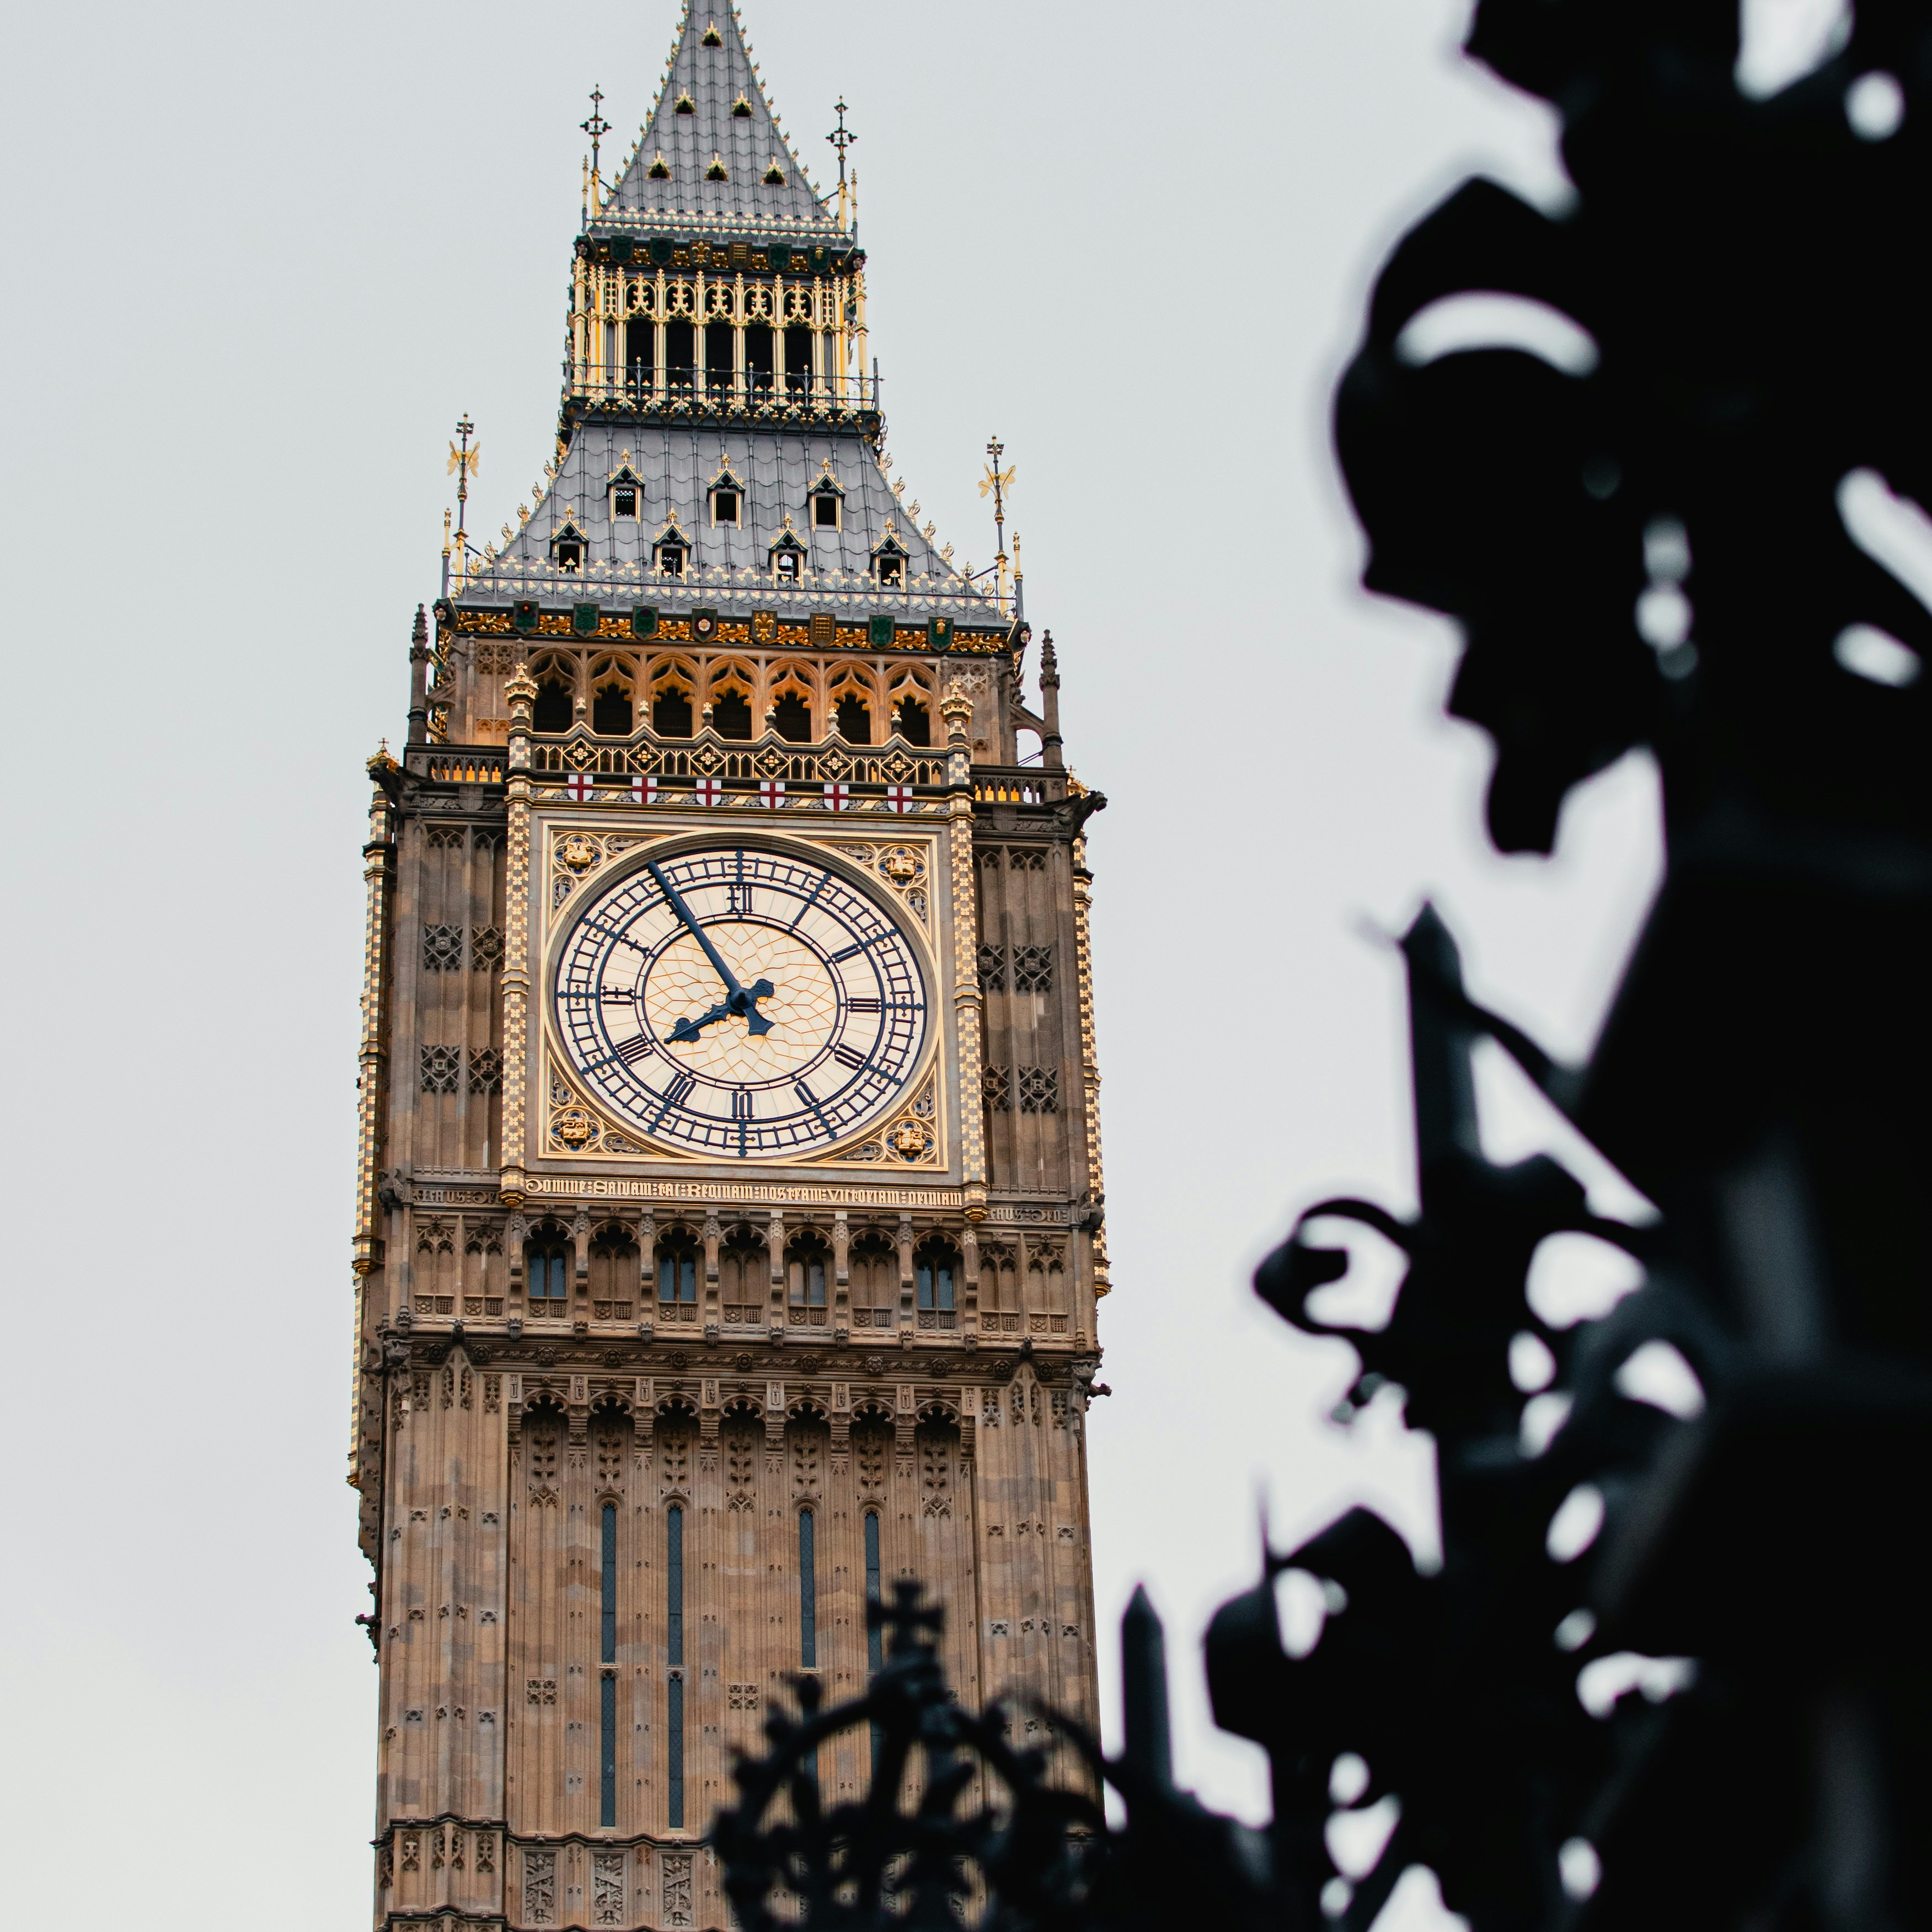
UK Policy Response

Slide 8
Key Existing and Emerging Sustainability Legislation/ Regulation that impacts business
Climate Change Act (2008)
  Long-term 2050 net zero legally binding target
  Statutory carbon budgets (78% reduction by 2037) – national Net Zero Strategy
  Climate change adaptation
Companies Act (2006)
  s172 Director Duties covering environment; community; high standards of business conduct; relationships with employees, suppliers, customers
  Companies (Strategic Report) (Climate-related Financial Disclosure) Regulations 2022 for large organisations
  Adoption of International Sustainability Standards Board disclosures
Environment Act (2021)
  Long-term legally binding targets (water, air quality, biodiversity and resource efficiency and waste)
  Cross-government Environmental Improvement Plan (interim targets set the pace of change needed)
  Biodiversity Net Gain for new development
  Environmental Due Diligence – Forest Commodity Products
Modern Slavery Act (2015)
Planning and Infrastructure Bill (2025)

Slide 9
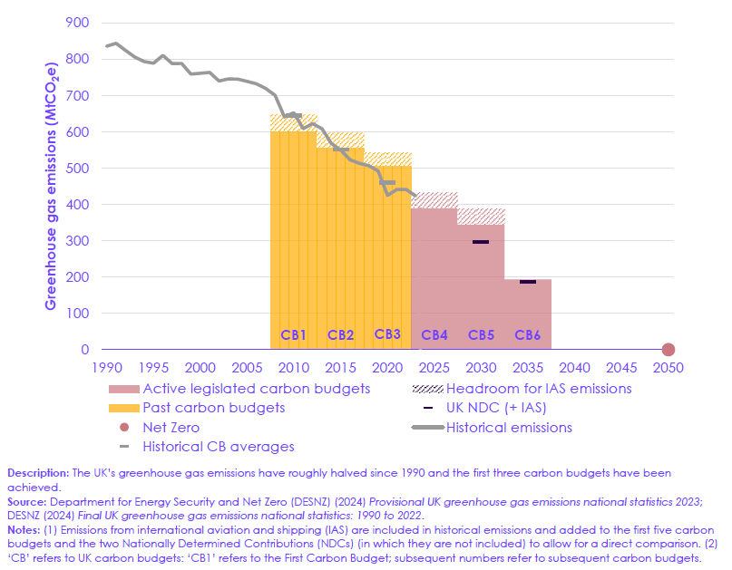
UK historical emissions and carbon budgets
Most of the emissions reduction to date have been through:
Power Sector (81%)
Industry (63%)
Fuel Supply (mainly methane from coal 60%)
Waste (66%) mainly methane from landfills
Plus some reductions in residential and surface transport
Note 2030 and 2035 NDCs
Source: Climate Change Committee (2025) The Seventh Carbon Budget: Advice for the UK Government.

Slide 10
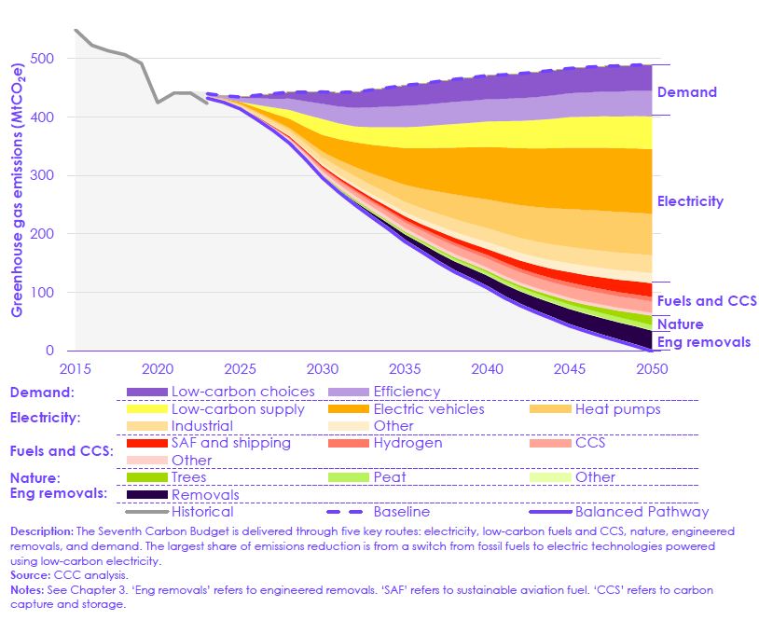
Sources of abatement towards 2050 Target
Role of demand reduction (efficiency and choices)
Increasing importance of electrification
Heat pumps 3-4x more efficient than gas boilers
EVs – cheaper to run but strategic decision needed to weigh capital costs
Hydrogen
Climate Change Committee Advice is for an 87% emissions reduction for the 7th Carbon Budget 2038-2042.
Source: Climate Change Committee (2025) The Seventh Carbon Budget: Advice for the UK Government.

Slide 11
Advice to Government on UK Climate Risk Assessment – priorities for urgent action
“…the gap between the level of risk we face and the level of adaptation underway has widened. Adaptation action has failed to keep pace with the worsening reality of climate risk.”
Independent Assessment of UK Climate Risk - Climate Change Committee (theccc.org.uk)
“The UK’s preparations for climate change are inadequate.” 2025 update

Slide 12




Environment Act 2021
New environmental governance framework Policy Statement on Environmental Principles
Biodiversity
Water
Air Quality
Waste
Long-term targets in each of the topics of biodiversity, water, air quality and waste – 13 targets overall
Environmental Improvement Plan -
Framework for Biodiversity Net Gain for new development projects
Duty on local authorities to “conserve and enhance” biodiversity in their areas
Office for Environmental Protection (OEP) – hold public authorities to account for failures to comply with environmental law

Slide 13

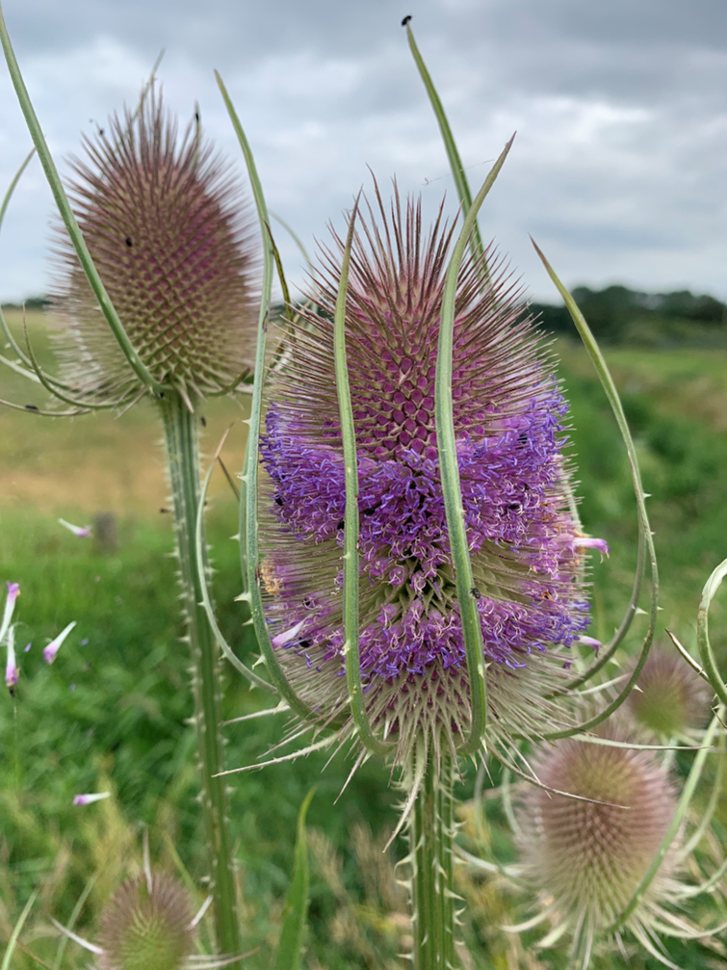
Planning and Infrastructure Bill
TENSION

Slide 14
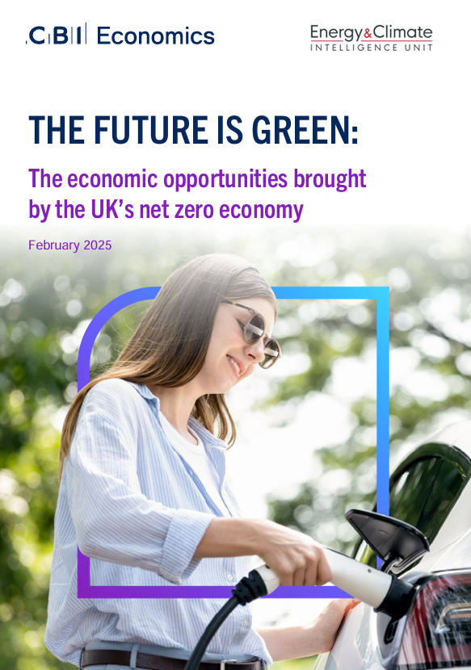
Green vs Growth???
“The net zero economy has become a powerhouse of job creation and economic expansion with 10.1% growth in the total economic value supported by the net zero economy since 2023”
“Jobs supported by net zero businesses were 38% more productive than the UK average”

Slide 15
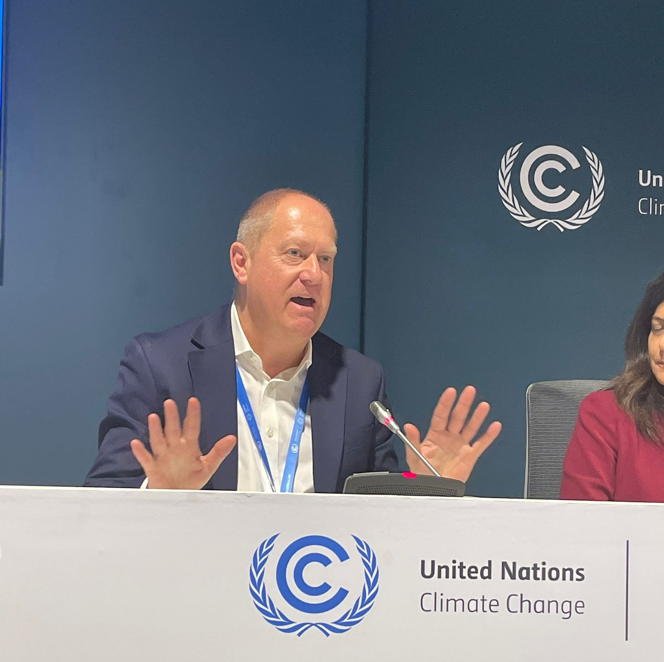
Skills, Training & Jobs…we have most of the solutions
#GreenSkillsAtCOP campaign
Capacity building and Just Transition
Integrated into many of the discussions on climate mitigation and resilience
Focus is on the next set of NDCs…and in the UK, delivery of Climate Change Act and Environment Act targets

Slide 16
Martin Baxter
Deputy CEO
m.baxter@iema.net
@mbxsustain.bsky.social
www.iema.net/all-jobs-greener

